Slide 1

“H2020: Project Proposal Evaluation”
Implementation Evaluation Guidelines
Odysseas Spyroglou
IPR, Legal & Financial Issues Expert
Istanbul, 8-9/12/2016
Notes:
Guidelines for evaluation of Implementation of the proposal.
Evaluation criteria, guidelines for implementation evaluation and preparation of evaluation report.

Slide 2
Evaluation criteria: Implementation
Research and Innovation Actions/Innovation Actions/Coordination Actions
Implementation
Quality and effectiveness of the work plan, including extent to which the resources assigned to work packages are in line with their objectives and deliverables
Appropriateness of the management structures and procedures, including risk and innovation management
Complementarity of the participants and extent to which the consortium as a whole brings together the necessary expertise
Appropriateness of the allocation of tasks, ensuring that all participants have a valid role and adequate resources in the project to fulfil that role

Slide 3

Evaluation Criteria Explained (Work Plan)
Quality and effectiveness of the work plan, including extent to which the resources assigned to work packages are in line with their objectives and deliverables
Is there a well structured WBS (Work Packages, Tasks, Deliverables)?
Are Resources assigned to WPs well balanced?
Are WP objectives in line with project aim?
Do deliverables serve the project’s outcomes?
Are there explanatory visuals ? (Gantt, pert chart)?

Slide 4
Evaluation Criteria Explained (Structure)
Appropriateness of the management structures and procedures, including risk and innovation management
Is there a strong Management Structure?
Who will manage the project: coordination, steering committees, executive team, advisors, general assembly, etc.
Are detailed procedures in place?
How to handle: important decisions, disagreements between partners, technical and administrative issues.
Are risks identified, mitigation plans exist?
Implementation risks, ethical & privacy issues, mitigation plans.
Is innovation management addressed?
Innovation Management (process) requires understanding of market and technical problems to successfully implement creative ideas: Create new or improved product, service or process AND/OR respond to external or internal opportunity

Slide 5
Evaluation Criteria Explained (Consortium)
Complementarity of the participants and extent to which the consortium as a whole brings together the necessary expertise
Is the coordinator strong and experienced?
Has the team relevant technical/scientific knowledge/management experience?
Good understanding of relevant market aspects for innovation.
If needed, proposal includes plan to acquire missing competences?
Are participants complementary?

Slide 6
Evaluation Criteria Explained (Tasks)
Appropriateness of the allocation of tasks, ensuring that all participants have a valid role and adequate resources in the project to fulfil that role.
Do all participants have a valid role?
Do they have adequate resources?

Slide 7

Wrap it up: Implementation Criteria
Good and well presented WBS
Reliable management structures
Innovation management addressed
Strong complementary consortium
Adequate resources
Risks identified and Mitigation plans proposed

Slide 8
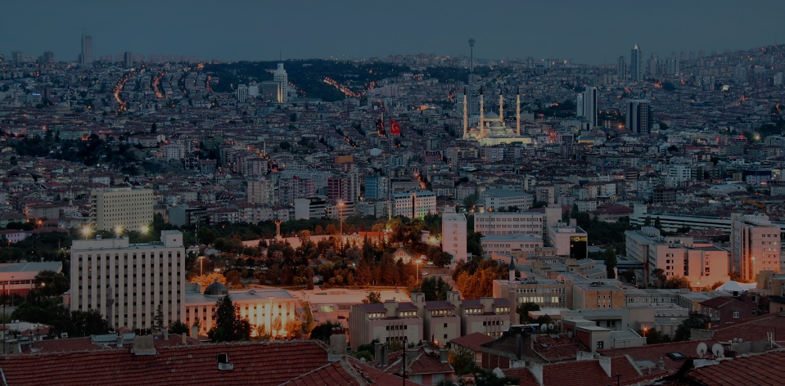
Contact:
Office Address
Turkey in Horizon 2020 Project
No:6/2 Mustafa Kemal Mah. 2119. Sok.
06520 Çankaya/Ankara,Turkey
Tel: +90 312 219 69 80
http://www.turkeyinh2020.eu/
Notes:
And don’t forget that we are all here to help, especially you as Information Multipliers to achieve better results for Turkey in H2020.

Slide 9

Thank you!
Teşekkür ederim!
Notes:
Teşekkür ederim!
Thank you very much for your attention.
I hope it wasn’t too painful.
All presentations will be available in our website the following days.

Slide 10

Credits / Disclaimer
© “Turkey in Horizon 2020”
The information and advice contained in this presentation are the sole responsibility of the project team and can in no way be taken to reflect the views of the European Union. The team of "Turkey in Horizon 2020" project is not responsible for the consequences of errors or omissions herein enclosed. Re-use of information contained in this presentation for non-commercial purposes is authorised and free of charge, provided the source is acknowledged. Our project team is not responsible for any impact or adverse effects on third parties connected with the use or re-use made of the information contained in this presentation.
Credits
No name (CC BY-NC 2.0) / Slide 1 / barbara carneiro, Flickr.com
Data Center (CC BY-NC 2.0) / Slide 2 / Bob Mical, Flickr.com
Pick Me (CC BY-NC 2.0) / Slide 3 / Aftab Uzzaman, Flickr.com
Internet (CC BY-ND 2.0) / Slide 5 / Lars Zimmermann, Flickr.com
Stone (CC BY 2.0) / Slide 5 / nikolay semenov, Flickr.com
Ankara (CC BY 2.0) / Slide 9/ Jorge Franganillo, Flickr.com
Tea in the spotlight (CC BY-ND 2.0) / Slide 10/ captain.orange, Flickr.com
Large copyright sign made of jigsaw puzzle pieces (CC BY- 2.0) / Slide 11/ Horia Varlan, Flickr.com
You can check the Creative Commons Licences here: https://creativecommons.org/licenses/

