Slide 1
H2020 – Registration & Validation of organisations
Focused Group Training – H2020 Legal & Financial issues
Ankara 10 November 2017
Vangelis Argoudelis / FORTH

Slide 2
Eligibility for funding
Status of United Kingdom (UK)?
3rd countries (= not EU Member States)
Associated countries (AC): Iceland, Norway, Albania, Bosnia and Herzegovina, the former Yugoslav Republic of Macedonia, Montenegro, Serbia, Turkey, Israel, Moldova, Switzerland, Faroe Islands, Ukraine, Tunisia, Georgia, Armenia | Automatically eligible for EU funding
Industrialised countries and Emerging economies: Countries with jointly agreed co-funding mechanism covering most or all thematic areas: China, Hong Kong & Macao, Republic of Korea, Mexico, Russia, Taiwan Countries with jointly agreed co-funding mechanism covering selected thematic areas: Australia, India, Japan Countries with co-funding by a region: Brazil, Canada Countries without jointly agreed co-funding mechanism: New Zealand, USA | EU funding under conditions: Foreseen in call Existence of bilateral agreement Deemed necessary
Developing countries: ~ 130 other countries | Automatically eligible for EU funding

Slide 3
Outline of the Presentation
Registration
Validation
Documents for validation
The LEAR
Financial Viability Check
Messages and documents via PP
Guidance Documents

Slide 4
1. Registration (1)
Takes place in the H2020 Participant Portal (PP) http://ec.europa.eu/research/participants/portal/
To access the PP an entity first needs to create an European Commission Authentication Service (ECAS) account
The user may search to check if the entity does not already exist in the database, and avoid therefore unnecessary duplicated registration

Slide 5
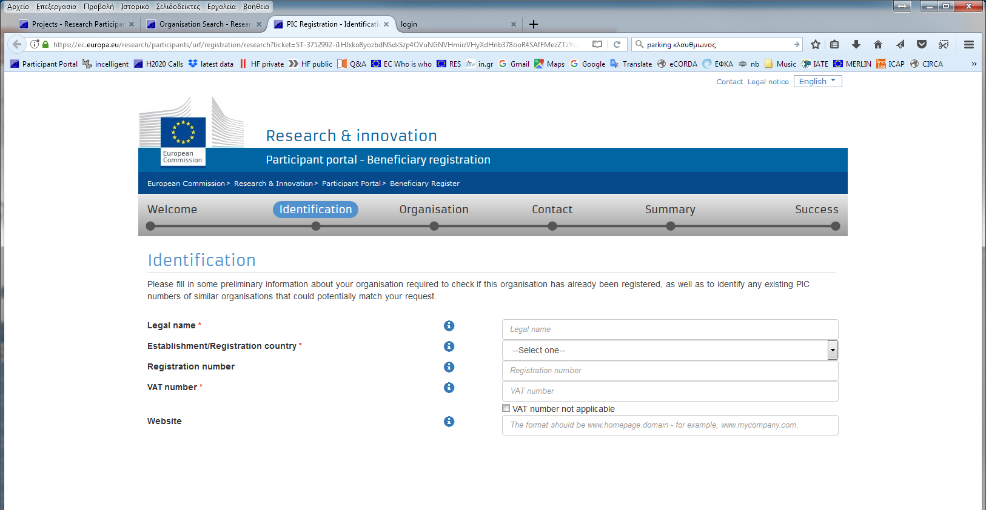
1. Registration (2)
Welcome page

Slide 6
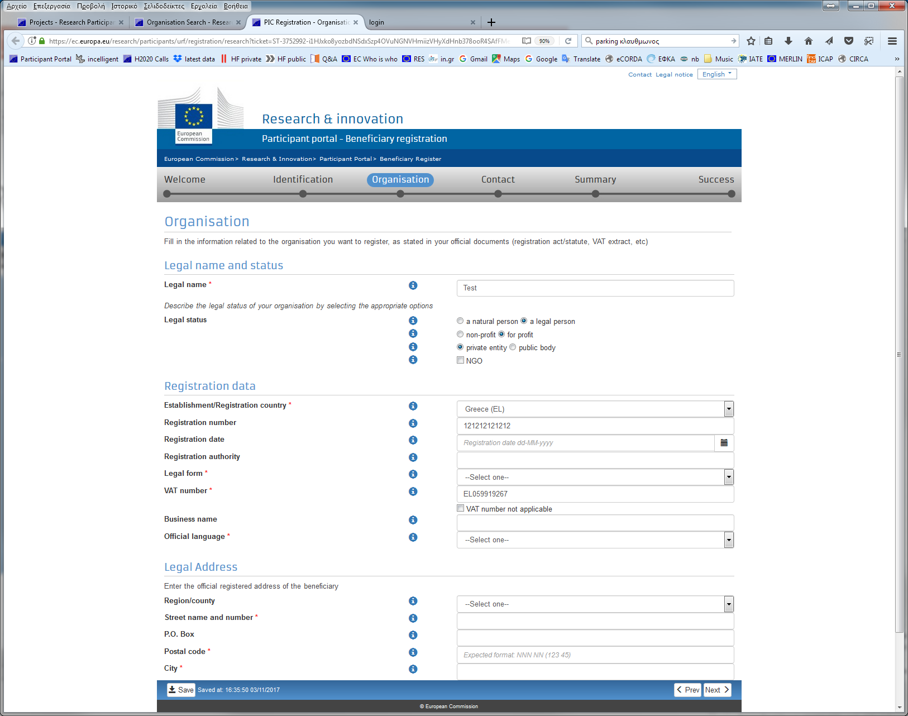
1. Registration (3)

Slide 7
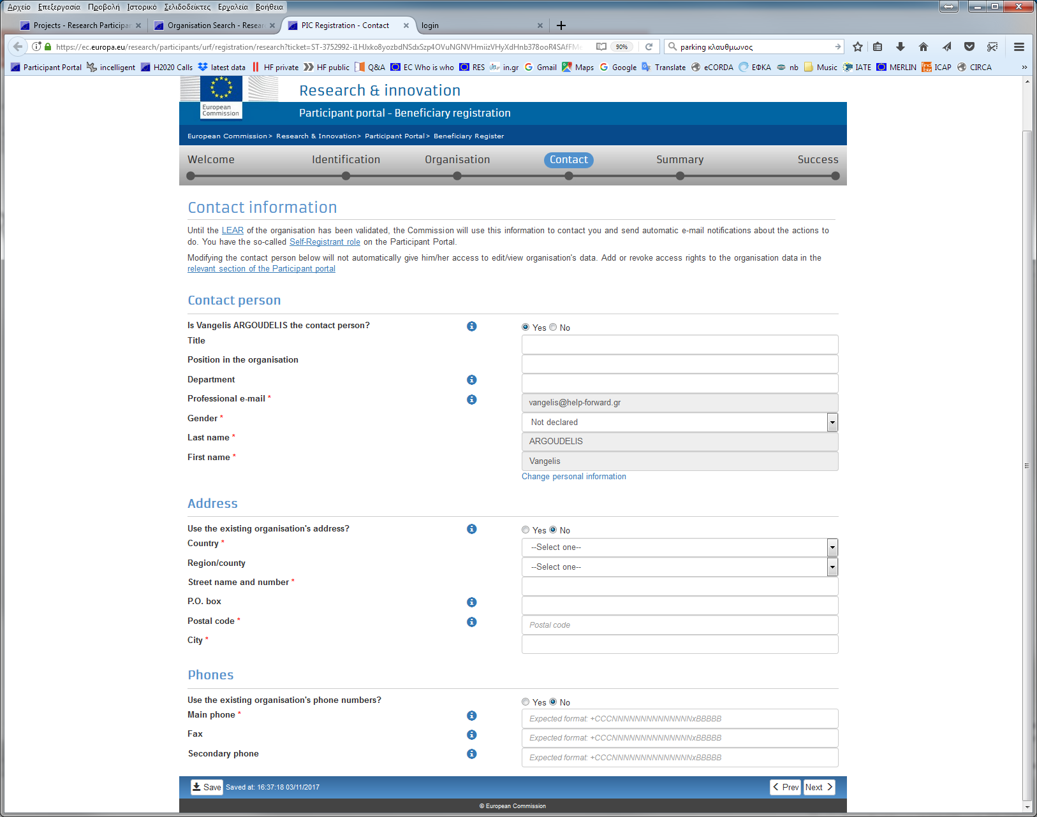
1. Registration (4)

Slide 8
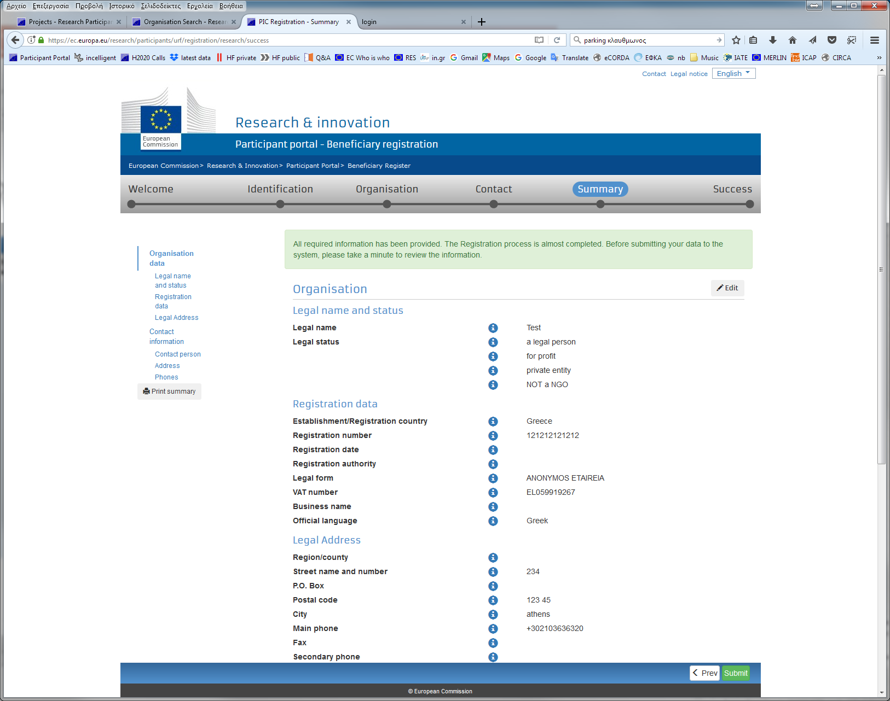
1. Registration (5)

Slide 9
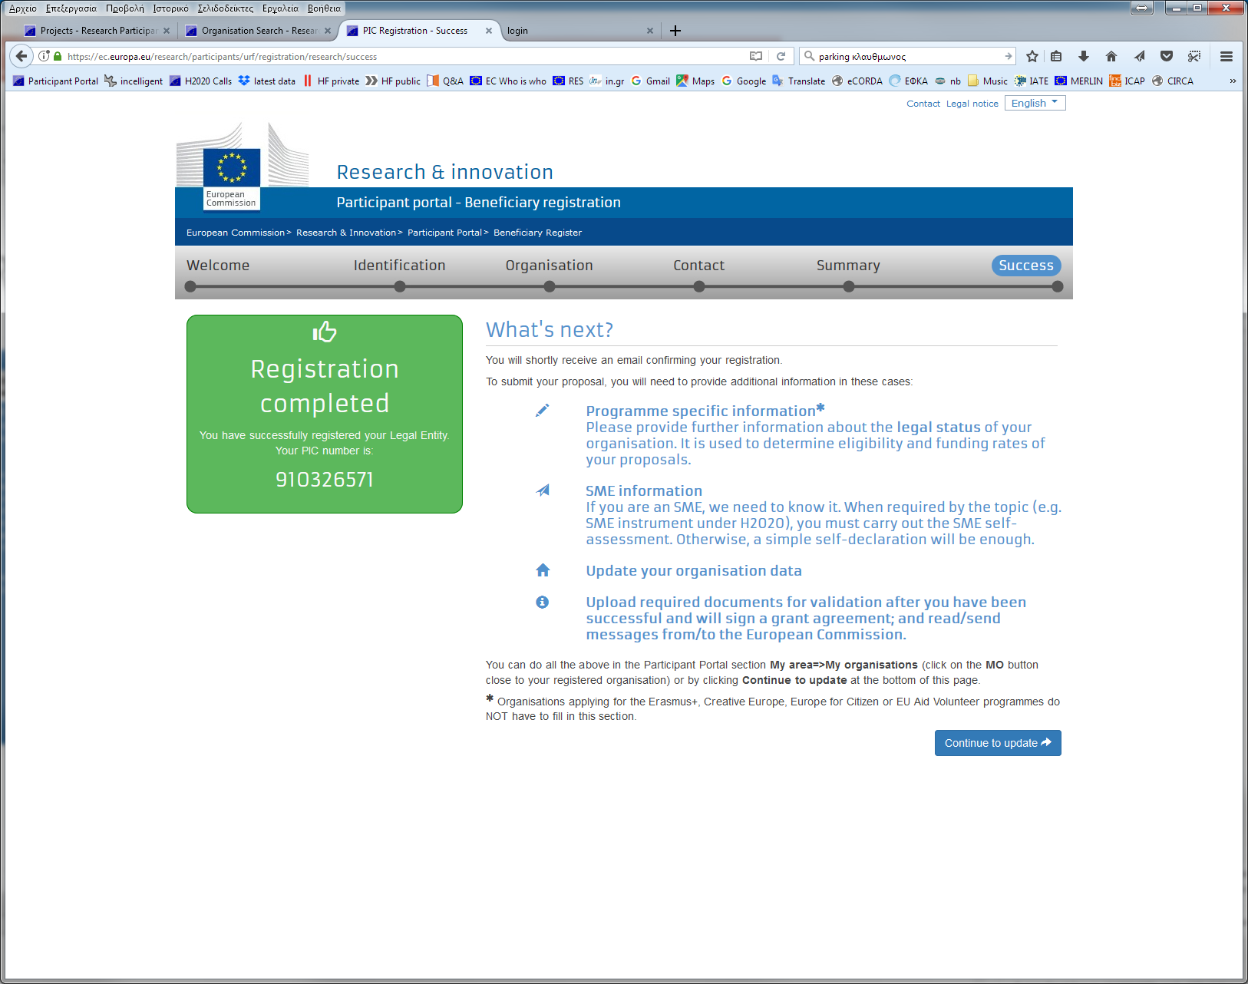
1. Registration (6)

Slide 10
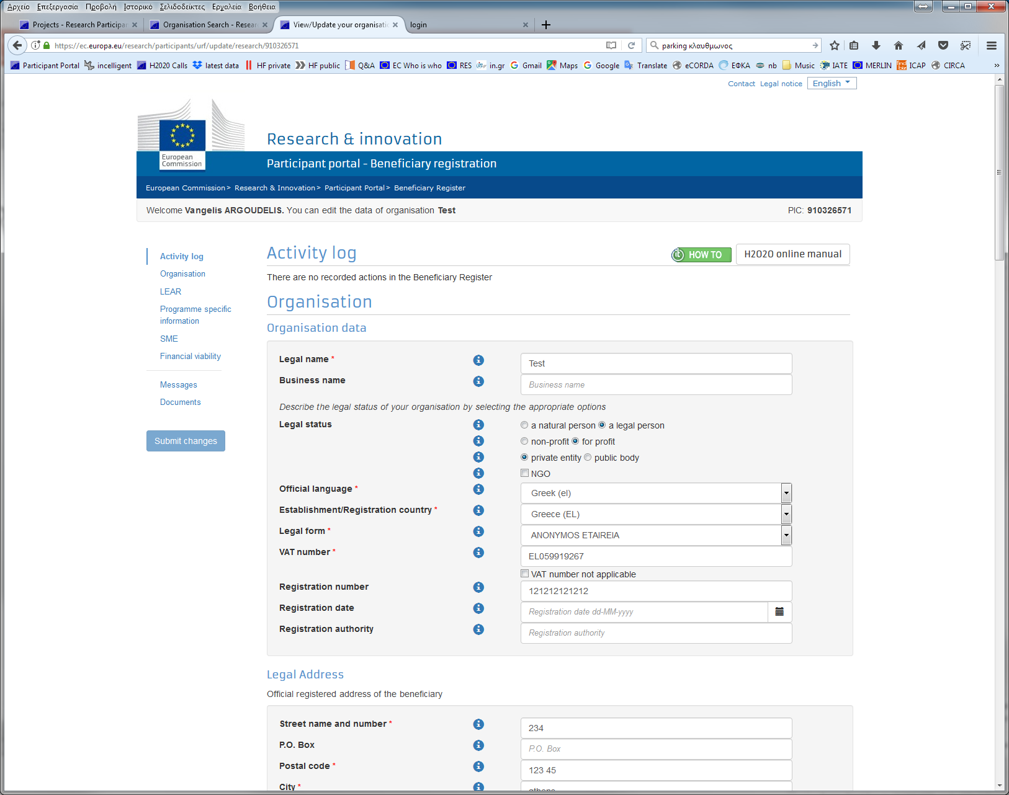
1. Registration (7)

Slide 11
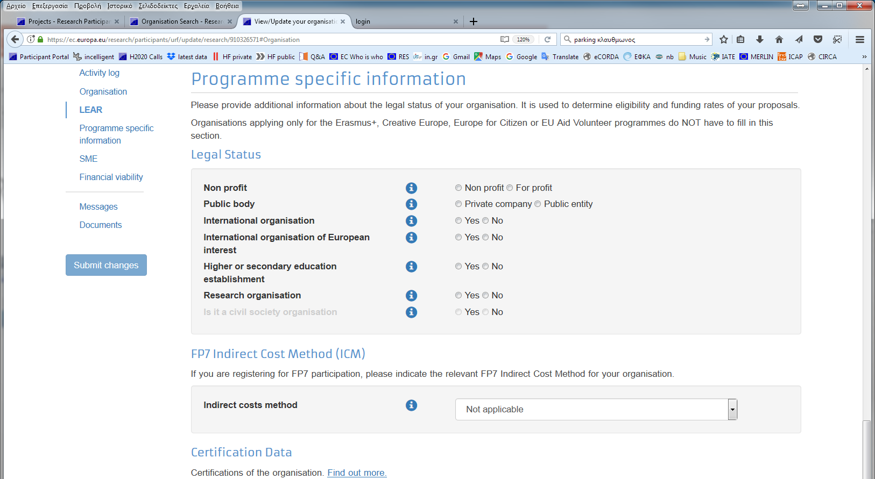
1. Registration (8)

Slide 12
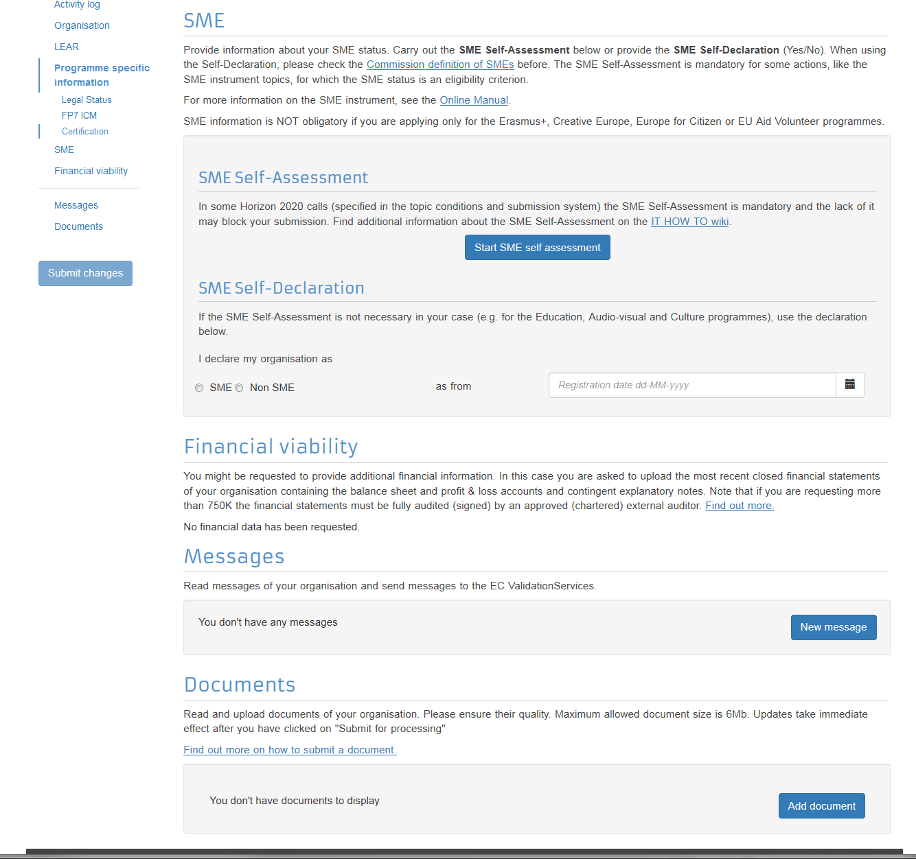
1. Registration (9)

Slide 13
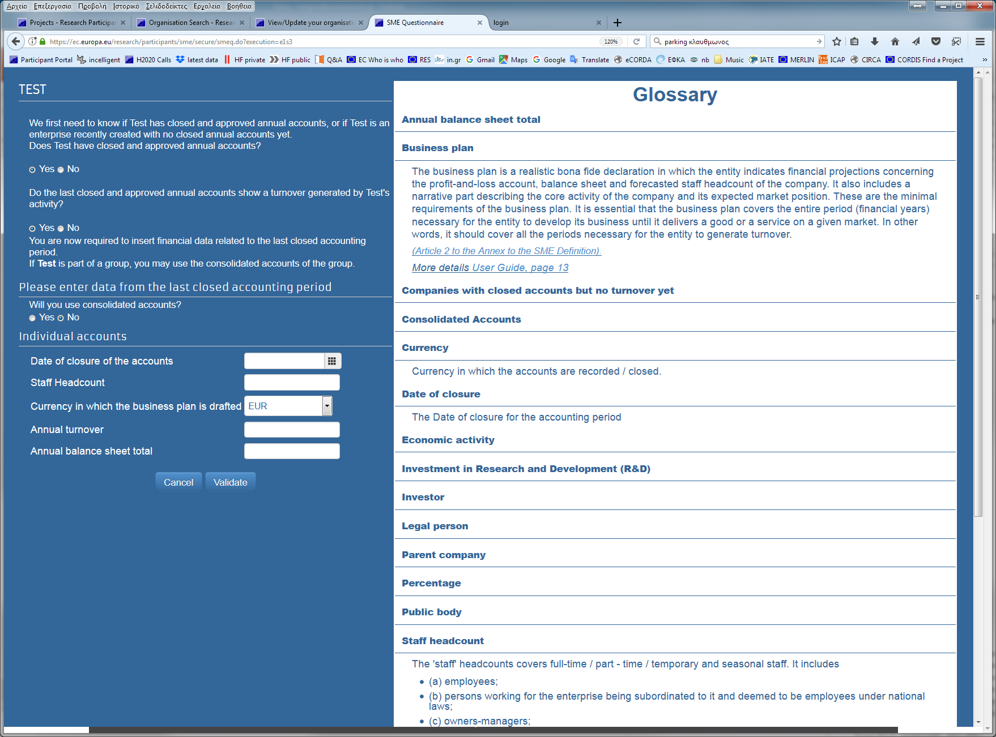
1. Registration (10)

Slide 14
1. Registration (11)
Entity is registered and automatically gets a Participant Identity Code (PIC) number
This PIC can be used to submit any proposal in the EPSS
Validation of the data to be done by the EU in the future ONLY when preparing Grant Agreement

Slide 15
2. Validation (1)
Only during Grant Agreement Preparation
VALIDATION
Legal Data
H2020
Status
LEAR
REGISTER
FVC
On basis of
documents
REA VS &
DG BUDG
validate
data
Mandatory
LEAR
nomination
process on basis of
blue ink
signature
New Participants
via the
Beneficiary Register
on the
Participant Portal
Attribution
of status and
validated
PIC number
If
needed,
financial
viability
check
COMMUNICATION VIA PARTICIPANT PORTAL

Slide 16
2. Validation (2)
  Validation is unique and valid throughout H2020.
    40.000 FP7 validated entities are migrated into H2020.
    21.000 entities validated in H2020.
  During validation the validation service (REA) verifies: (i) legal existence, (ii) H2020 status of an applicant, (iii) Extended Mandate of the LEAR and (iv) financial viability (when required)
  Validation is required for all entities participating in H2020 Grant Agreements as beneficiaries (AND linked 3rd parties)

Slide 17
2. Validation (3)
  Validation is generally performed on the basis of supporting documents.
  Main documents required for Validation:
    Legal entities form (duly completed and signed)
    VAT extract (if applicable)
    Copies of Registration extract (for private organisations), law/decree (for public entities), Treaty (for international organisations)
    Copies of Statutes (if entity declares non-profit status)
  Documents uploaded in the Participant Portal (pdf) by the LEAR
  EU may request additional documents if needed

Slide 18
2. Validation (4)
Large notion of legal entity
An entity without legal personality can be assimilated to a legal entity and obtain its own PIC, if:
  The conditions of the EC Financial Regulation are met:
  Also Natural persons can participate as Beneficiaries (new in H2020)
Capacity of its representatives to undertake legal obligations on behalf of the entity
Financial and operational capacity of the entity equivalent to that of a legal person

Slide 19
2. Validation (5)
Research organisations:
Validation no longer based on supporting documents but on self-declaration. However, non–profit status has to be met and verified by the REA VS.
Non-profit organisations:
  Definition: "a legal entity which, by its legal form, is non-profit making AND/OR which has a statutory obligation not to distribute profits to its shareholders or individual members "

Slide 20
2. Validation (6)
SME status via the Web-based SME questionnaire
  SMEs fill out a web based questionnaire on the PP to determine whether they qualify as an SME or not.
  Ex-post checks of the status will be carried out by the REA on a random basis and/or upon request of the operational services.

Slide 21
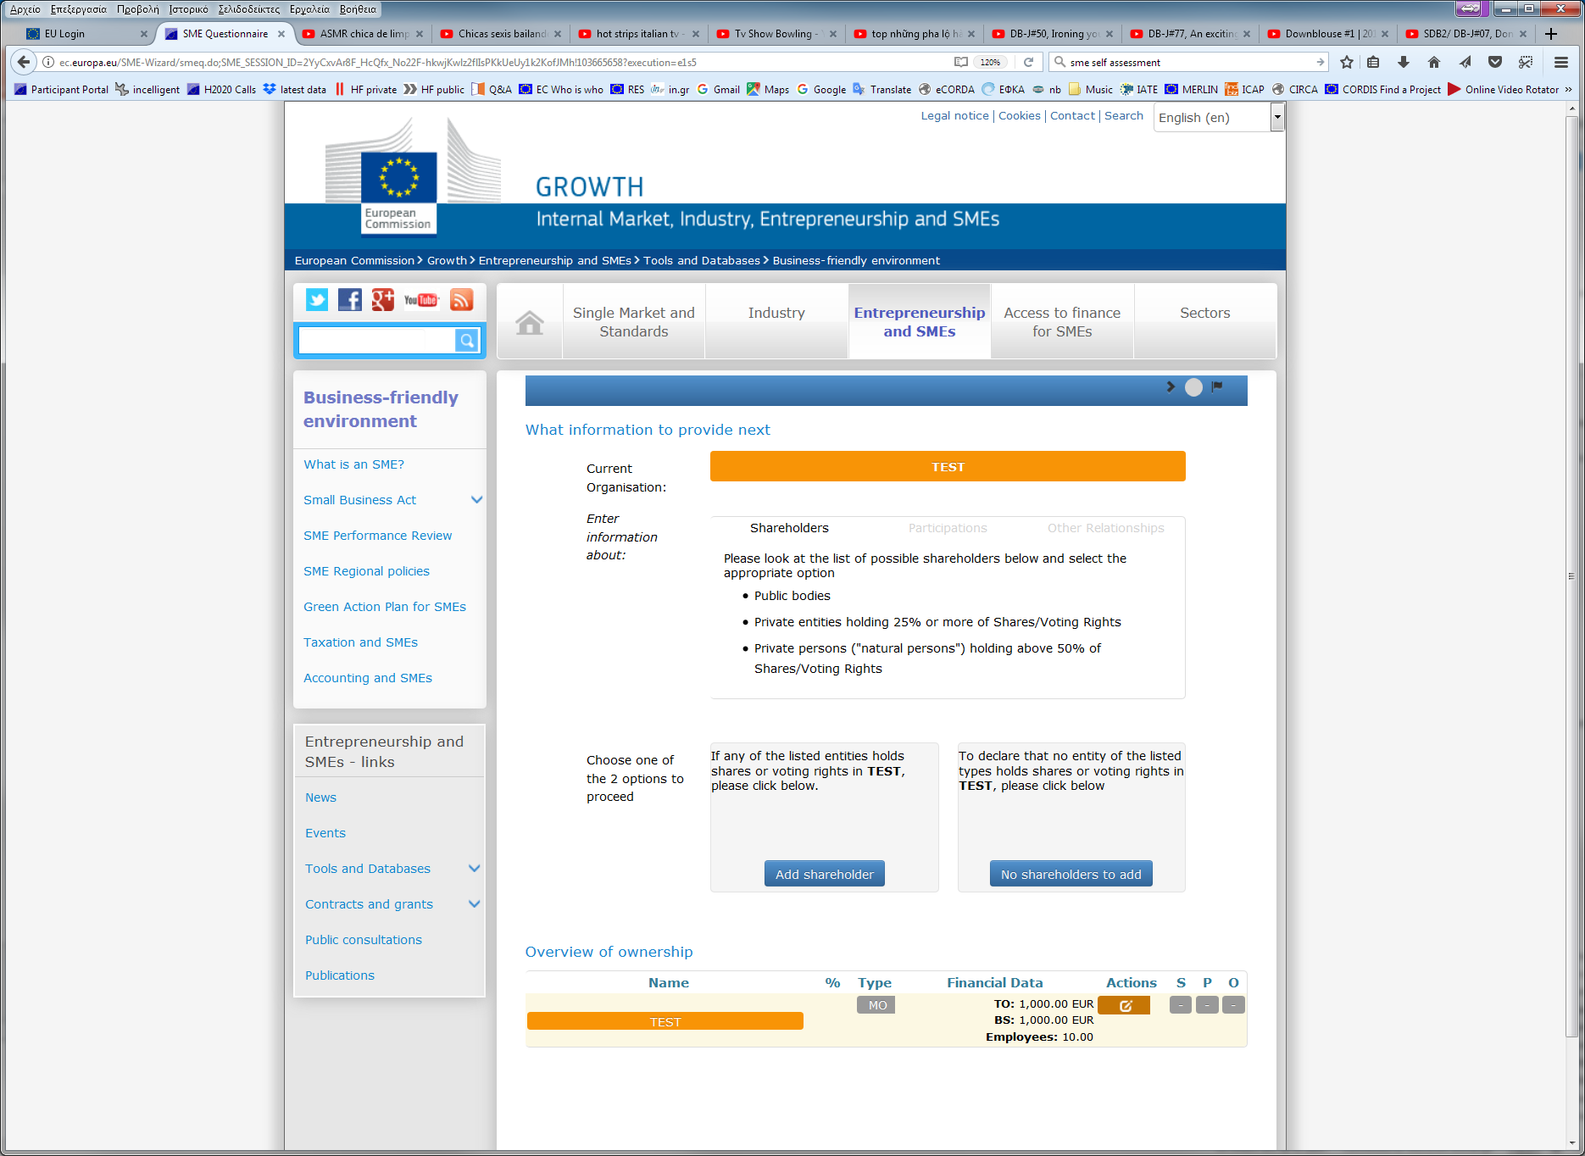
2. Validation (7)
SME self-assessment questionnaire:

Slide 22
4. The LEAR (1)
  The LEAR (Legal Entity Appointed Representative):
    (i) Manages the legal and financial data of the organisation and notifies the EU about changes in legal data/status;
    (ii) Submits FVC documents if required;
    (iii) Nominates in the PP the persons who act as legal representatives
    (iv) Nominates in the PP the persons who sign financial statements.
All LEARs registered under FP7 have been re-appointed in H2020 (due to the "extended LEAR mandate)

Slide 23
4. The LEAR (2)
  Documents required for LEAR's appointment:
    Letter of Appointment (duly signed by legal representative)
    Roles and Duties (duly signed by LEAR and legal representative)
    Declaration of Consent (duly signed by legal representative)
    Copies ID card of the LEAR and ID card of the legal representative
    Proof of nomination of the legal representative
Until today: ORIGINAL documents to be sent by post
Soon: ONLY SCANNED pdf documents to be uploaded (and original kept for ex post audit)

Slide 24
4. The LEAR (3)
  Next steps:
  REA VS checks if all documents are in place
  Either requests corrections OR approves the LEAR appointment
  PIN code is sent by email or SMS (if mobile provided)
  LEAR account activated and operational

Slide 25
5. Financial Viability Check (1)
  In general, the financial capacity is checked if:
    The beneficiary is a coordinator, and
    The requested EU funding for the project is ≥ 500 000 EUR.
  Applicants for mono-beneficiary grants are not considered as "coordinators'
  Upon request by the Authorising Officer, a financial viability check can be performed on any participant

Slide 26
5. Financial Viability Check (2)
  The FVC assessment for successful applicants is carried out by the REA via the data uploaded by participants in the Beneficiary Register.
  Result: Weak | Acceptable | Good
  At proposal level, coordinators are asked to declare that they have self-checked their Financial Capacity using the FVC self-check tool (result displayed online)
  If weak: Final decision taken by the Authorising Officer for each individual project

Slide 27
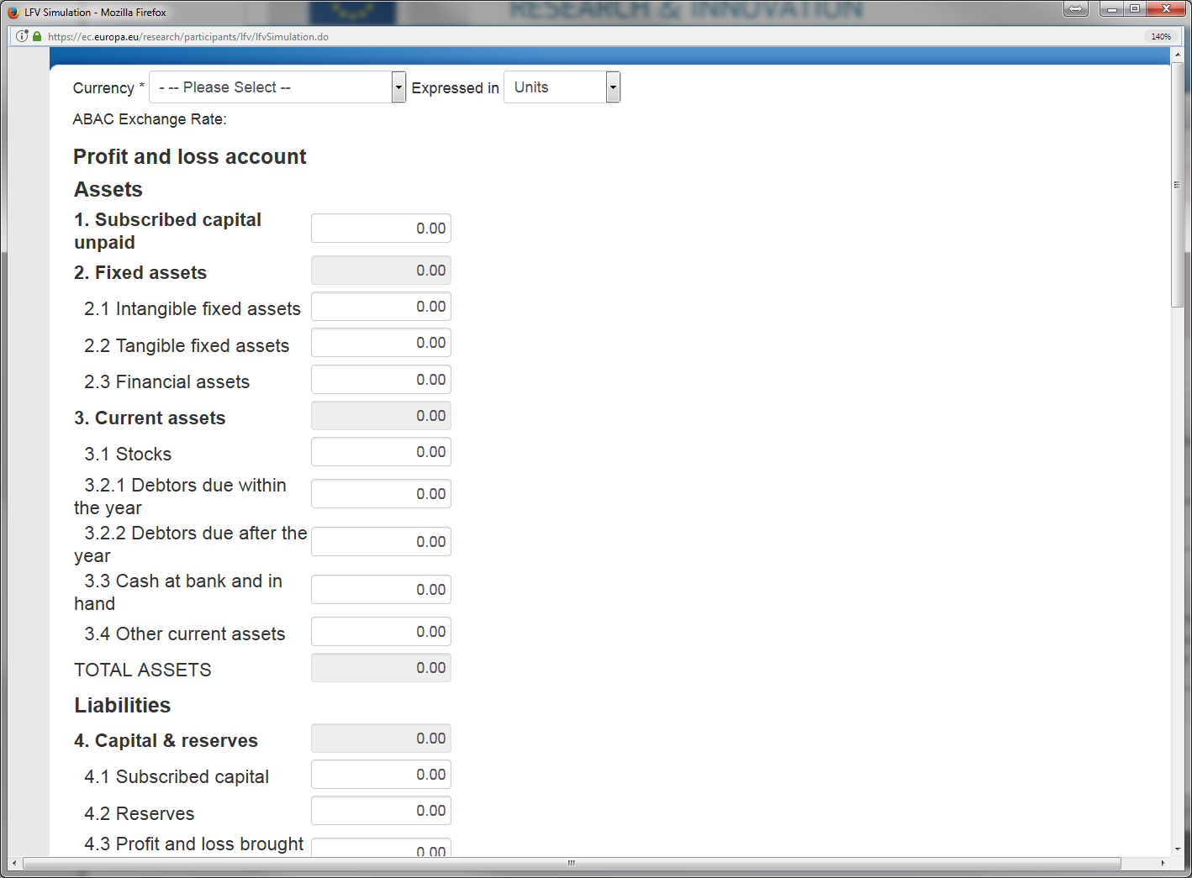
5. Financial Viability Check (3)
  Financial Viability self-check tool
The result of the FVC self-check is not binding for the EC

Slide 28
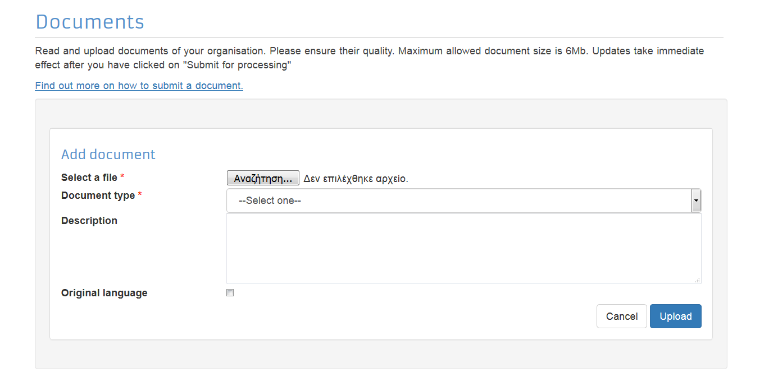
6. Messages and documents via PP (1)
  All documents can be uploaded inthe Portal.

Slide 29
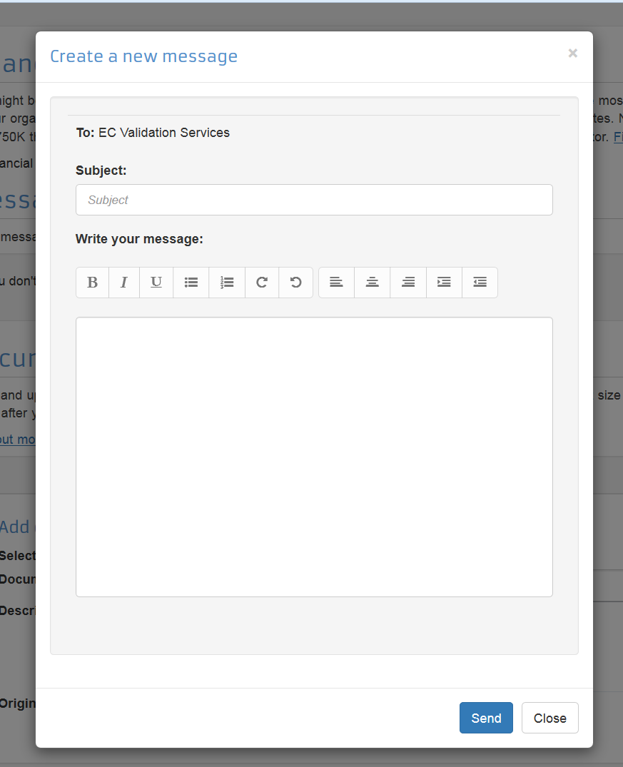
6. Messages and documents via PP (2)
  Messages can be exchanged via the Participant Portal and they can be seen in the system.
  Messages from the REA VS may also be sent as email to the participant.

Slide 30
7. Guidance documents
 Participant Portal
 How to participate
 Reference Documents
 Guidance
 Section on beneficiary registration, validation and financial viability check
ALSO:
Beneficiary Register User's Guide

