Slide 1
H2020 - Electronic Proposal Submission System (EPSS)
Focused Group Training – H2020 Legal & Financial issues
Ankara 10 November 2017
Vangelis Argoudelis / FORTH

Slide 3
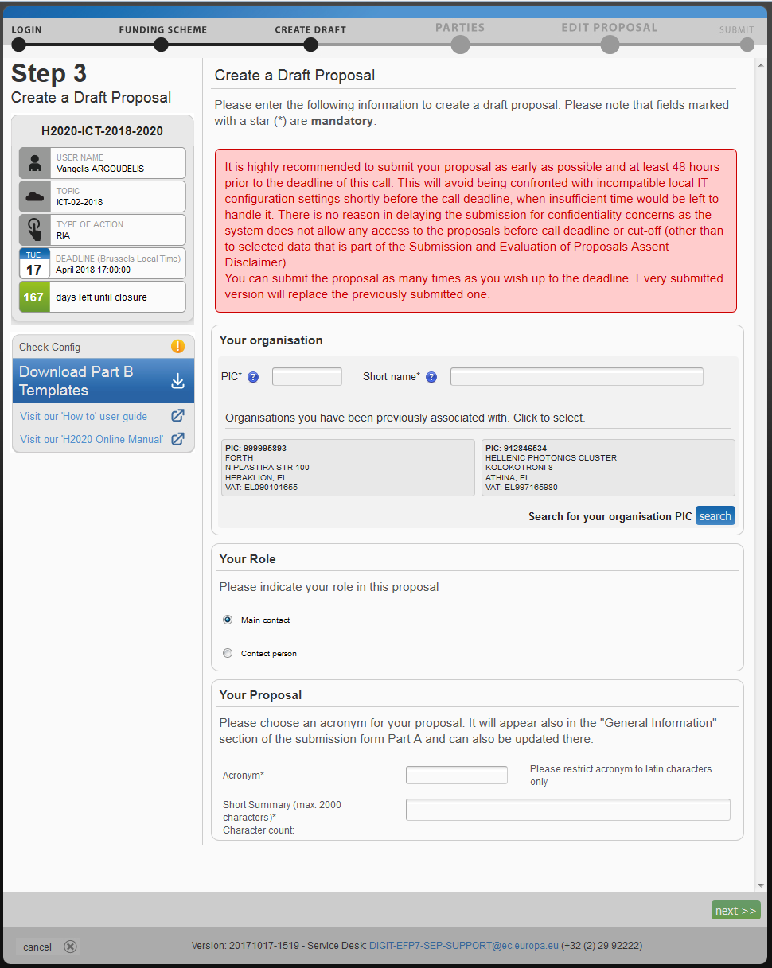

Slide 4
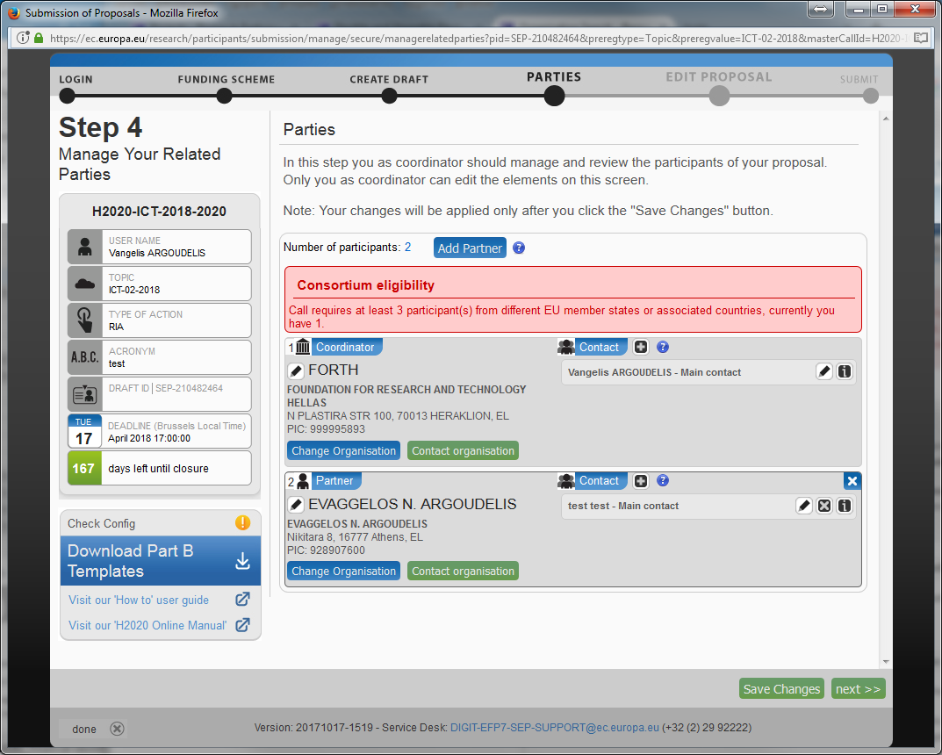

Slide 5
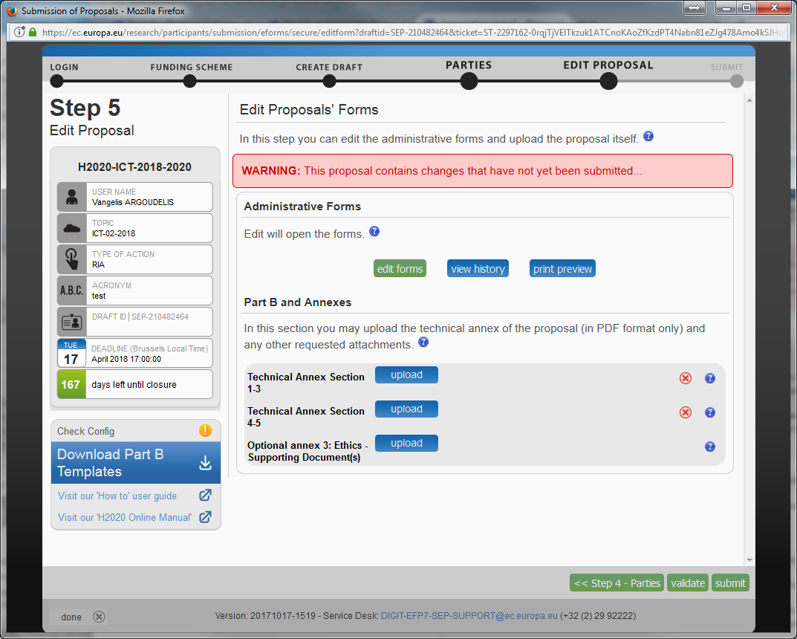

Slide 6
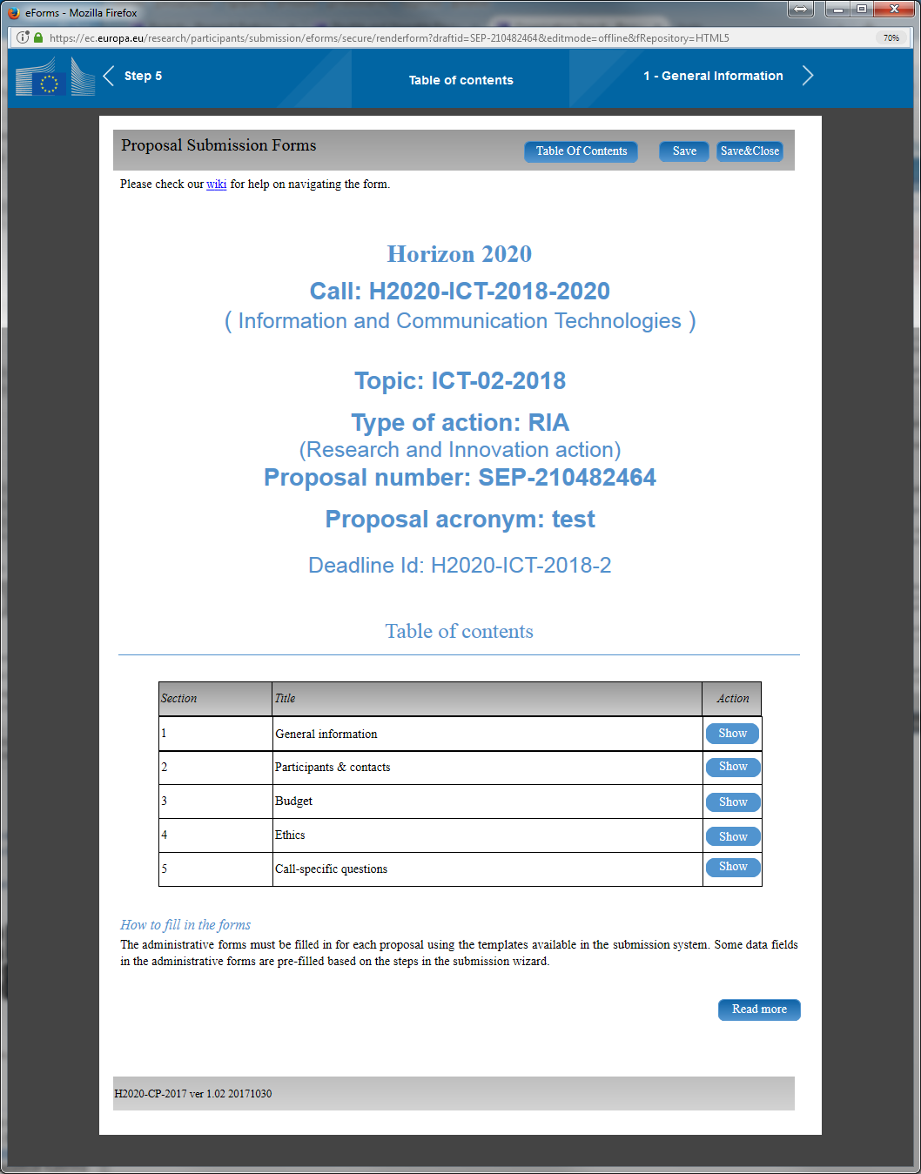

Slide 7
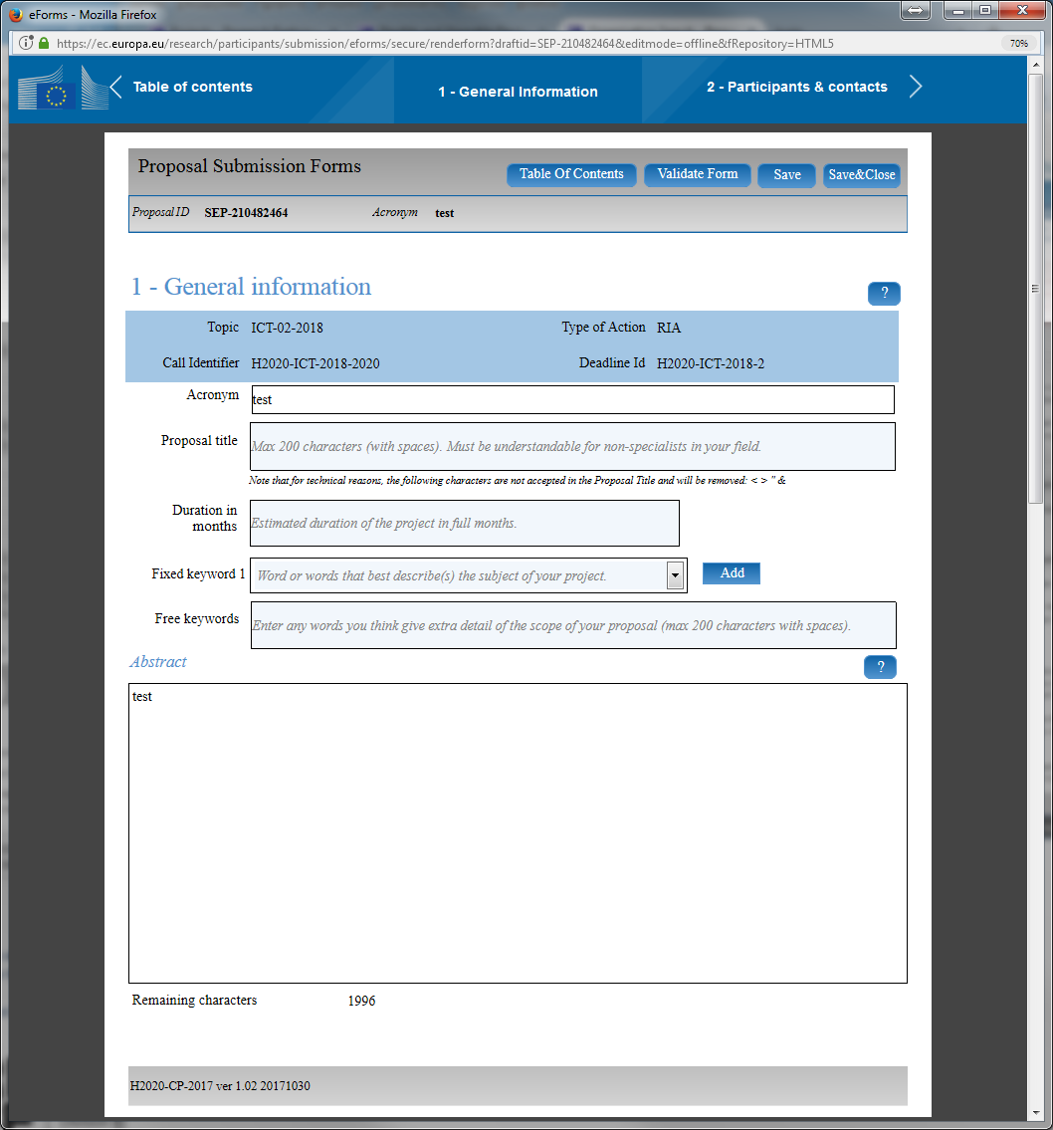

Slide 8
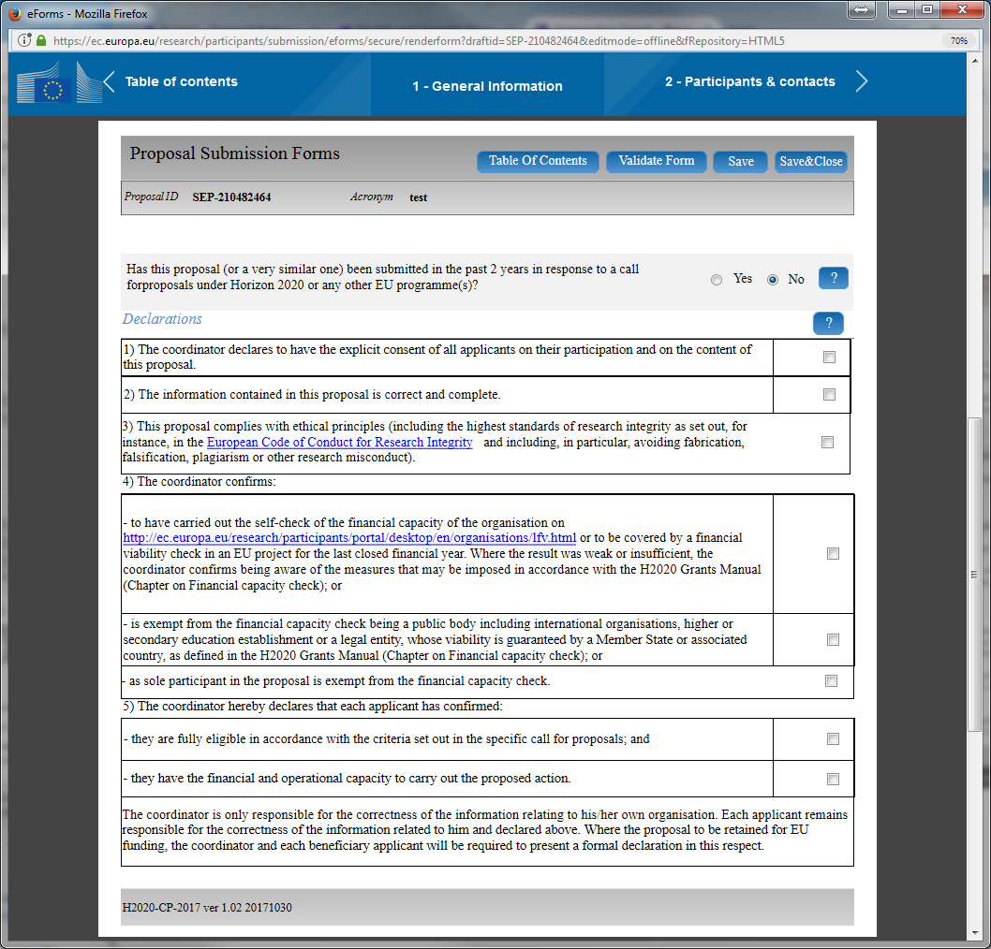

Slide 9
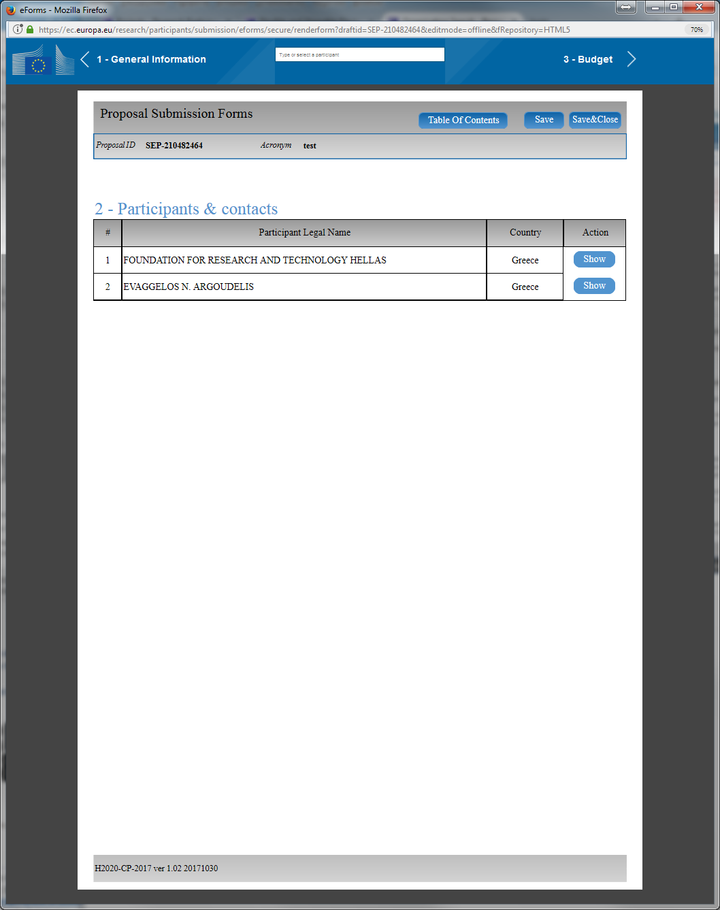

Slide 10
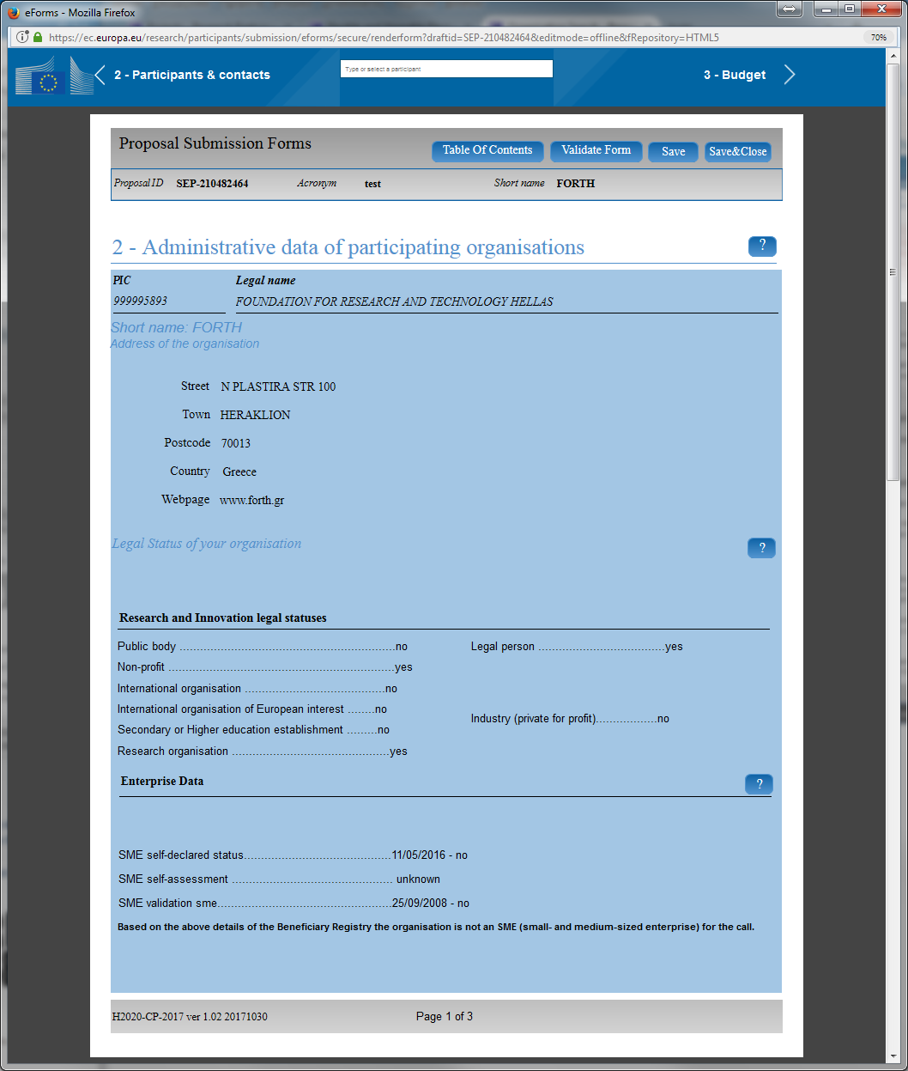

Slide 11
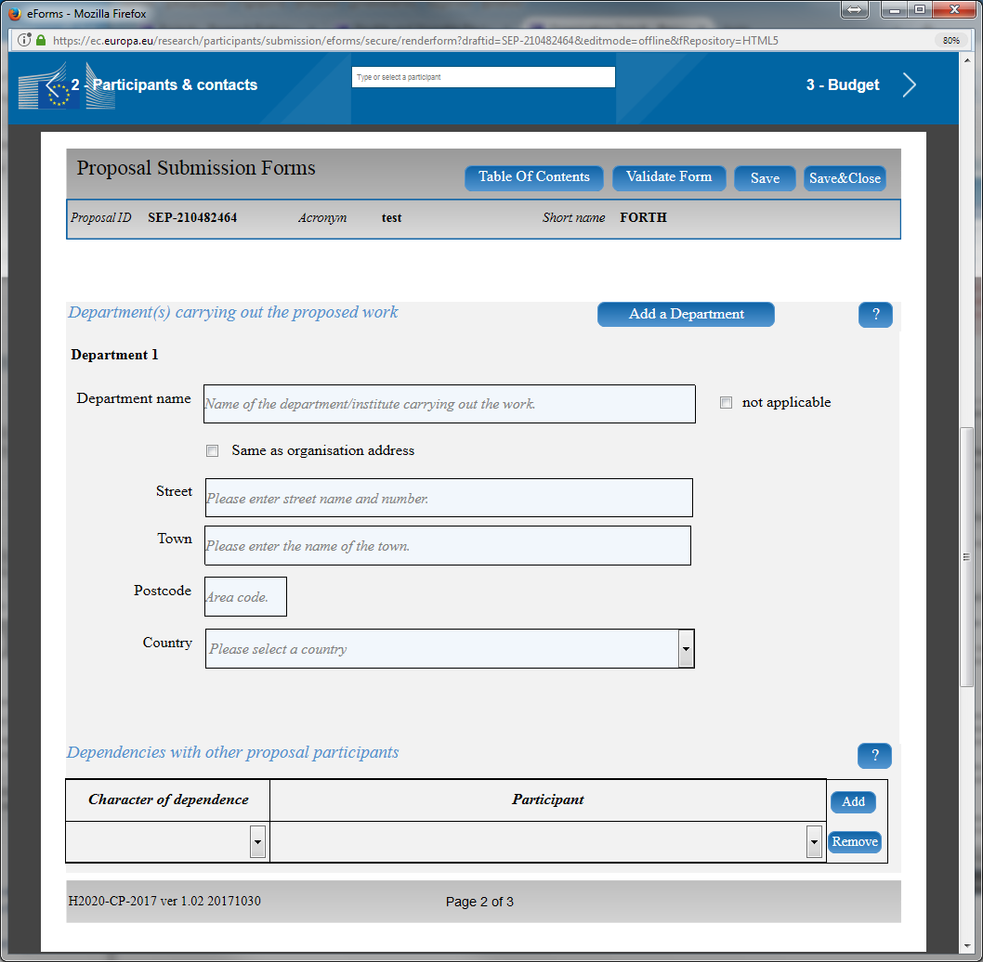

Slide 12
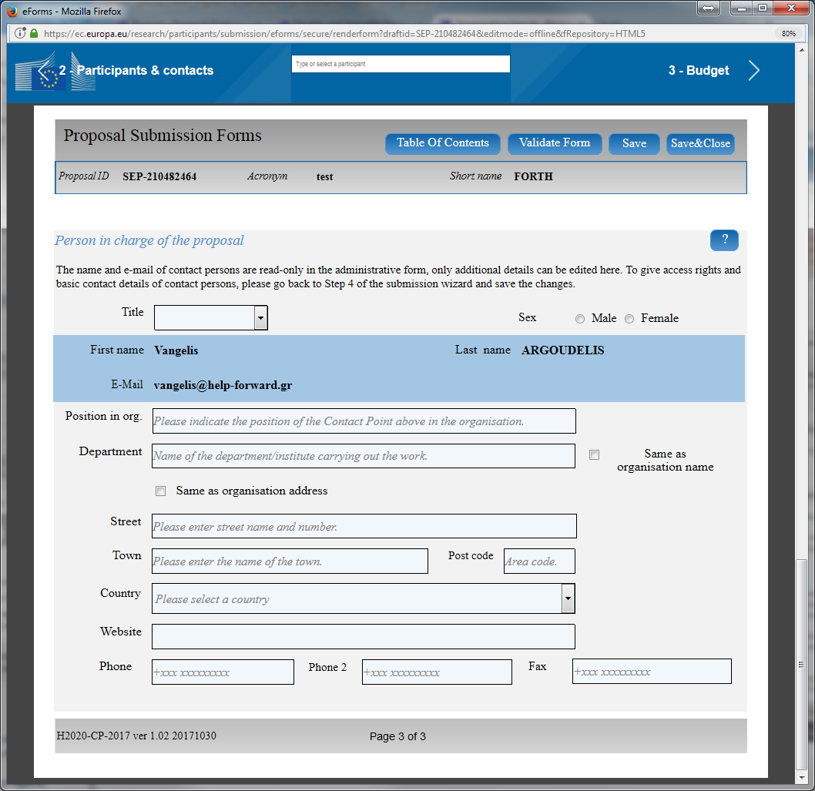

Slide 13
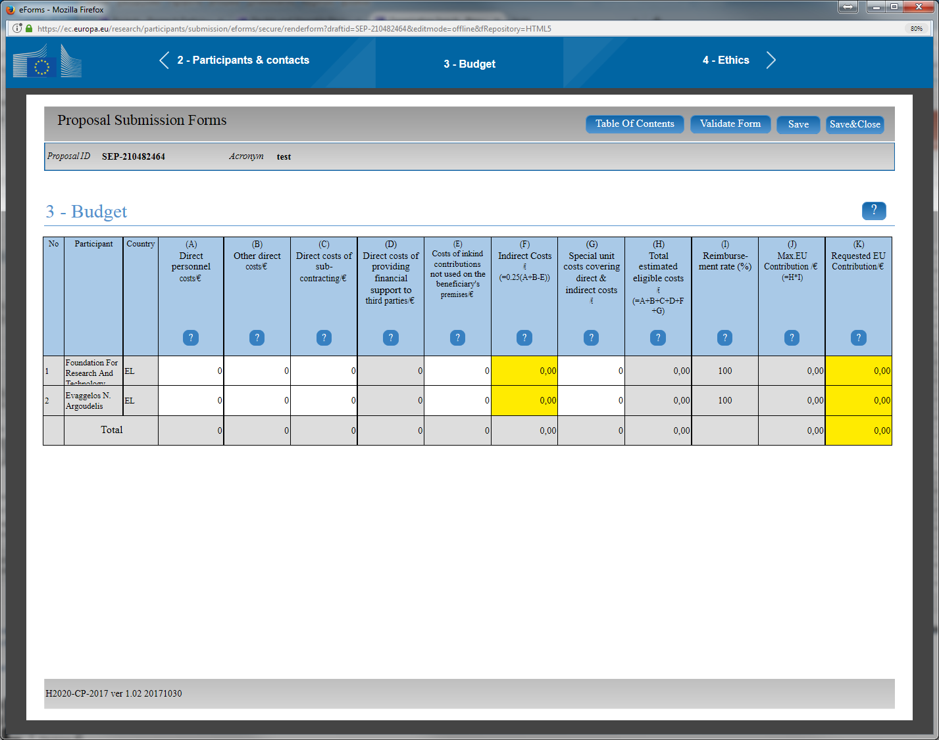

Slide 14
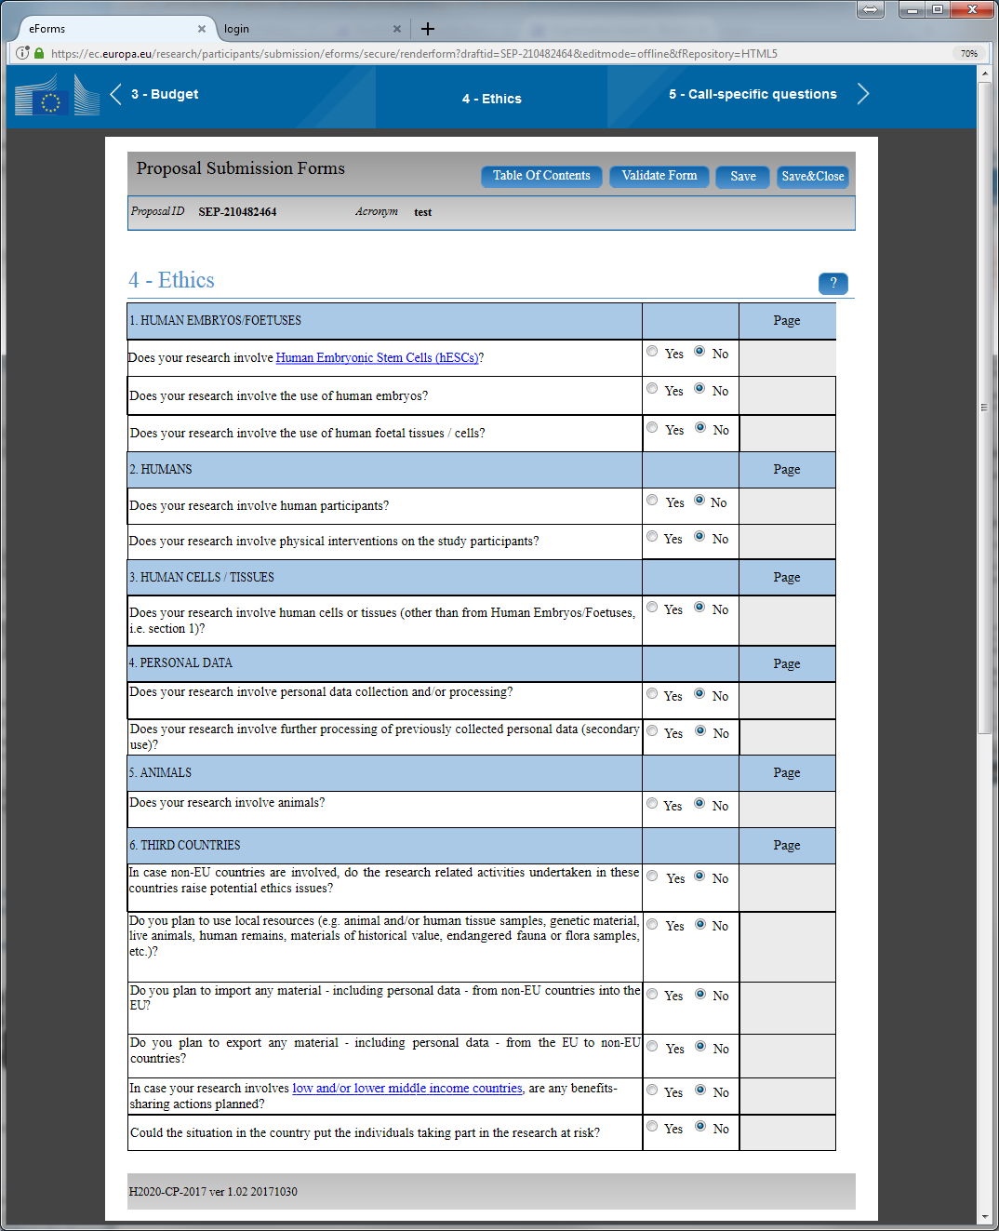

Slide 15
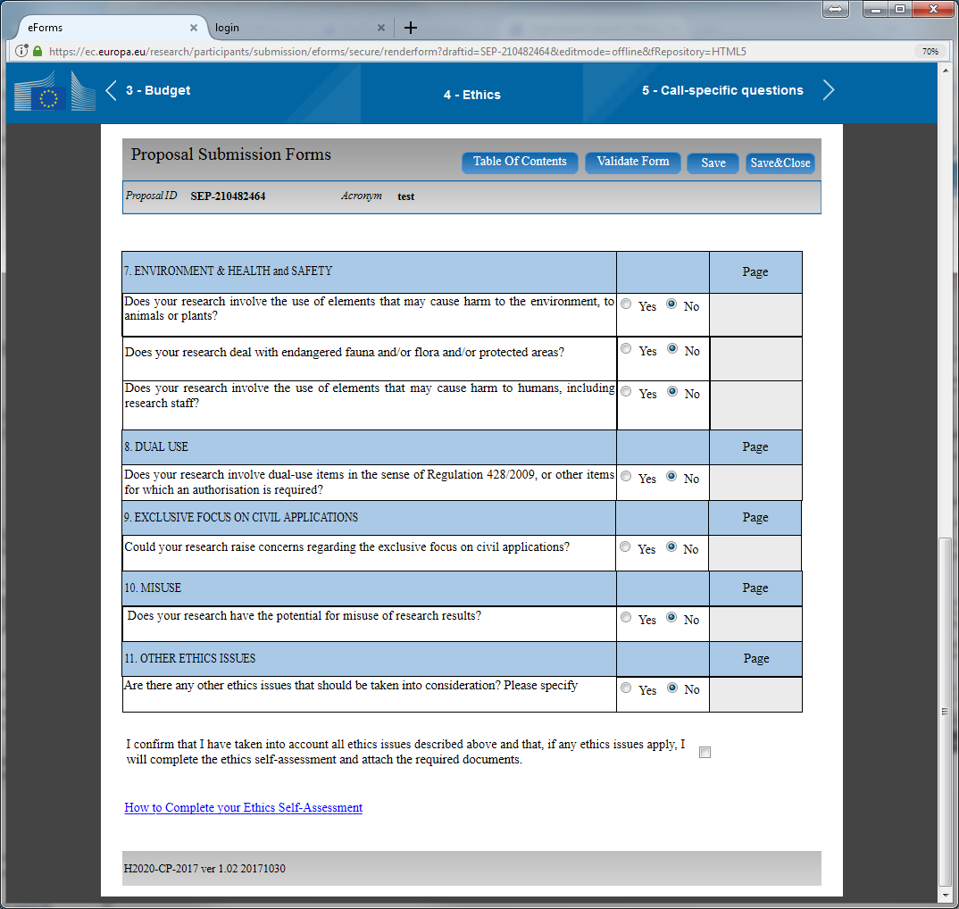

Slide 16
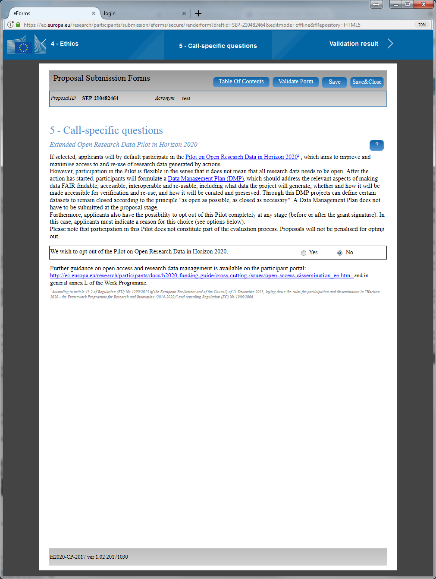

Slide 17
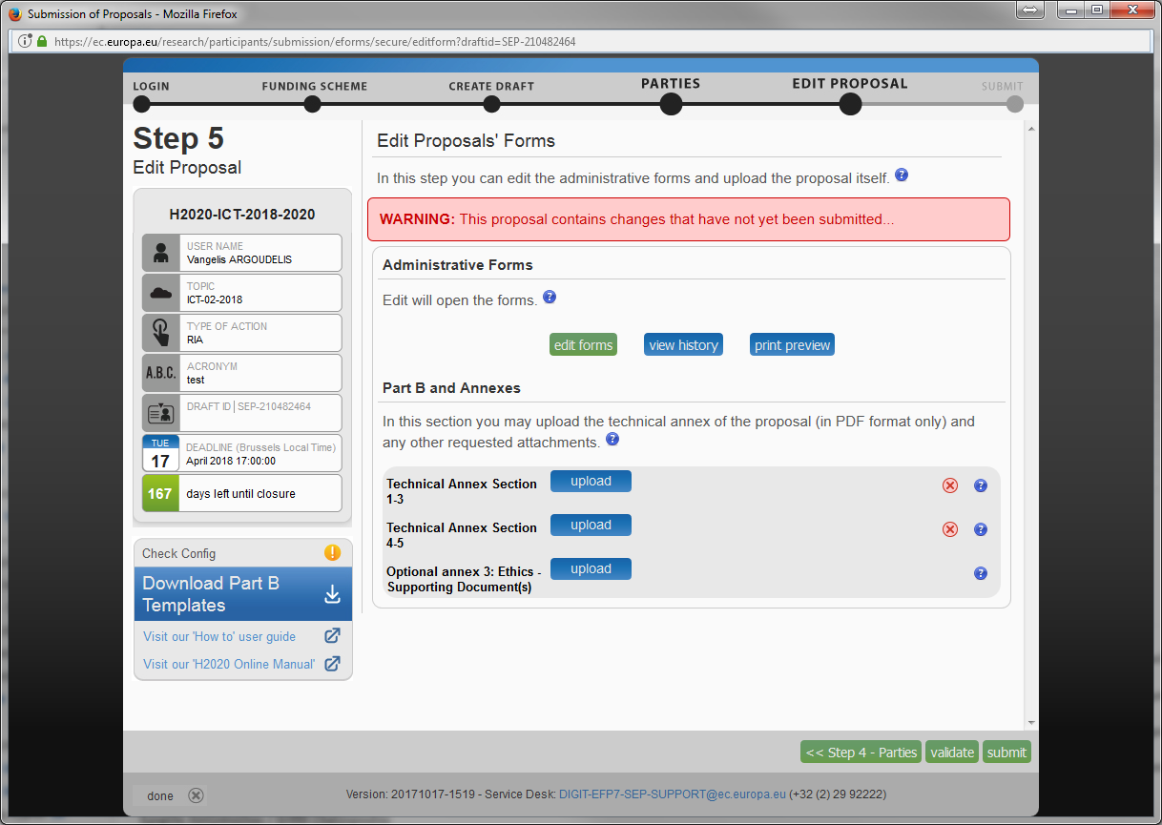

Slide 18
The End
Thank you for your attention !
Vangelis Argoudelis
Legal & Financial NCP for HORIZON 2020 in Greece
FORTH/ PRAXI Network
vangelis@praxinetwork.gr

