Slide 1
H2020 – Financial Reporting
Focused Group Training – H2020 Legal & Financial issues
Ankara 10 November 2017
Vangelis Argoudelis / FORTH

Slide 2
Project reporting obligations
Article 19 of the GA
Continuous Reporting (Deliverables, Milestones)
Periodic Reporting (60 days after end of reporting period, usually 12-18 M)
Periodic technical report
Periodic financial report
Final Reporting (in addition to the periodic report for the last reporting period)
Final technical report – summary for publication
Final financial report - CFSs
Article 20 of the GA
All reporting done electronically through the Participant Portal.

Slide 3
Periodic report – Technical report
Template available in Periodic Reporting module
Explanation of the work / progress
Deliverables, milestones, risks, ...
Questionnaire for statistics
Entered in the IT tool through the Continuous Reporting module.
Info about gender, dissemination, ...

Slide 4
Periodic report – Financial report
Individual financial statements:
Costs claimed to be reimbursed per Cost category
Explanations on the use of resources (Effort / PersonMonths per Work Package)
Explanations about Other direct costs and subcontracting

Slide 5
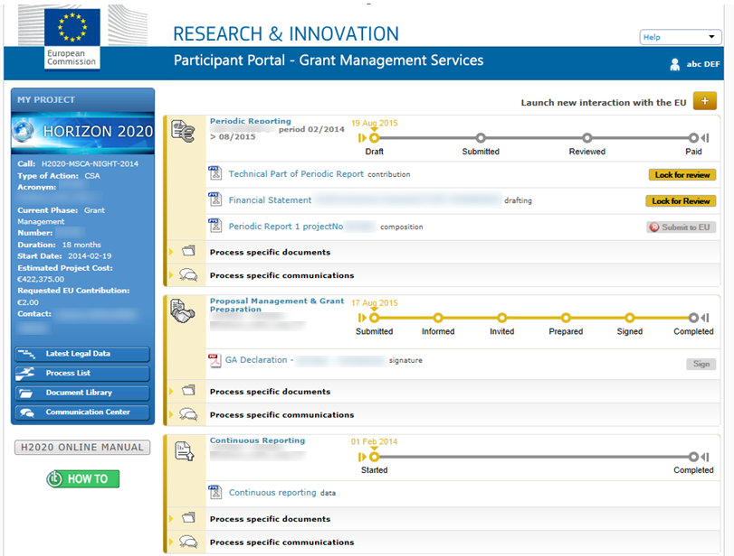
Periodic reporting module
Periodic Reporting Module

Slide 6
Periodic reporting module
Activated after the end of each reporting period
All beneficiaries complete their own Financial Statement and their contribution to the Technical Part of the Periodic Report.
Beneficiaries e-sign and submit their Financial Statements to the Coordinator.
The Coordinator approves the elements of the Periodic Report & submits to the EU Services.
EU services review the submitted Periodic Report and accept or reject it.
The PO/ FO may request additional documents/ justifications/ explanations
Approval and Payment

Slide 7
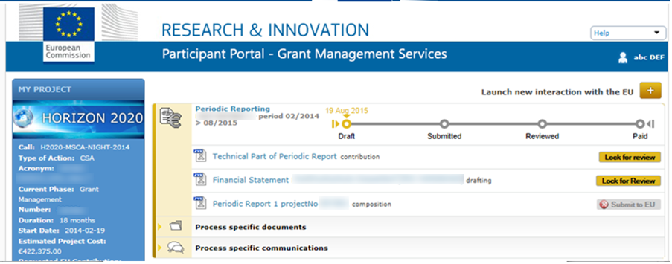
Periodic reporting module

Slide 8
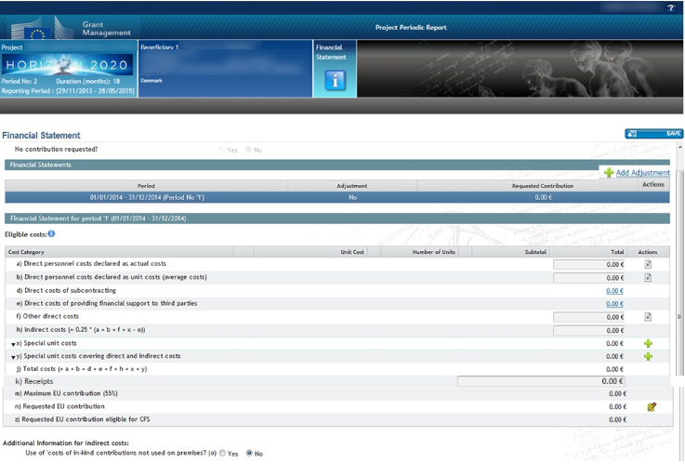
Financial report

Slide 9
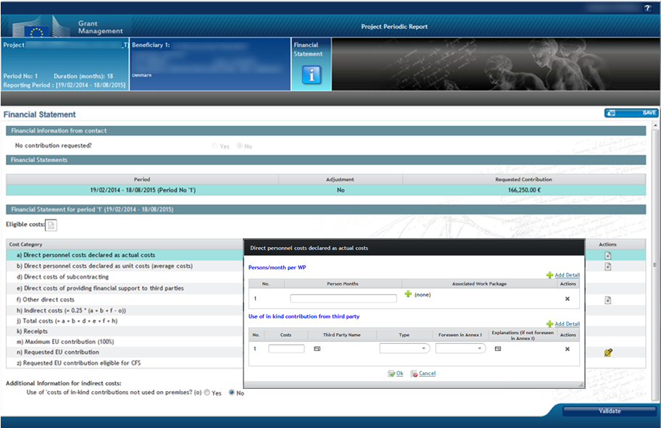
Financial report

Slide 10
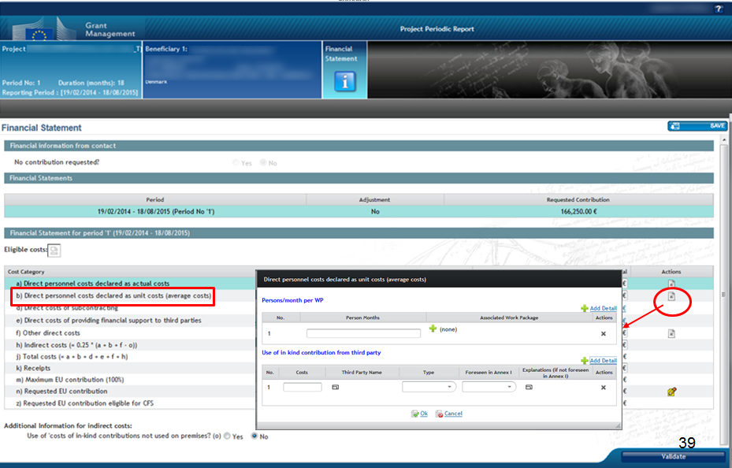
Financial report

Slide 11
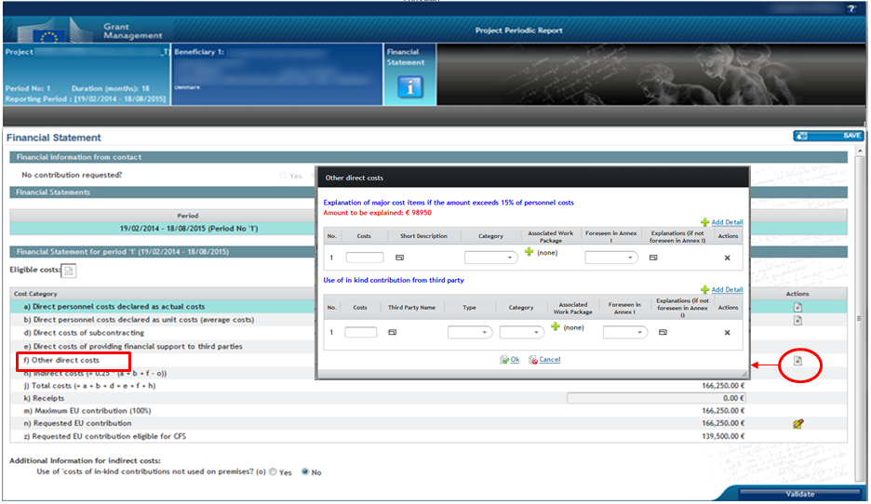
Financial report

Slide 12
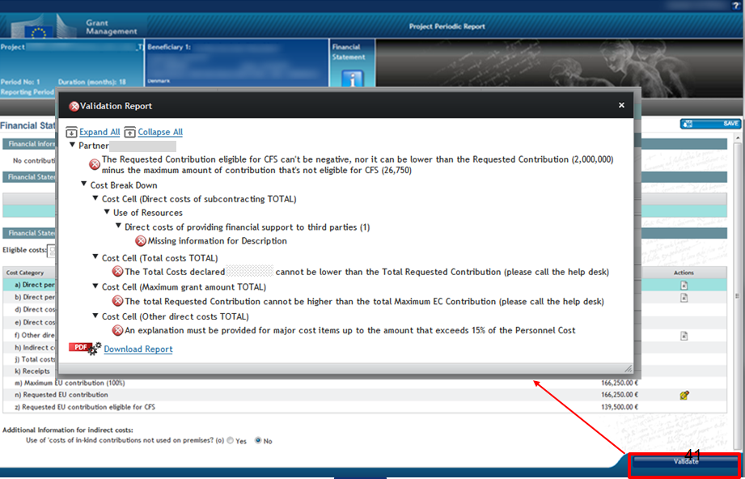
Financial report

Slide 13
Financial report
When done, click "Save" and then "Lock for Review"
Data are frozen (cannot be edited)
Financial Statement created as pdf document

Slide 14
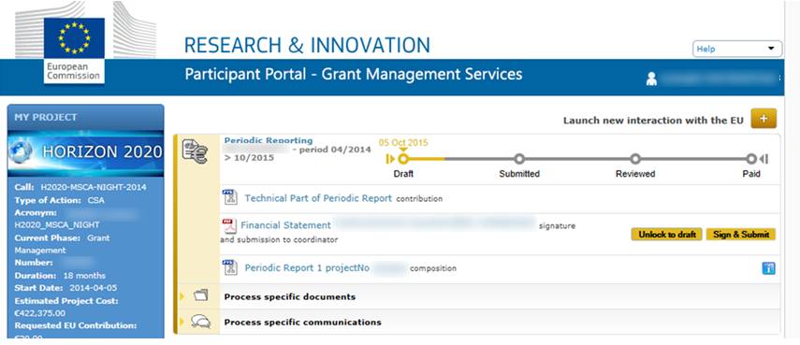
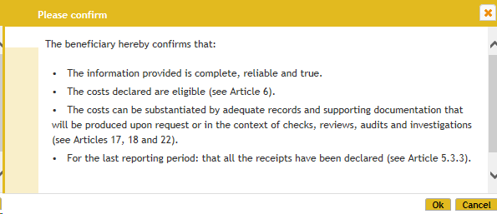
Financial report
Performed ONLY by the Financial Signatory (FSIGN)

Slide 15
Financial report
Certificates on the Financial Statements (CFS - if required)
When EU contribution ≥ 325.000 €, as reimbursement of actual costs and unit costs on the basis of usual cost accounting practices
Known as “1st level control”
To be uploaded in the same page as the Financial Statement figures
Cost for CFS eligible under "Other direct costs"
Example – requirement of CFS or not
Budget (RIA action) | Case 1 | Case 2
Personnel costs (actual) | 270,000 | 250,000
Personnel costs (SME owners unit costs) | 60,000 | 80,000
Other direct costs | 65,000 | 65,000
Indirect costs 25% | 98,750 | 98,750
Total requested EU contribution | 493,750 | 493,750
EU contribution requested as actual costs | 335,000 | 315,000
CFS | required | not required

Slide 16
Financial report
Costs are always reported in EUROS
Conversion is made as follows:
 | Accounting records in € | Accounting records NOT in €
Costs incurred in € | No conversion | No conversion
Costs incurred NOT in € | Conversion according to the usual practices of the beneficiary | • Average daily exchange rate for the reporting period (source: ECB website) • (if no daily euro exchange rate is published) Average monthly accounting rate for the reporting period (source: ECB website)

Slide 17
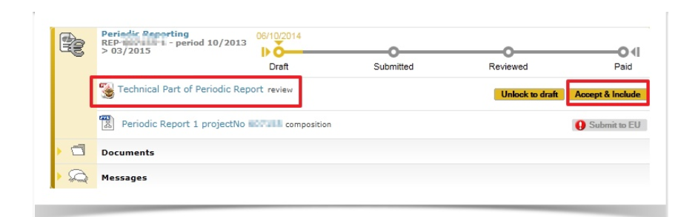
Periodic report
The Technical Part of the Periodic Report created, checked and "lock for review"
Technical Part of the report generated as PDF
ONLY Primary and Coordinator Contact(s) can "unlock to draft" the Technical report in order to make corrections OR "Accept & include"

Slide 18
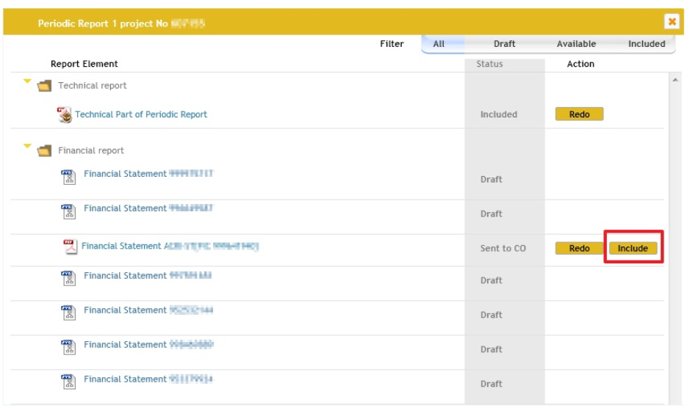
Periodic report
ONLY Primary and Coordinator Contact(s) can "Include" the individual Financial Statements of all partners

Slide 19
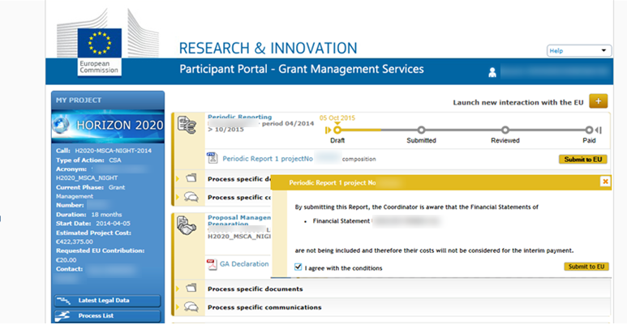
Periodic report
ONLY Primary and Coordinator Contact(s) can "Submit to EU" the finalised Periodic Report

Slide 20
Summary of the process
Periodic report
All Beneficiaries (including the coordinator)
Financial statement: insert data
Technical Report: insert data
Coordinator
Financial statements: Check
Technical Report: Check

Slide 21
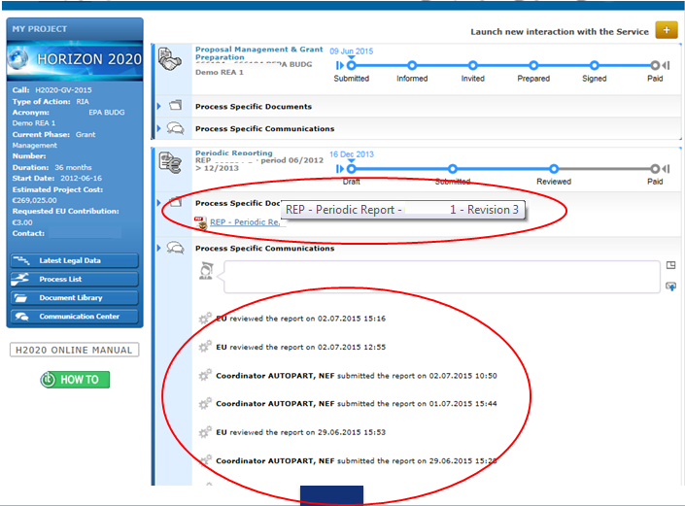
Follow up
Periodic report

Slide 22
Follow up
Periodic report
Project / Financial Officer may request changes/ more clarifications about Technical or Financial part (Rejection)
The Project / Financial officer may Approve the report and:
Either approve all costs , OR
Reject certain costs
EU assessment report is uploaded (pdf) accessible by all partners
Starting of the payment process
The coordinator or the beneficiary concerned may – within 30 days of receiving the notification - formally notify the Service of its disagreement with any rejected costs and provide justification.

Slide 23
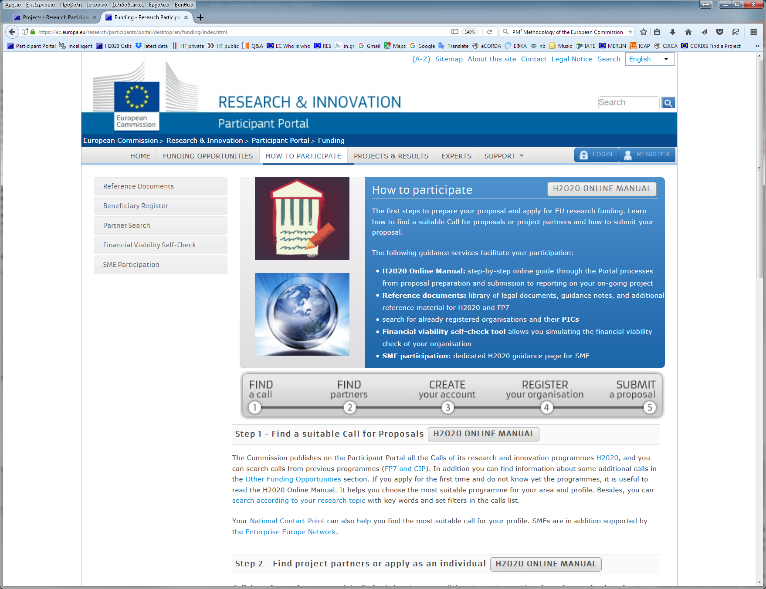
Further info

Slide 24
Exercise – Questions to the Audience
REGISTRATION: Beneficiary who is non-profit is wrongly declared as for profit during validation. When participating in an Innovation Action they realise they are funded 70% instead of 100%. They can change their registration status to "non-profit" but the GA has been signed with 70% funding rate for them. What can they do?
PARTICIPATION RULES: A company from the USA has a subsidiary established as a separate entity in Turkey. Is the subsidiary automatically eligible for funding?
PARTICIPATION RULES: A company from Japan wants to use one of its subsidiaries established in Turkey in order to receive H2020 funding. The subsidiary will be a beneficiary in a project and the mother company will act as linked 3rd party to the beneficiary. Can the mother company receive funding?

Slide 25
Exercise – Questions to the Audience
TRAVEL: Project in the field of Space Weather. The European Space Weather Week (ESWW) is the major conference in EU for this field. Am I allowed to participate in the ESWW conference and cover my travel expenses by the H2020 project, since it is relevant?
TRAVEL: The EU project officer has asked us to have the final review meeting 1 month after the official project end in order to evaluate together with the reviewer all the project's results. Is the cost for travelling to the final review eligible?
EQUIPMENT: I have some budget left under the category of equipment, and the project ends in 1 week. Since I have no alternative use of this budget, plus it is within the project's duration, can I use this budget to buy equipment for my lab?
EQUIPMENT: Can I buy computers for my lab/ company in the framework of a project to be used by the persons working on the action?

Slide 26
Exercise – Questions to the Audience
SUBCONTRACTING: Can I identify the subcontractor in the proposal to avoid all the administrative burden and procedures required (receiving and evaluating various offers from different providers, prove value for money, undergo open procedures/ tenders, …)?
SUBCONTRACTING: My organisation is beneficiary in a project and I am the scientific responsible. Is it forbidden to give a subcontract to a company which is owned by my brother?
COSTS: We did not have time to prepare the Consortium Agreement before signature of the Grant Agreement (during GA preparation), can we now charge the costs of our lawyer / managers for preparing the CA during execution of the project?

Slide 27
Exercise – Questions to the Audience
PAYMENTS: The consortium submitted their final report and financial statements to the EU. One of the beneficiaries (SME) had to return 50.000 euros back to the coordinator (total costs < total payments received). The final approval of the report by the EU took too long and finally we were paid 8 months after the project's end. Meanwhile during these 8 months, the SME beneficiary went bankrupt and ceased its activities ("winding up") without any notification to the consortium. How are we going to retrieve the 50.000?
REPORT: The Coordinator rejected my Financial Statement and did not include it in the consortium's periodic report. Does he have the right to do so? What are the rules about this case?

Slide 28
Useful contacts
TUBITAK National Contact Points for Legal and Financial Aspects in Turkey Mr Gürsel Fırat GEDIKLI firat.gedikli@tubitak.gov.tr
Mr Muaz Mücahit YILDIRIM mucahit.yildirim@tubitak.gov.tr
ncpfinance@tubitak.gov.tr

Slide 29
The End
Thank you for your attention !
Vangelis Argoudelis
Legal & Financial NCP for HORIZON 2020 in Greece
FORTH/ PRAXI Network
vangelis@praxinetwork.gr

