Slide 1





Turkey in Horizon 2020 II
Turkish Experience in INNOSUP-MIND4MACHINES
Eda Çığ Türktaş
Istanbul Chamber Of Industry
European Innovation Ecosystems: Connect-Scaleup-INNOVSMEs
6 July 2021

Slide 2
Introduction
Engineer, Project Expert, Project Coordinator @R&D and Technology Department of ICI
  Enterprise Europe Network, since March 2009
    Technology transfer and R&D funds
    Main contact point for FP7, H2020 in ICI in scope of EEN
    Preparation & Reporting of EEN project
  Main areas of work: innovation, R&D funds, university-industry collaboration, entrepreneurship, start-ups, digital transformation…
  Project coordinator- ICI-KOZA Start-up Accelaration Program (ISTKA Project (2018-2020)
  Project coordinator- ICI Turkey-EU Business Dialogue- TEBD (IPA-II Grant Project (2019-2020)
  Project coordinator: IPA-II Competetive Sectors Program Industrial Design Centre Project
ICI Digital Transformation Office (ISTKA Project 2018-2020)
Digital Transformation Excellence Centre
  To be established

Slide 3

About MIND4MACHINES
Call: H2020 INNOSUP-01-2020, Cluster Facilitated Projects For New Industrial Value Chains
Name: Manufacturing Industry’s Novel Digitalisation value chains FOR connecting MACHINES with people, process, and technology
ID: 101005711
Implementation Period: 14 June 2021-13 June 2024
EU contribution: € 4 999 737,50
Funding Scheme: IA - Innovation action
Min 75 % must be used for innovation support:
3,3 M direct funding + Project activities

Slide 4
About MIND4MACHINES
MIND4MACHINES aims
to facilitate cross-border and cross-sectoral collaboration and
to provide direct support for entrepreneurship and innovation in “smart ICT technologies for manufacturing industry”,
particularly covering the entire digitalisation value chain, from IoT (hardware, software, services and connectivity) to Big Data, Cloud Computing, Artificial Intelligence, Blockchain and Cybersecurity Technologies.
Thus, the project aims to create accelerate the market up-take of solutions for deep transformation of energy/resource intensive industries into sustainable, climate neutral and intelligent manufacturing, within the context of the European Green Deal.

Slide 5

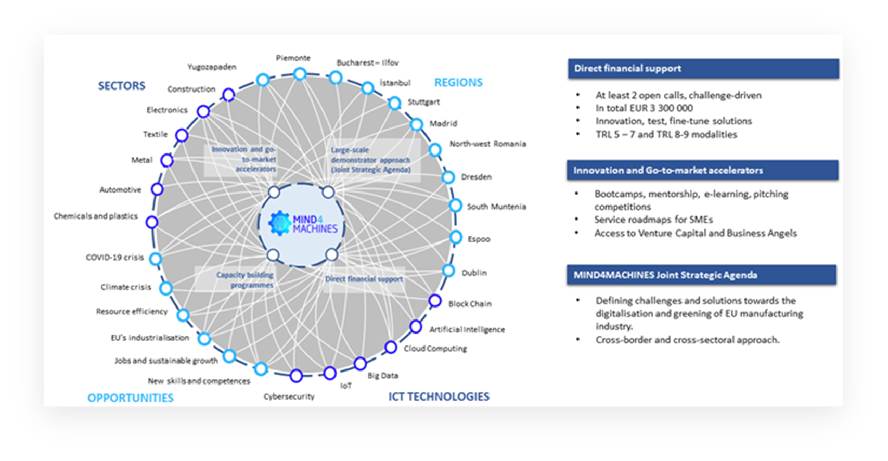
MIND4MACHINES Concept

Slide 6
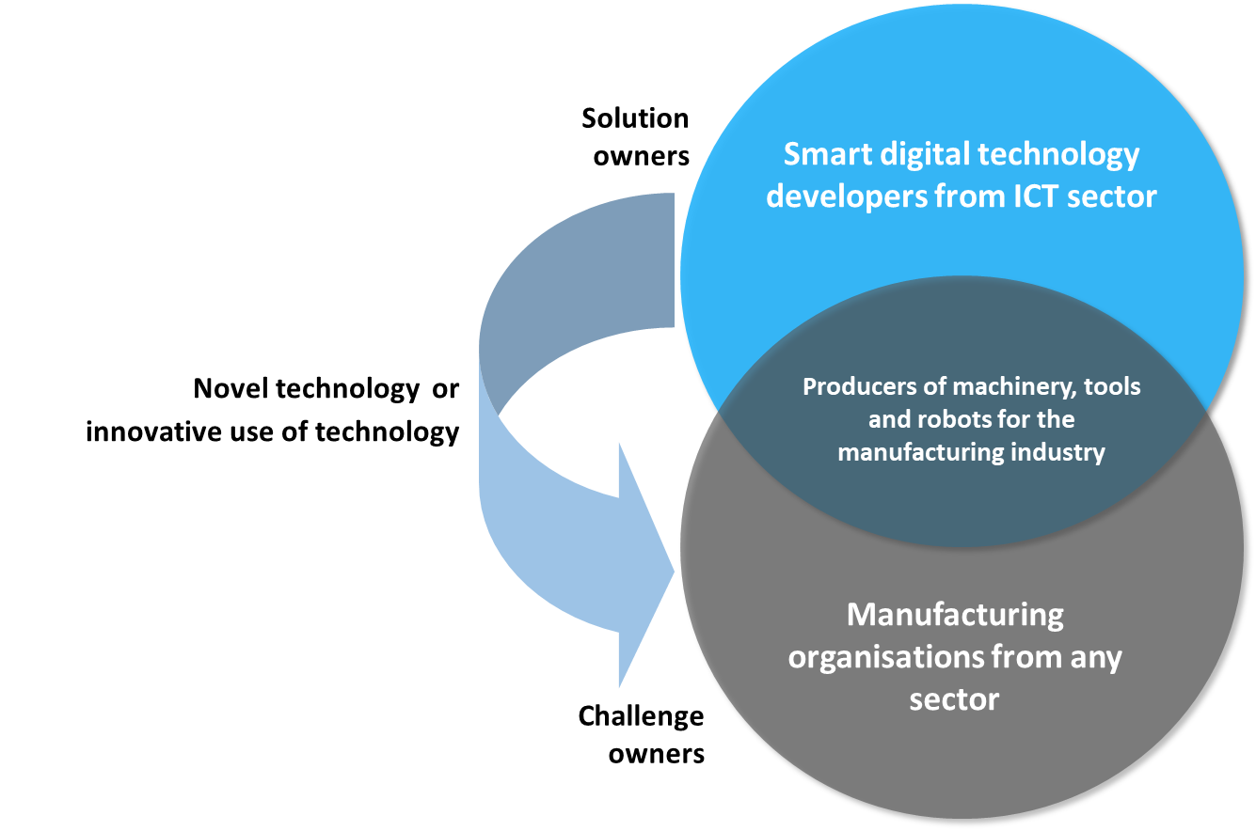
MIND4MACHINES Concept
MIND4MACHINES aims to establish a large-scale demonstrator approach to show the potential of the latest ICT solutions (AI, Big Data, Cloud Computing, IoT, etc.) to be used as a lever towards the transformation of the European manufacturing industry into an innovation-led sector able to cope with the societal challenges of our era: climate change, bioeconomy, circular economy, energy efficiency, etc.

Slide 7
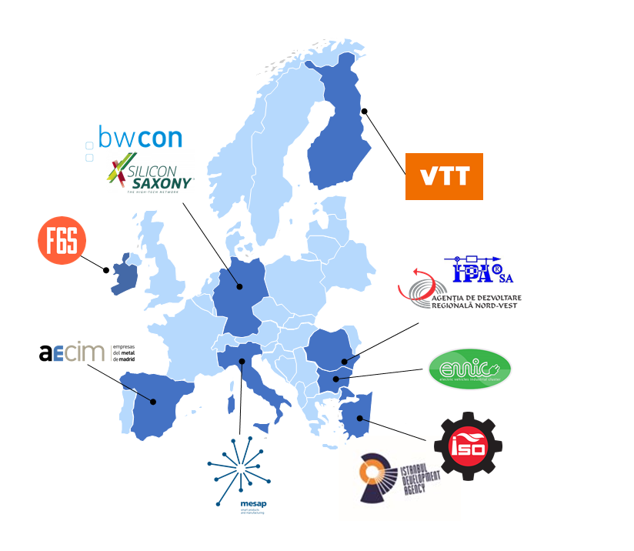
MIND4MACHINES Consortium
Nº | Participant | Short name | Country | Type
1 | Istanbul Sanayi Odasi (Istanbul Chamber of Industry) | ICI | TR | Chamber of Industry
2 | BWCON GMBH | BWCON | DE | Cluster organisation
3 | Asociacion De Empresarios Del Comercio E Industria Del Metal De Madrid | AECIM | ES | Business Association
4 | Agentia de Dezvoltare Regionala Nord-Vest | NWRDA | RO | Regional Dev. Agency
5 | Silicon Saxony e. V. | SISAX | DE | Cluster organisation
6 | SC IPA SA | IPASA | RO | R&D Institute
7 | Centro Servizi Industrie SRL | MESAP | IT | Cluster organisation
8 | Industrialen Klaster Elektromoboli | EVIC | BG | Cluster organisation
9 | Istanbul Development Agency | IDA | TR | Regional Dev. Agency
10 | VTT Technical Research Centre of Finland | VTT | FI | Research organisation
11 | F6S | F6S | IE | Tech SMEs cluster

Slide 8
Story Behind-Summary
Search for a proper Call, January 2019
INNOSUP-01-2018-2020
1st Stage Submission, April 2019
2nd Stage Submission, September 2019
Revision and Resubmission,
2nd Stage, September 2020
Evaluation Results, December 2019
Reserved list, 12.5 points
1st stage, April 2020
Evaluation Results, January 2021
Funded, 15 points ☺

Slide 9
Story Behind-Detail
2019- First Submission
Search for a Suitable Call
INNOSUP-01-2018-2020
Examination of the call
Call Documents
Previous projects
Preparation of the Concept Note
Decision on the Concept
Partner Search
EEN Forum (4 partners)
EU Cluster Collaboration Platform
(targeted search and first contact)- (3 partners)
1st Stage Submission, April 2019
10 pages
8 partners
TUBİTAK Coordinator Support Program: Project Writing Support
2nd Stage Submission, September 2019
TUBİTAK Coordinator Support Program: Project Writing Support
Evaluation Results, December 2019
Reserved list, 12.5 points (not funded)
LoIs from different stakeholders collected
2020- Revision and Resubmission
1st Stage Resubmission, April 2020
9 partners (8 partners from last year+ISTKA)
2nd Stage Submission, September 2020
TUBİTAK Coordinator Support Program: Project Review Support
9 partners+ 2 new partners
Evaluation Results, January 2021
Funded, 15 points
LoIs from different stakeholders collected

Slide 10
Evaluation Summary Report 2019
1- Excellence
Direct support to SMEs is well designed by competition and open support schemes, efficiently combining financial support and knowledge transfer for innovations development. However the voucher scheme is very complex and challenging to manage/ dificil de gestionat.
TRL overview is not totally presented. Specifically, it is not sufficiently described how innovative projects already regarded as TRL 8-9 are going to be positioned and benefit from the proposed Action. This is a minor shortcoming.
3 - Quality and efficiency of the implementation
The Gantt chart includes appropriate activities durations schedules. However, there is a shortcoming related to the time frame scheduled for "mapping and analysis of needs and challenges", which is regarded as unnecessarily long (9 months).
The proposal adequately plans 78% of the total project budget for direct SMEs support. The vouchers for travel, ideas generation and open competition scheme are clearly detailed.
However, a shortcoming is the budget figures are not adequately supported by a specific breakdown of remaining amounts of SME funding. Respectively, the provision of business support services (training, mentoring) is not fully clear in the sense of whether these activities will be provided by the partners or by external actors. The dedicated budget for each option is not clearly specified.
Nine critical risks have been very well identified. Each risk has been assessed properly for its likelihood and relevant mitigation measures have been identified. However, a minor shortcoming is that the respective critical risk impact levels are not provided.
A minor shortcoming, though, is that certain costs lack detailed description, namely: organisation of international events.
2-Impact
A shortcoming/ neajuns is that some of the supported initiatives at TRL lower level (between 2 and 4) are insufficiently presented in sense of their description and justification. In addition, those represent insufficiently mature innovative projects for an innovation action under this Call.
A minor shortcoming is that the part referring to exploitation of the project results is not presented in adequate accuracy (such as announced but not presented table, which represents slight confusion in reading that paragraph).

Slide 11
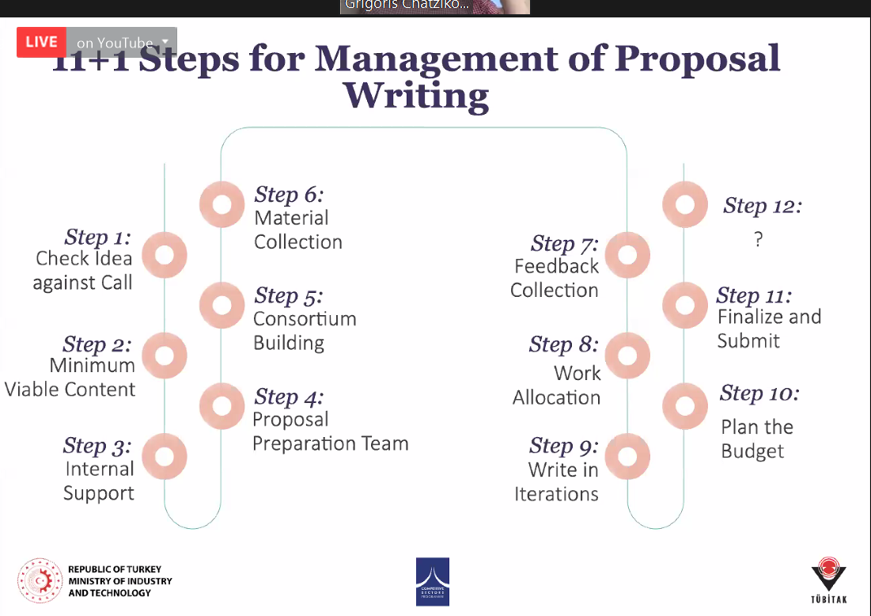

Remarks on Proposal Writing Process
Partners: Regional coverage and main contribution taken into account
From 2019 to 2020: EU Green Deal and Covid-19 measures added.
1-to-1 meetings with partners esp. at the 2nd stage. More talk with big sharks…
Proposal writing in summer…
Partners feedback on the proposal gathered via online meetings & e-mails.
External support

Slide 12
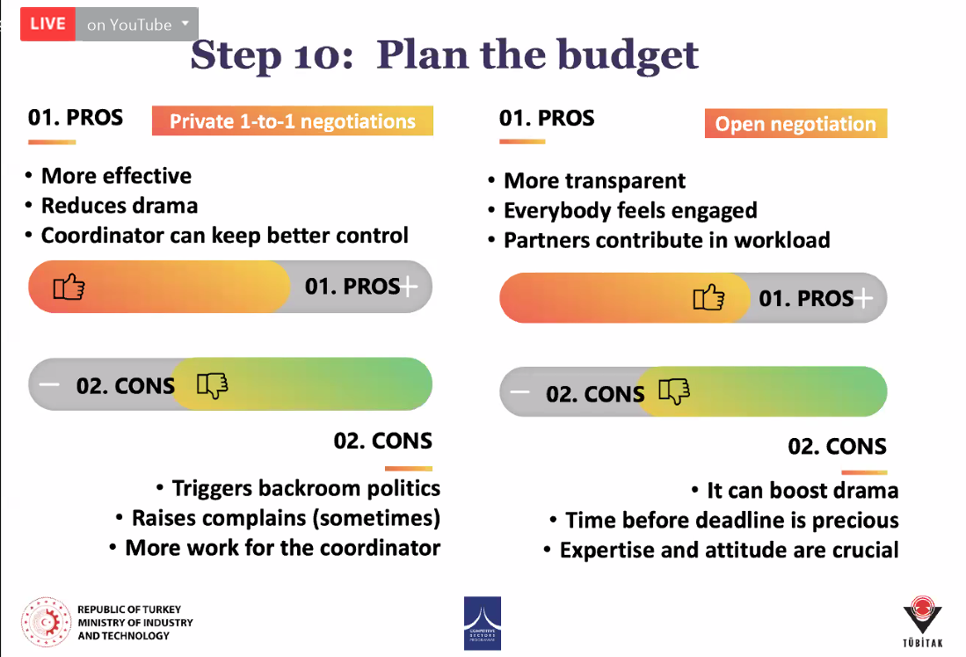
Remarks on Proposal Writing Process
Budget
Worked on budget first
Then shared with the partners seperately
After the negotiation with all the partners ended the budget was shared with all

Slide 13
Remarks on Proposal Writing Process
Be sure that the targets/goals in the project are SMART
Proofreading by possible colleagues, partners…
Spell check
Check numbers, dates of deliverables in the text and any other table
WP and Task leaders must be OK with their duty.
Document must have one owner (if not decided to work on a shared document)
Pay attention to different versions arriving from different parties!!!
Every comment and change must be taken to the master document!!!
Submit earlier to the PP, the docs can be revoked and reuploaded after submission until the deadline.

Slide 14
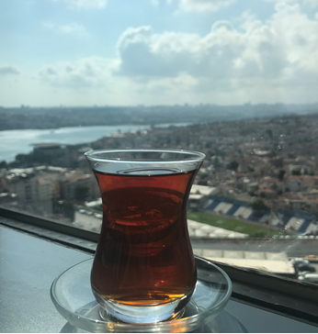
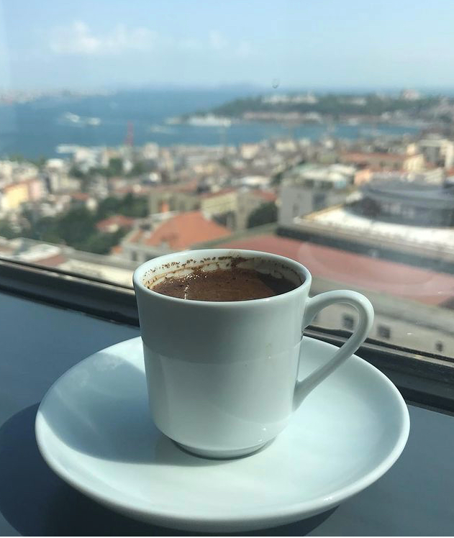
THANK YOU ☺
Eda Çığ Türktaş
İstanbul Chamber of Industry
R&D and Technology Department
E-mail: ecig@iso.org.tr
https://www.linkedin.com/in/edacig/

Slide 15
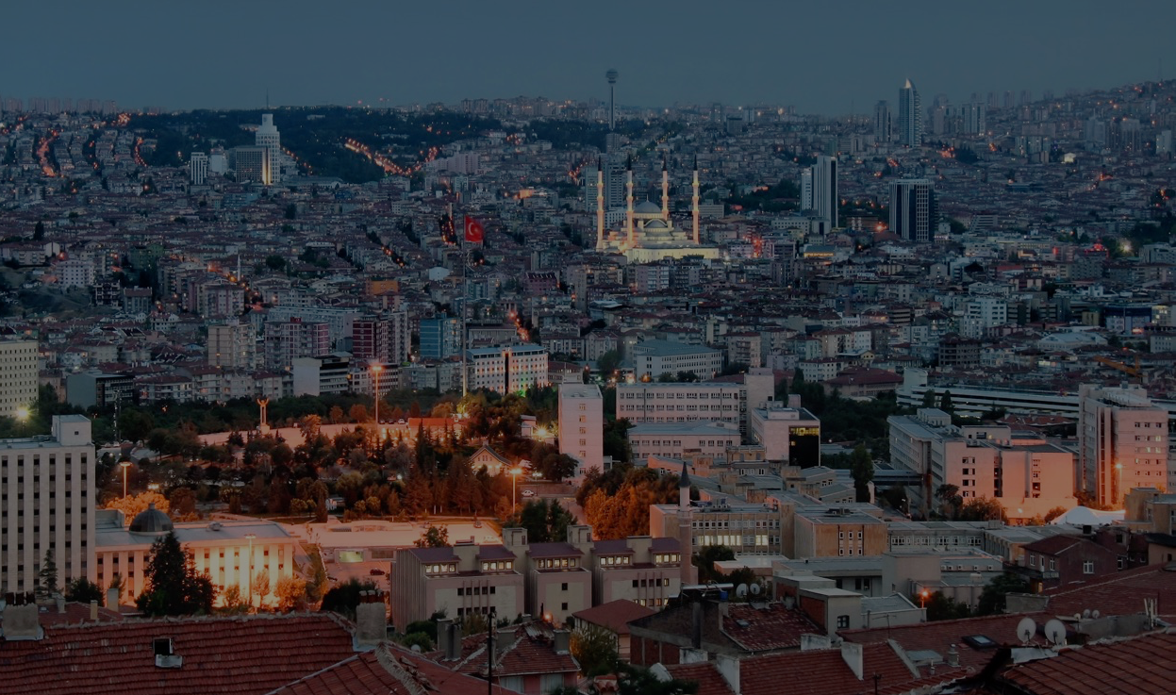
Contact:
Office Address
Turkey in Horizon 2020 Project
And Sokak 8/12 Akasya Apt. 06680 Çankaya/Ankara
06520 Çankaya/Ankara,Turkey
Tel: +90 312 467 61 40
http://www.turkeyinh2020.eu/
info@TurkeyinH2020.eu

