Slide 1





Turkey in Horizon 2020 II
The EIC Accelerator
Full Proposal Application Process
Project Writing Camp 6
September 16, 2021

Slide 2
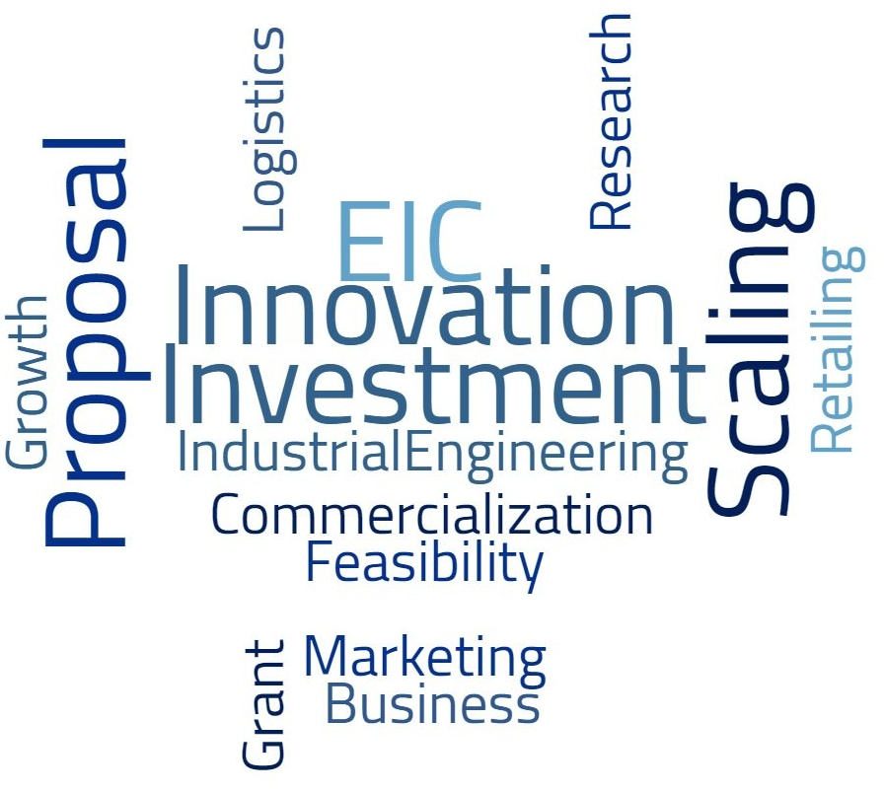
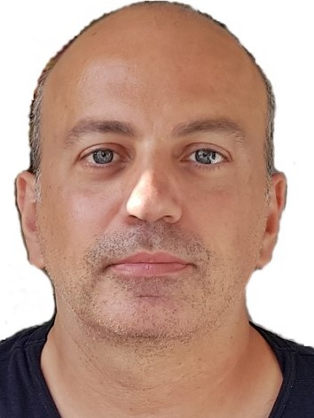
Serkan Bolat
s.bolat@idi.ie
linkedin.com/in/sbolat
serkanbolat.com
Istanbul

Slide 3

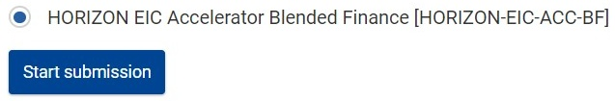
€96B
2021-2027
The European Union’s 9th R&D and Innovation Framework Program
TECHNOLOGICAL SOVEREIGNTY
EUROPEAN COMPETITIVENESS
SUSTAINABLE SOCIETY

Slide 4


EIC Accelerator
open to SMEs, individuals, and mid-caps from any field
High-risk high-growth high-impact market-creating breakthroughs
supports later stages of tech development and market deployment
up to 2,5M of grant and 15M of equity in addition to business acceleration services
3 funding types: grant-only, grant first, and blended finance
3-stage evaluation: Short Application, Full Application, Jury Interview
up-to-date program details: Accelerator Call submission: AI Platform
latest event: Full Proposal Writing for EIC Accelerator

Slide 5
EIC Accelerator Statistics and Budget
Stages | Numbers
Short applications | 2.300+
Short applications given ‘GO’ | 1.300+
Full applications (83% requested blended finance) | 801
Invited for Jury Interview | 113
Funded (TBD) | <100
Call | Jun 16 | Oct 6 | Total (€M)
Open | 300 | 300 | 600
Green Deal Innovations | 125 | 125 | 250
Strategic Digital and Health Tech | 125 | 125 | 250
Total | 550 | 550 | 1.100

Slide 6
Applications by Call, June cut-off
Open
Innovations in any field of technology / application
Strategic Digital and Health Technologies
Green Deal Innovations for Economic Recovery
Climate mitigation, clean energy, circular economy, eco-friendly food system, renovation of buildings, sustainable mobility, preserving / restoring biodiversity, zero-pollution
High-performance / Edge computing, Quantum Tech, Cybersecurity, AI, Blockchain, Cloud, IoT
Early / Point-of-care diagnostics, Cell / gene therapy, E-health, Biomarkers, Bioprocessing 4.0, Healthcare intelligence
47%
28%
25%

Slide 7

Funding Types Proposal Content
Grant First 70% of TRL 5-8 costs 30% co-financing investment if lacking own resources Chance for blended finance |  | Go2Market section can be loose Full FTO analysis and other necessary studies to prepare for TRL 9 onwards Key Milestone before 2/3 of project duration to decide project continuations
Grant Only 70% of TRL 5-8 costs | Detailed Go2Market section with TRL 9 onwards Clear differentiation of TRL 5-8 and TRL 9 activities Demonstration of the capacity to co-finance TRL 5-8 activities and to fund TRL 9 onwards | Detailed Go2Market section with TRL9 onward activities Clear differentiation of TRL 5-8 and TRL 9 activities Demonstration of the capacity to co-finance TRL 5-8 activities and to fund TRL 9 onwards
Blended Finance Grant for 70% of TRL 5-8 costs Investment for 30% co-financing and/or for TRL 9 onwards |  | Detailed Go2Market section with TRL 9 onwards Descriptions of TRL 5-8 activities if grant requested | Detailed Go2Market section with TRL 9 onwards Descriptions of TRL 5-8 activities if grant requested

Slide 8





Cost Eligibility | TRLs
TRL 5-8 ‘Innovation’ activities
Prototyping, Piloting, Validating, Demonstrating, and TRL 9 Planning
TRL 9 ‘Market Deployment’ activities
Commercialization, sales, scale-up, manufacturing, and manufacturing
Large Scale Prototype
Prototype System
Demonstration System
First of a Kind Commercial System
Full Commercial Application
Main Eligible Costs: Personnel, travel, equipment, products, services, indirect costs (25% of above)
Main Ineligible Costs: Currency exchange losses, interest, deductible VAT, excessive expenditure,…

Slide 9

Full Application
Short Application + Pitch Deck + Video 4 Evaluator Reports
Business Plan (created online) Pitch Deck
Freedom-to-Operate analysis
Data Management Plan
Financial information
Letters of Intent Annex
optional

Slide 10

Proposal Writing
EIC provides 3-day business coaching to help develop full proposal
You can revise most things from short application
Address the evaluator comments on your short application
Give equal importance on every aspect of your project
Organize your thoughts, avoid confusion and brainstorming
Consider emerging developments and competition, do not write just for today

Slide 11
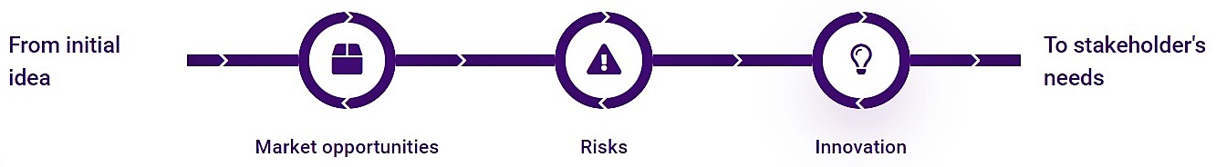
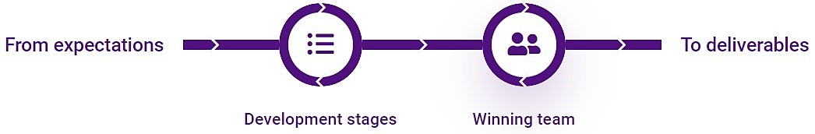





Business Planning
Ideation
Development
Know
Prepare
Enter
Scale
Impact
Go2Market

Slide 12
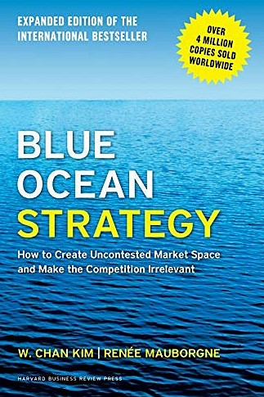
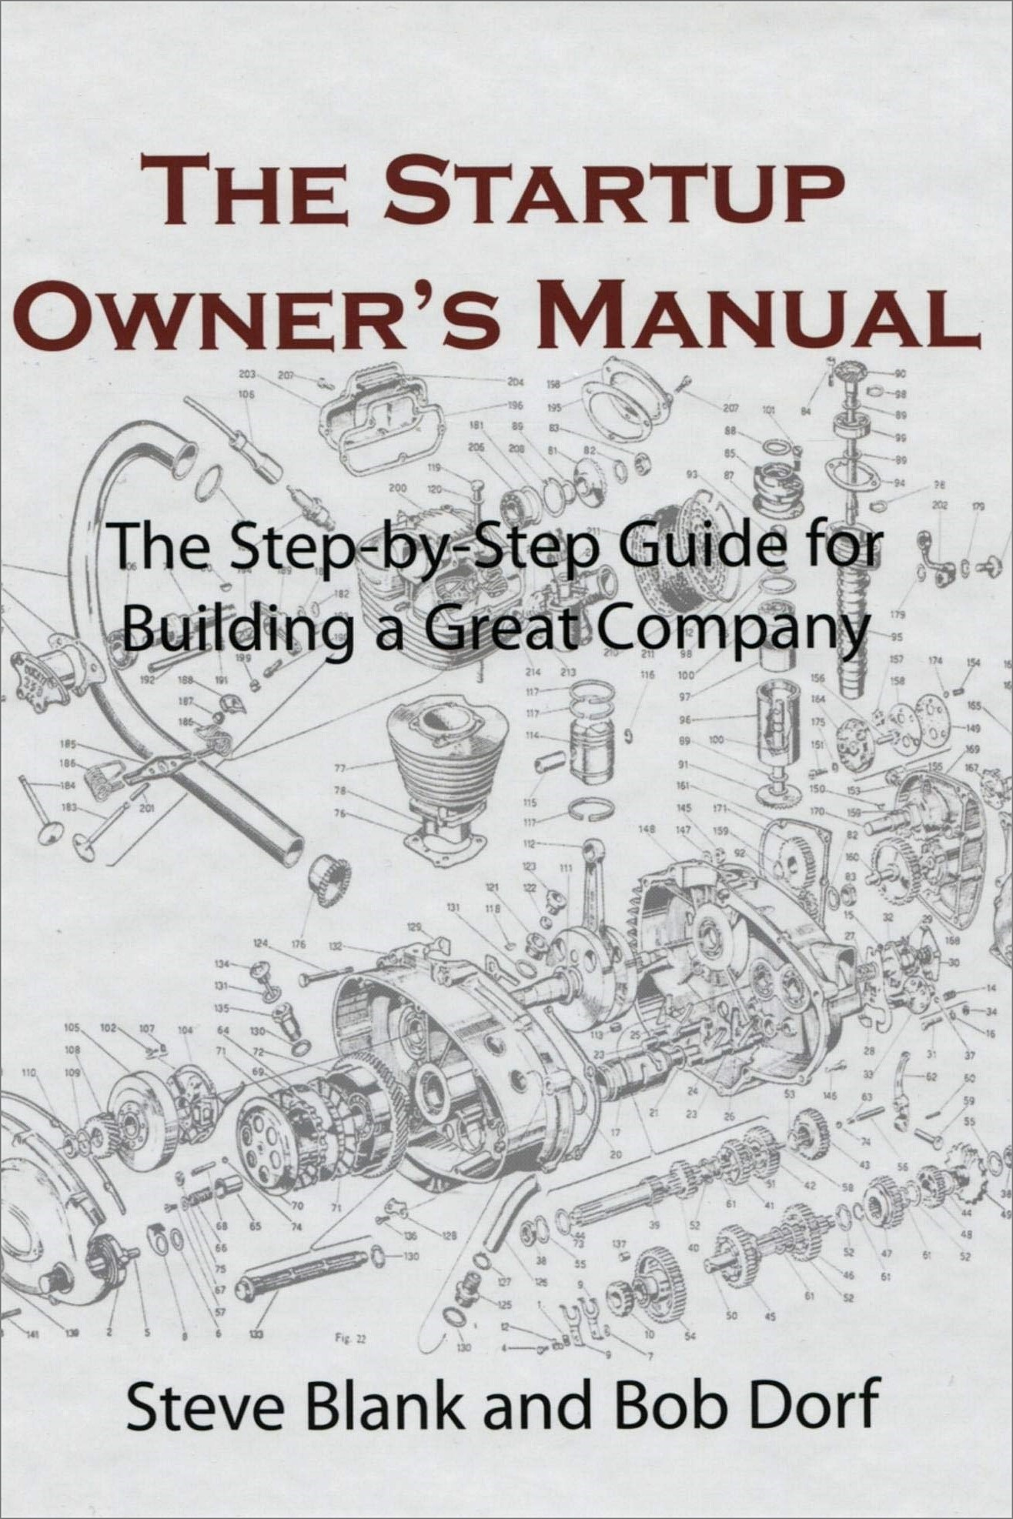

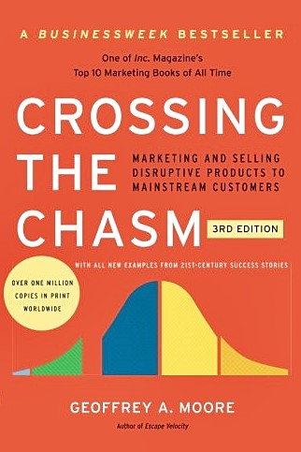

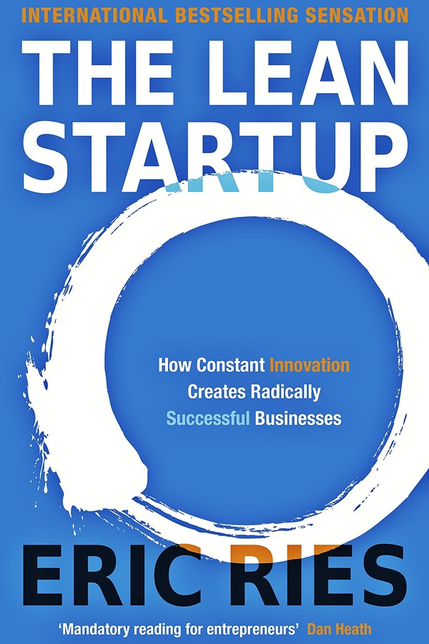
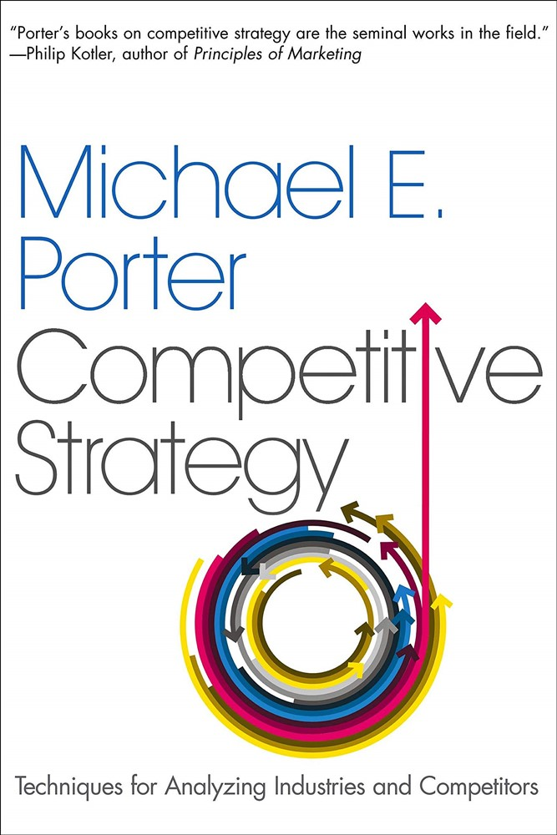
Business planning in breakthrough innovations

Slide 13
Ideation | Opportunities, Risks, Innovation
Innovativeness
USPs
Positioning
Value Proposition
Use Case 1
Feature 1
Feature 2
Use Case 2
Feature 3
Use Case 3
Feature 4
Feature 5
Pains
Gains
Risks
Work Packages

Slide 14



Development | Stages, Team
Innovation
Technology Readiness Level
1
2
3
4
5
6
7
8
9
Business Readiness Level
Market/Scale up
Work Packages
≥3 WPs for Innovation |  | ≥2 WPs for Market/Scale up
Tasks | Deliverables | Tasks | Deliverables
Milestones |  | Milestones
recruitment

Slide 15
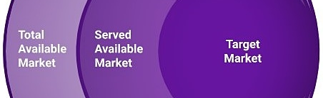
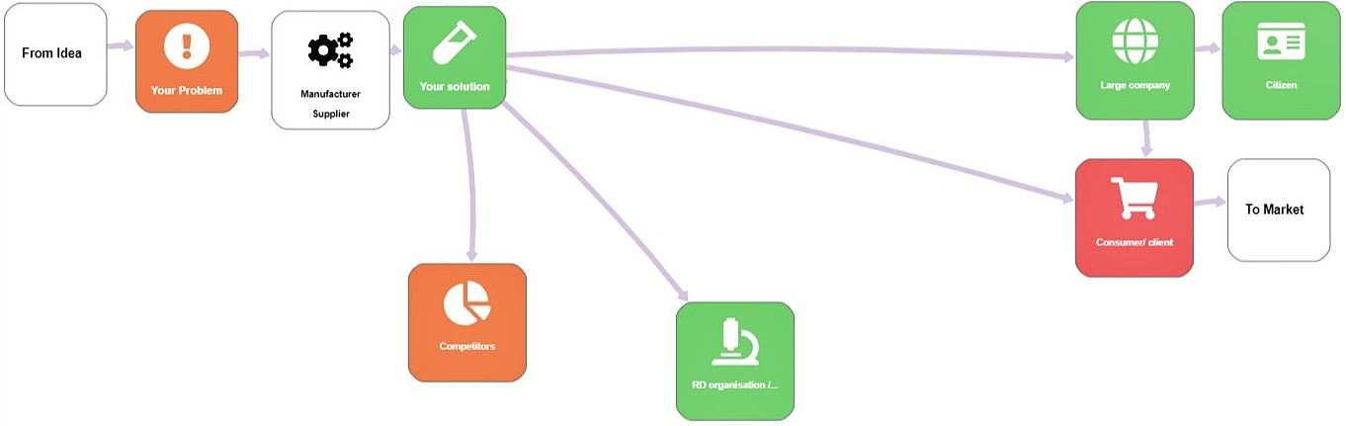
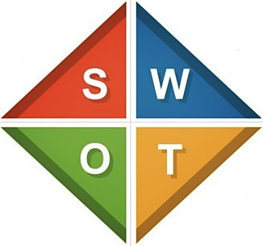
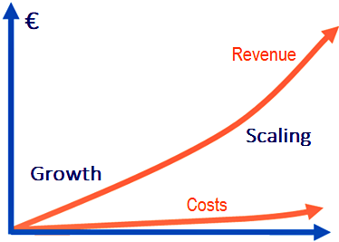
Go2Market | Know, Prepare, Enter, Scale, Impact
Business Model
Key Activities | Value Proposition |  | Customer Relationship
Resources |  |  | Channels
Costs |  | Revenues | Revenues

Slide 16
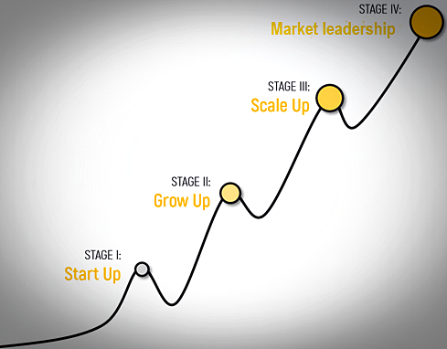
Pitch Deck
No slide limit, 10-12 slides suggestible
No pre-defined Template, .pdf only
Pitch Deck will be used in Jury Interview if invited
Summarize, visualize, and complete the information shared in the online forms; avoid repetitions

Slide 17

Freedom-to-Operate (FTO) Analysis
No pre-defined Template, .pdf only
Describe your IP (Intellectual Property)
Outline the market barriers and restrictions related to IP Rights
Conclude that you have FTO to develop and commercialize your innovation with no IP infringement

Slide 18
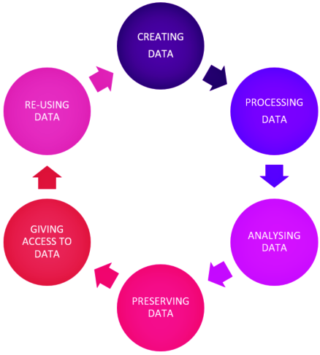
Data Management Plan (DMP)
No pre-defined Template, .pdf only
No fully developed DMP
Summarize
what data will be collected, processed and/or generated
which methodology and/or standards will be applied
how data will be shared and/or preserved during the project and beyond

Slide 19
Financial Information
P&L
Revenues
Gross Margin
Selling, General and Administrative expenses
R&D expenses
Other operational expenses
EBITDA
Interest
Other revenues/expenses (including grants)
EBT
Taxes
Net Income
BALANCE SHEET
Total assets
of which
Cash and cash equivalents
Inventory
Accounts receivable
Property and Equipment
Intangible assets
Other assets
Outstanding liabilities
of which
Accounts payable
Short-term debt
Long-term debt
Other liabilities
Equity
of which
Share capital
Retained Earnings
Other equity
Downloadable Excel Template available
Covers next 3 years
No pre-determined financial ratios or projections to meet
CASHFLOWS
Cashflows from operating activities (net)
Cashflows from investing activities (net)
Cashflows from financing activities (net)
of which
Proceeds from grants
Proceeds from issuance of debt
Repayment of debt
Proceeds from issuance of equity
Dividends
Net increase/decrease in cash and cash equivalents

Slide 20

Letters of Intent
Optional Upload
No Template, .pdf only
Letters of Intent/Support, Reference Letters, E-mails,…
From Investors, Pilot Customers, Stakeholders,…

Slide 21
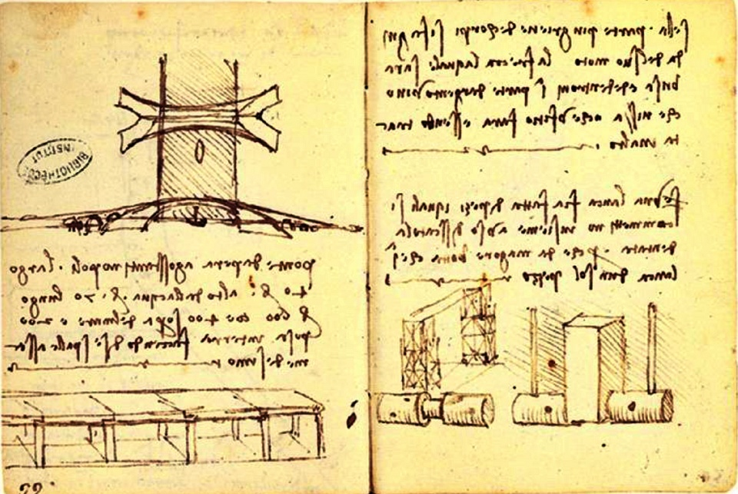
Annex
Optional Upload, max. 10 pages
No Template, .pdf only
Do not repeat the info in online forms and mandatory uploads
Employee CVs, company history, feasibility report, and a business plan are not the best choices
You may share images, graphs, tables, illustrations, or testimonials

Slide 22





Full Proposal Evaluation
3 main criteria, 3 evaluators
No scores, No ranking; only Go and No Go
9 x Go will pass to Jury Interview
Evaluation Reports accessible in 5 weeks.
Jury Interviews after 9 weeks
Proposals not evaluated comparatively but on their own merits
1 No Go failure. So, consider the diversity of evaluators when drafting your proposal

Slide 23

Full Proposal Evaluation Criteria
Excellence
Impact
Breakthrough and market-creating nature
Timing
Technological feasibility
Intellectual Property
Scale-up potential
Broader impact
Market fit & Competitor analysis
Commercialization strategy
Key partners
‘Challenge call’ criterion, if any
Level of risk, implementation, and need for Union support
Team
Milestones
Risk level of the investment
Risk mitigation

Slide 24



Full Proposal Resubmission
No redress procedure
First time rejection…
Improved proposal can be submitted to one of next 2 full application cut-offs.
Second time rejection…
No resubmission allowed for months.
Then, a new or improved proposal can be submitted as short application.

Slide 25

Closing Remarks
Your fundraising effort is key to EIC support
Design your project for full market deployment
Focus on value chain performance
Highlight Gain/Pain metrics
Best innovations + most committed teams - not best drafted proposals will win
When in doubt, listen to your heart

Slide 26
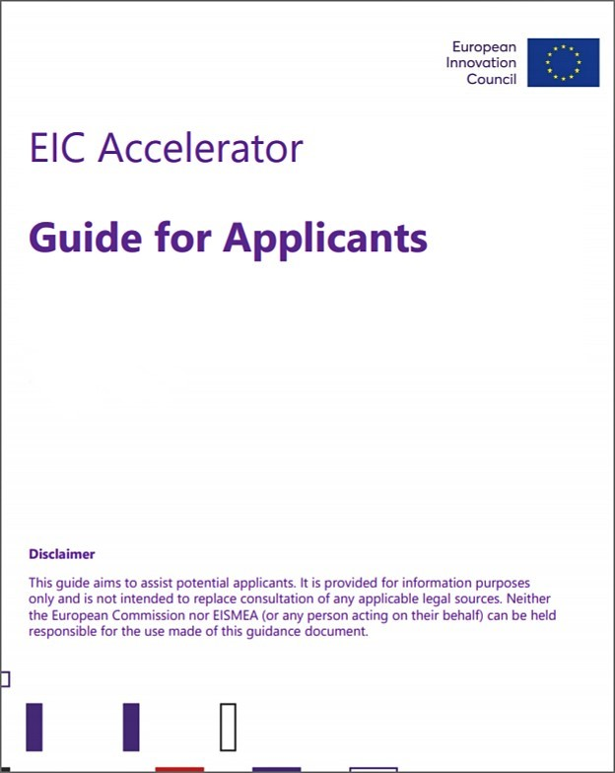
Further References
EIC Accelerator Call
EIC AI Platform
Turkey in Horizon 2020 event recordings
EIC Work Program 2021
EIC Accelerator web site
Accelerator FAQ
Guide for Applicants
EIC Applicants’ Day Presentatitons
European Green Deal
TUBITAK Horizon 2020
EIC EISMEA TUBİTAK Horizon Europe

Slide 27

If you have any questions, we are happy to help!
Turkey in Horizon 2020 Project
And Sokak 8/12 Akasya Apt. 06520 Çankaya/Ankara,Turkey
Tel: +90 312 467 61 40
http://www.turkeyinh2020.eu
info@TurkeyinH2020.eu

