Slide 1
EIC Accelerator
Project Writing Camp for SMEs (PWC-6)
Odysseas Spyroglou, KE2
Ankara, 16 Sep 2021
Photo by Christian Lue on Unsplash
Notes:
Welcome to event for IMS.
HE is ready to start. New calls are expected.
Recently the Strategic plan and WP were leaked. Not officially released. Still we decided to present.
Having said that, let me introduce myself.
My name is Odysseas Spyroglou.

Slide 2
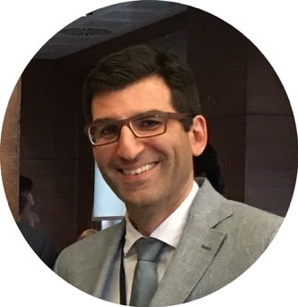
Meet the instructor
Odysseas Spyroglou
Key Expert 2. Legal, Financial & IPR
Innovation consultant with engineering, ICT and financial background.
Over 20 years of working experience in EU funded projects: preparing proposals, building consortia and managing projects under FP7, CIP, COSME, INTERREG, MED, H2020 and more.
Specialise in Project Management & Quality, Intellectual Property and reengineering business processes.
Designed and delivered more than 300 training sessions on Innovation Management, IPR, Entrepreneurship, Proposal Writing, Project Management, financial administration.
20+
Years
60+
Projects
90m+
Funds
linkedin.com/in/ospyroglou
Notes:
I am a Key Expert in TH2020 project. An EU co-funded project that supports Turkish organisation and helps them to access EU funding.
I have an academic background in Engineering, ICT and corporate finance and for the last 20 years I am dealing with research and innovation projects from different posts and positions.
2021 is a key year for the world and European Union. Not only because we hope that we will manage to finish with the covid19 pandemic but because it is new strategic and financial period for EU as well.

Slide 3
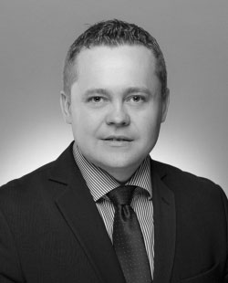
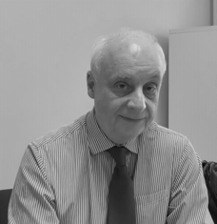
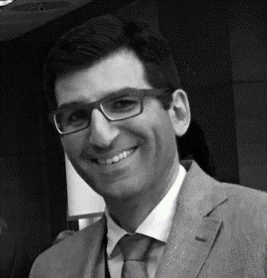
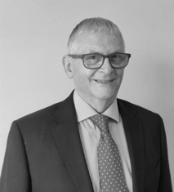
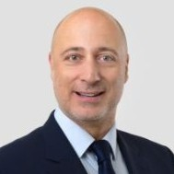
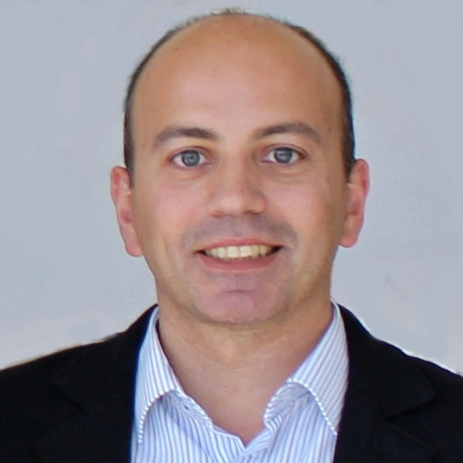
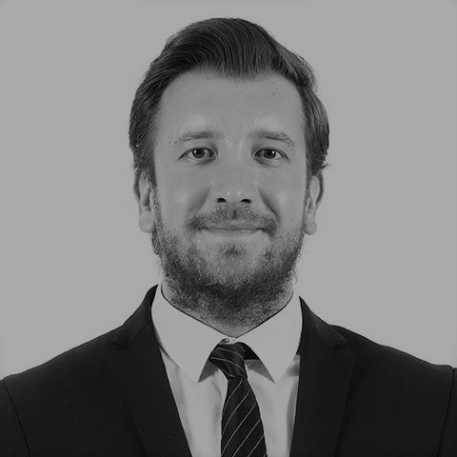
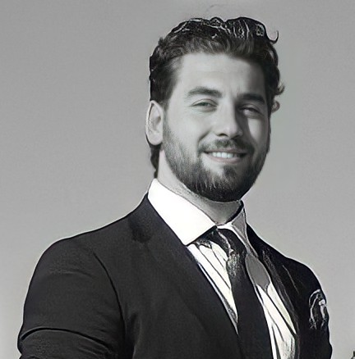
The whole Team
KONRAD NIERUBIEC
PROJECT DIRECTOR
k.nierubiec@idi.ie
DR ALEKSANDER BAKOWSKI
TEAM LEADER
a.bakowski@idi.ie
ODYSSEAS SPYROGLOU
LEGAL & FINANCIAL KEY EXPERT
o.spyroglou@idi.ie
PHILIP SOWDEN
SME KEY EXPERT
p.sowden@idi.ie
ADAMANTIOS KOUMPIS
TRAINING COORDINATOR
a.koumpis@idi.ie
SERKAN BOLAT
SME & INNOVATION EXPERT
s.bolat@idi.ie
KEMAL ONUR GÜNGÖR
DEPUTY PROJECT DIRECTOR
k.gungor@idi.ie
NURKIZ YAPICI
PROJECT COORDINATOR
n.yapici@idi.ie
ŞELALE DAĞALP, ^{PMP®}
COMMUNICATION AND VISIBILITY MANAGER
s.dagalp@idi.ie
TUĞÇE ERYILMAZ
PROJECT OFFICER
t.eryilmaz@idi.ie
UYGAR BALTACI
PROJECT ADMINISTRATOR
u.baltaci@idi.ie
ELİF BENGİ ÖZDEMİR
COMMUNICATION EXPERT (JNKE)
b.ozdemir@idi.ie
SELİN DOĞRUSÖZ
PROJECT AND EVENT ASSISTANT
s.dogrusoz@idi.ie

Slide 4
Horizon Europe and Accelerator
Our approach to helping SMEs ahead of each cut-off date
Webinar
General Advice on HE
Project Writing Training Event
Accelerator Short Application
Project Writing Training Event
Accelerator Full Application
Project Writing Camp
Dealing with final Q&As on proposals ahead of submission

Slide 5
Project activities …
Training Events
Introductory
Focus Groups
IPR
Access to Risk Finance
Webinars
Lobbying
Project Writing Camps
SME Support
1-to-1 Support
Project Writing Training
Pitching Workshop
Feasibility Reports
Investment Readiness
Networking
Brokerage Events
International Study Visits
Award Ceremonies
Conferences
Info Days
Tools
Website
Helpdesk
Training Guides

Slide 6
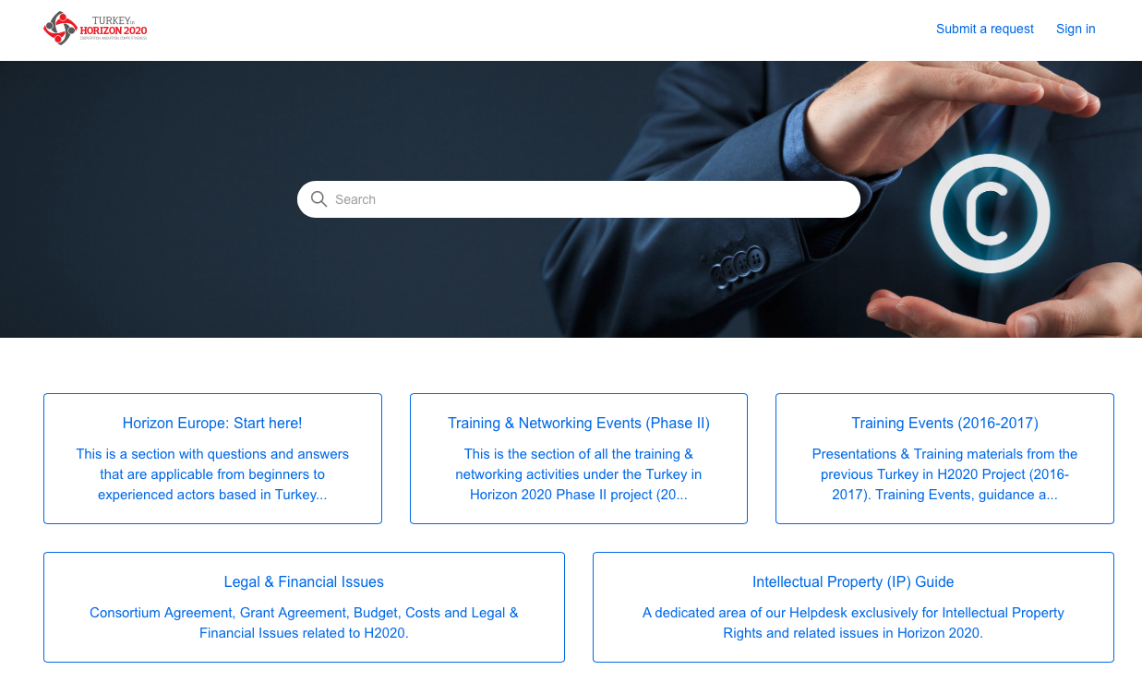
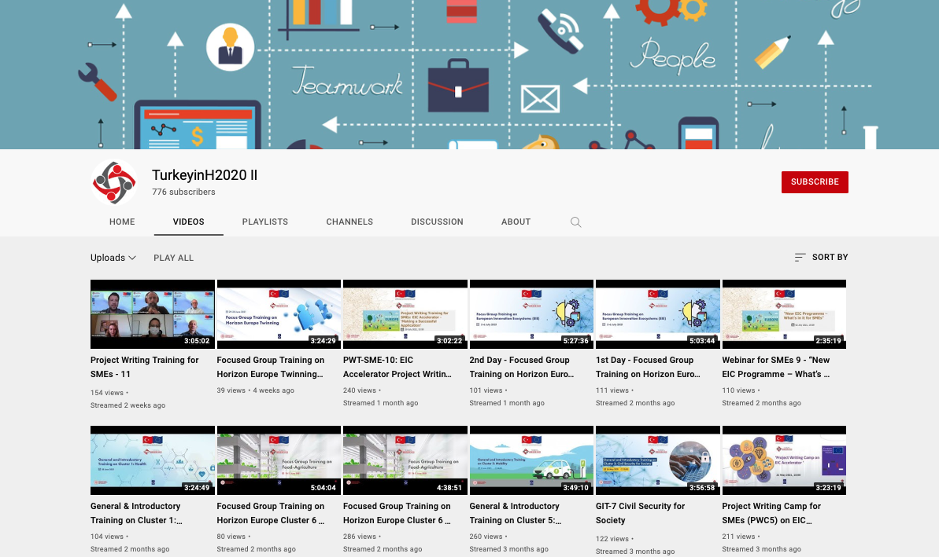
Our Online Presence
Http://helpdesk.turkeyinh2020.eu
https://www.youtube.com/c/TurkeyinH2020II/

Slide 7
What we will cover EIC Accelerator
Strategic Digital and Health Technologies
Green Deal innovations for the Economic Recovery
Next Cut-off: 6 Oct 2021
Identified areas of strategic relevance
An overview of EIC Accelerator & Horizon Europe Policies
Insights from Successful applicants
A detailed walk through of the new EIC application process
An interpretation of the proposal & its evaluation
The evaluators point of view: how to convince the jury panel

Slide 8
Strategic Digital and Health Technologies
Digital Tech
Advanced high-performance computing
Edge computing
Quantum technologies
Cybersecurity
Artificial Intelligence
Blockchain
Coud infrastructure
Internet of Things
Health Tech
AI-driven tools for early diagnosis
Point-of-care diagnostics
Cell and gene therapy approaches
Biomarkers
Bioprocessing 4.0
Healthcare intelligence services
E-health solutions
Distribution of Interviewees by Technology areas
40+% of Jury Interviewees will be selected among those targeting Digital Tech areas
40+% of Jury Interviewees will be selected among those targeting Health Tech areas
Additional Evaluation Criterion: Does the innovation have the potential to be a strategically important technology for Europe, in terms of welfare of citizens or relevance to economic development?
Proposals must describe this impact in relation to above strategic technology areas.

Slide 9
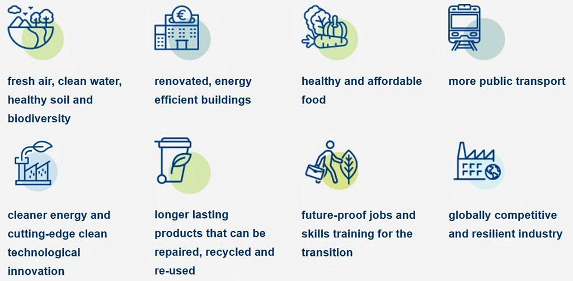
Green Deal Innovations for the Economic Recovery
Priority Areas
Renewable energy
Deep Renovation of buildings
Low carbon industries
Batteries and energy storage systems
50+% of Jury Interviewees will be selected among those targeting above priority areas
Additional Evaluation Criterion: Does the innovation have the potential to make a significant impact on at least one of the Green Deal goals?
Proposals must quantitatively describe this impact in relation to the Green Deal goals, such as reduction or avoidance of GHG emissions.

Slide 10
Vision of Europe
A sustainable, fair and prosperous future for people and planet based on European values.
Tackling climate change
(35 % budgetary target)
Helping to achieve Sustainable Development Goals
Boosting the Union's competitiveness and growth

Slide 11
Commission Priorities Where EC is going to focus the next 4 years.
European Green Deal First Climate-neutral continent, resource efficient economy
Europe fit for Digital Age Empower people with new generation of Technology
Economy that works for People Attractive investment environment, quality jobs
Stronger Europe in the World Champion multilateralism and rules-based order
Promoting European way of Life Protection of rule of law, justice, core values
New push for European Democracy Bigger say to European citizens, protect democracy
Recovery Plan for EuropeL: Next Gen EU
Photo by Christian Wiediger on Unsplash
Photo by Guillaume Périgois on Unsplash
Notes:
Start with the commission political priorities.
These are announced usually in the change of leadership, so when this new EC under VDL took office.
They do not come out from thin air. They are product of long term deliberation, discussion, agreements with all EU institutions.

Slide 12
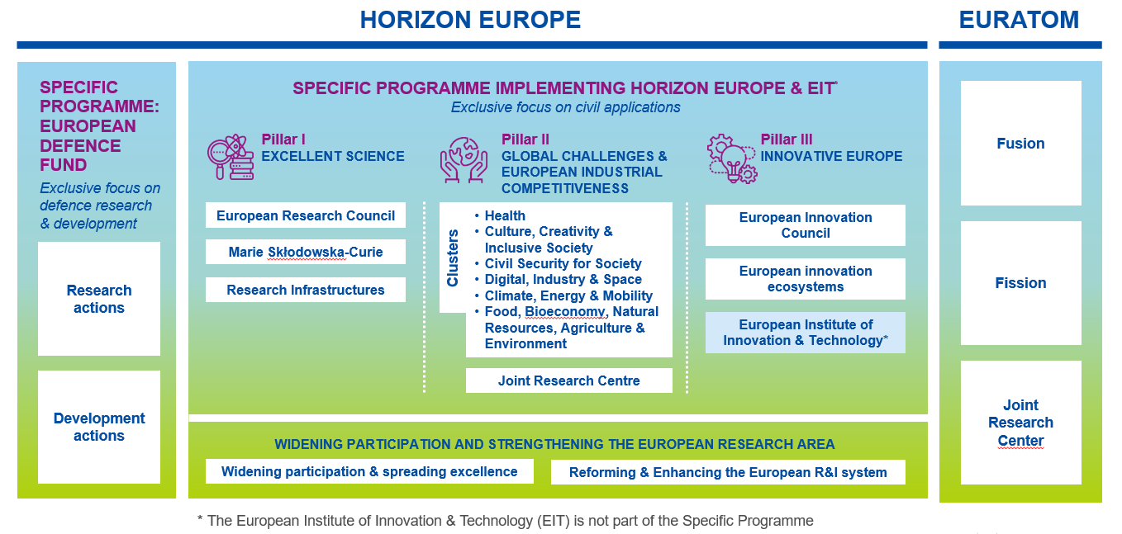
Structure of Horizon Europe How Horizon Europe is organised
Photo by Christian Wiediger on Unsplash
Notes:
HE Structure similar to H2020.
PILLAR 1: Same
PILLAR 2: Used to be Insdustrial leadership (Key technologies, Private Investments in R&I), SMEs
PILLAR 3: Societal Challenges (All thematic: health, Food, Security, Climate, Transport, etc.)

Slide 13
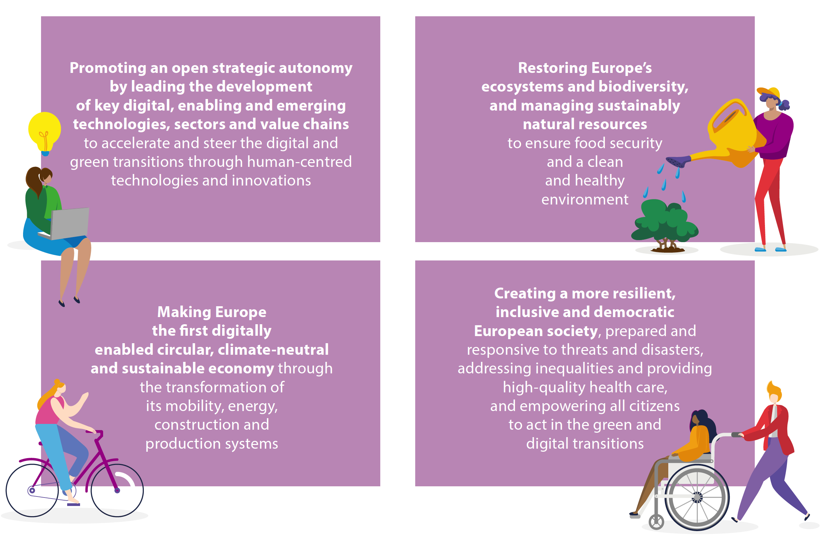
HE Key Strategic Orientations Mirroring political priorities of the EU
A // Digital Transformation
B // Environmental
Protection
C // Sustainable Development
D // Resilience & Inclusivness
Titles outside the boxes are arbitrary, perception of the speaker.
Notes:
A lot of interconnections and common goals in each of the orientations.
Digital & Green Transitions : A, D
Climate and environmental protection: all
Inequalities and health: D

Slide 14
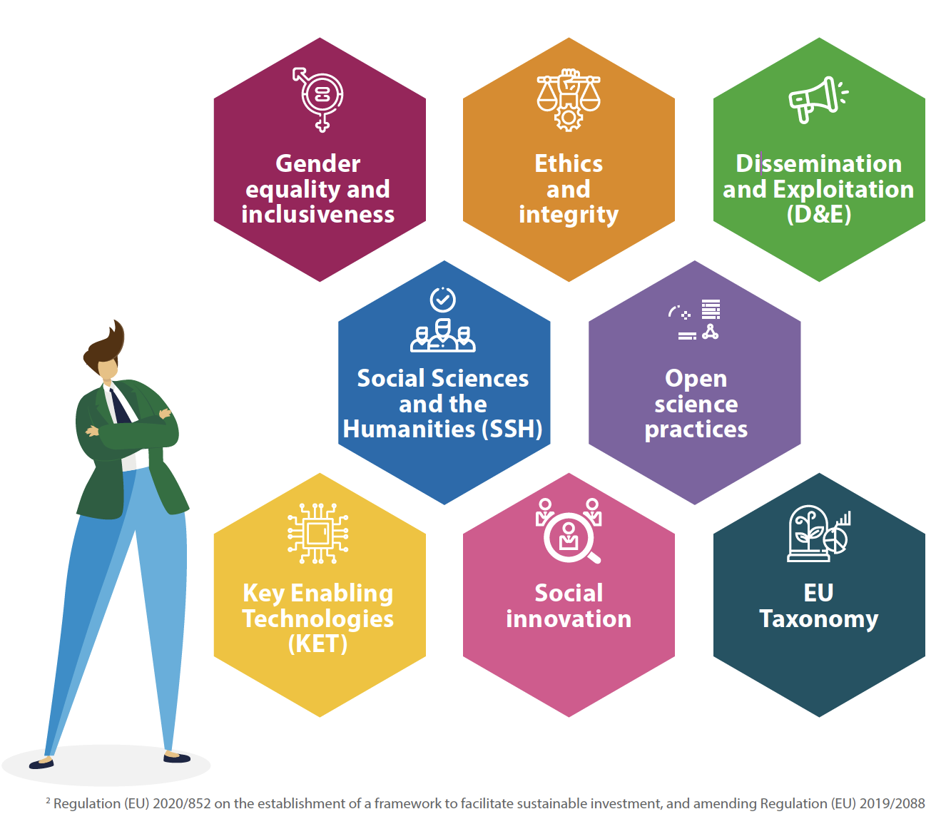
8 Horizontal Topics EU Funding Management Modes
Relevant to all programme components
Identified in Strategic Plan
Should be addressed appropriately
Photo by Christian Wiediger on Unsplash

Slide 15
EIC Main Components
EIC PATHFINDER
Funds for advanced research to develop scientific basis to underpin breakthrough technologies.
EIC TRANSITION
To validate technologies and develop business plans for specific applications.
EIC ACCELERATOR
Supports SMEs, start-ups and spin-outs to bring innovations to market and scale-up to commercial viability and funding.

Slide 16
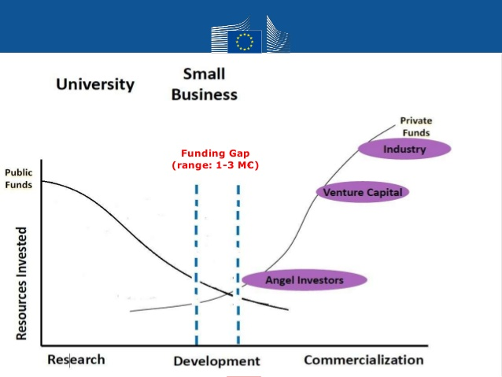
The funding gap EIC addresses

Slide 17
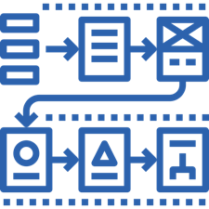
Get ready for EIC Accelerator How to prepare for HE
Study the Documents
EIC Work Programme 2021
EIC Accelerator Guide for Applicants
Learn the tools
Lean Methodology
Business Modeling
Tech Adoption Cycles
Business Plan
Data management
Financial Plan
Start building
Study the new Proposal Template
Ideation
Development
Go2Market
Prepare your concept
Submit the proposal
Photo by Christian Wiediger on Unsplash

Slide 18
Wrap it up From strategic policies to successful proposals
EU Vision
EC Priorities
SDG Goals
EIC strategic areas
EIC process
Photo by Brett Jordan on Unsplash
Notes:
Let’s wrap it up.
UP NEXT: HORIZON EUROPE

Slide 19
Q&A Time to ask your questions!

Slide 20
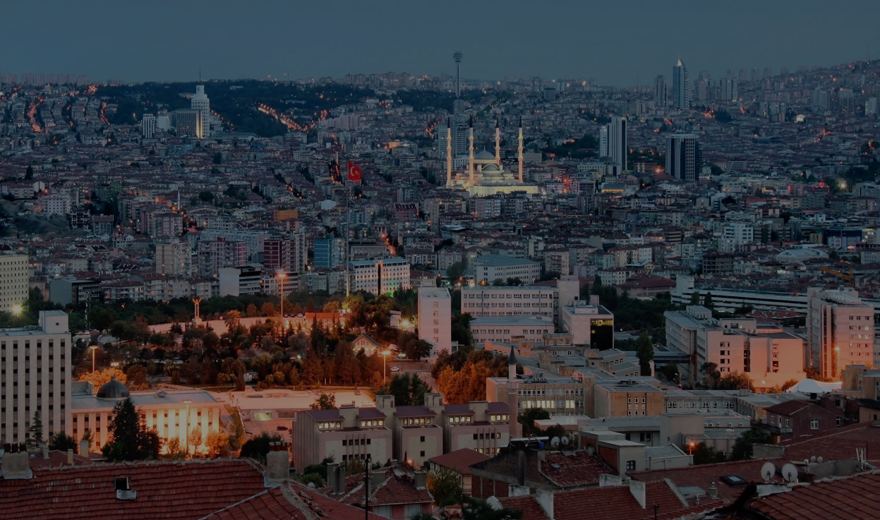
Contact:
Office Address
Turkey in Horizon 2020 Project
And Sokak 8/12 Akasya Apt. 06680 Çankaya/Ankara
06520 Çankaya/Ankara,Turkey
Tel: +90 312 467 61 40
http://www.turkeyinh2020.eu/
info@TurkeyinH2020.eu

