Slide 1
EIC Accelerator
Project Writing Camp for SMEs (PWC-6)
Odysseas Spyroglou, KE2
Ankara, 16 Sep 2021
Photo by Christian Lue on Unsplash

Slide 2
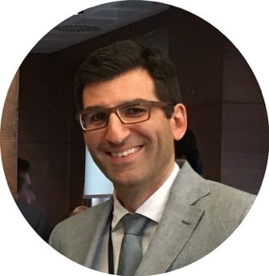
Meet the instructor
Odysseas Spyroglou
Key Expert 2. Legal, Financial & IPR
Innovation consultant with engineering, ICT and financial background.
Over 20 years of working experience in EU funded projects: preparing proposals, building consortia and managing projects under FP7, CIP, COSME, INTERREG, MED, H2020 and more.
Specialise in Project Management & Quality, Intellectual Property and reengineering business processes.
Designed and delivered more than 300 training sessions on Innovation Management, IPR, Entrepreneurship, Proposal Writing, Project Management, financial administration.
20+
Years
60+
Projects
90m+
Funds
linkedin.com/in/ospyroglou

Slide 3
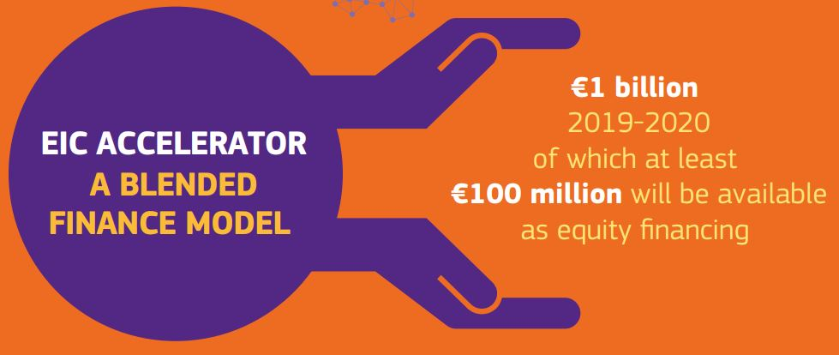
EIC Proposal Evaluation Jury Panel Interview
Application Process
Evaluation Process
Jury Panel Interviews
Experts and Roles
Scoring
Decision Process

Slide 4
EIC Proposal Evaluation Jury Panel Interview
01
02
03
04
05
STEP 1 – SHORT APPLICATION
STEP 2 – FULL APPLICATION
STEP 3 – JURY PANEL INTERVIEW
STEP 4 – INVITATION TO GRANT
STEP 5 – DUE DILLIGENCE
5 Pages Doc or 10 Slides or 3’ Video
4 Weeks Evaluation
Submitted at any time
Remote Evaluation by Experts
30 Pages Doc, Pitch Deck, Financial Annex
Full application on EIC AI based IT platform
Coaching Support
Remote Evaluation by Expderts (5-6 Weeks)
10’ Pitch
30’ Q&A
25’ Deliberations
40% of women CEOs are invited to interview
Results in 2-3 weeks
Negotiation for Grant Agreement
Work with PO
Prefinancing Payment
Compliance Checks
Due Dilligence
Syndication of co-investors
tranches of investment
objectives and milestones
Photo by Christian Wiediger on Unsplash

Slide 5
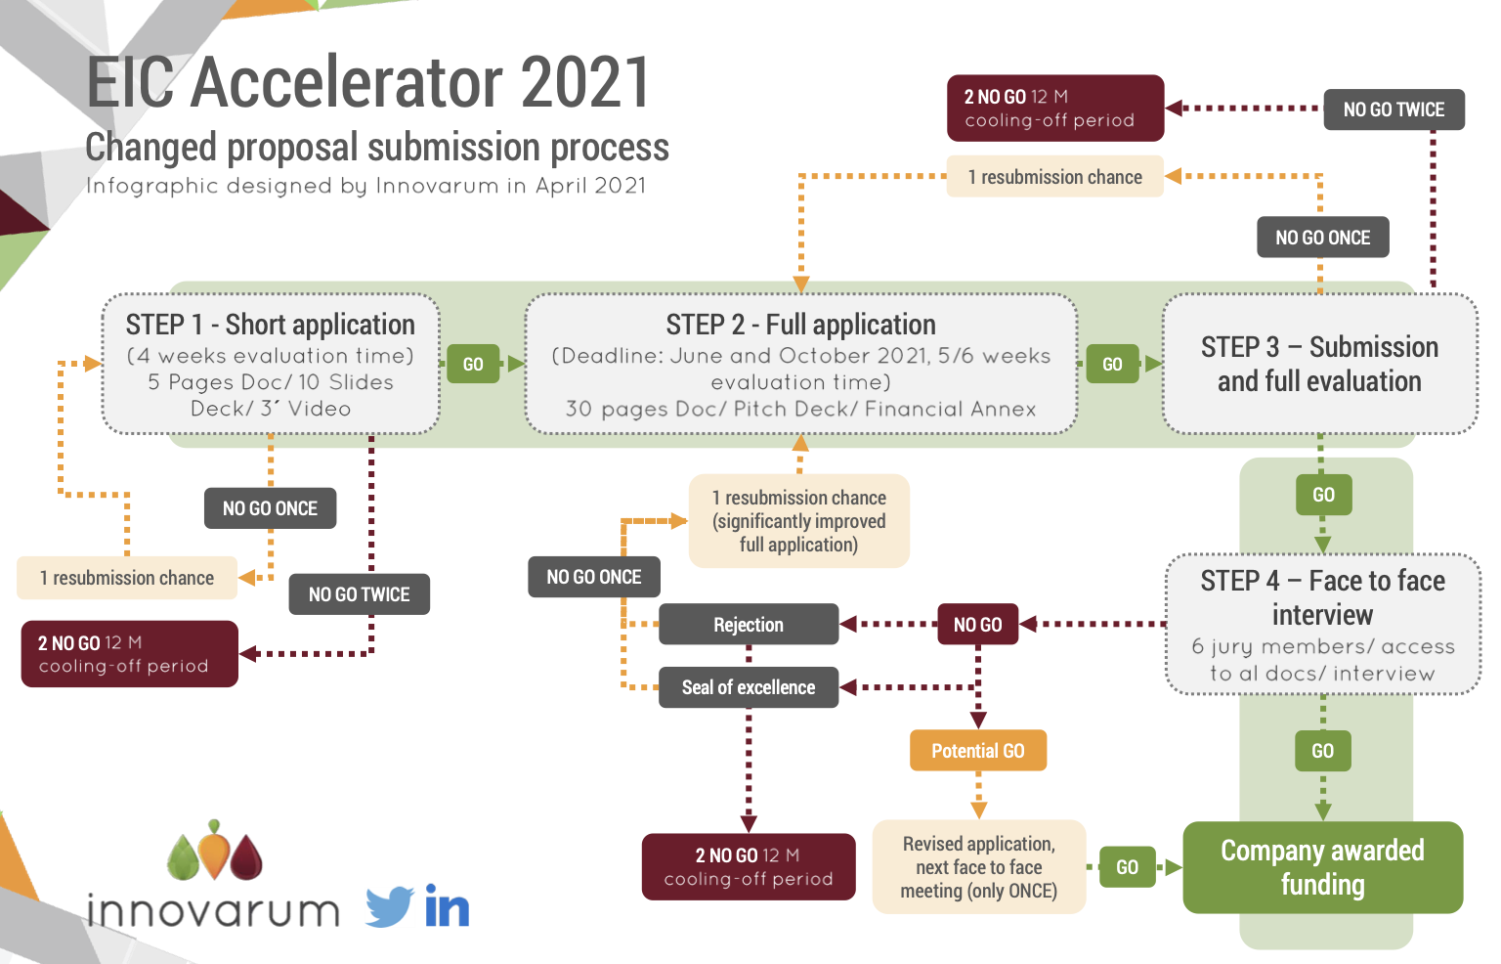
How many times? What happens with Resubmissions?
Infographic by Innovarum, 2021
Infographic by Innovarum, 2021
Designed by Innovarum, April 2021
Photo by Christian Wiediger on Unsplash
Photo by Guillaume Périgois on Unsplash

Slide 6
Jury Panel Interview What is expected?
8-9 weeks after cut-off
Brussels or Remotely (video conference)
Invitation letter 2 weeks prior
3 Members of company
6 (max) Jury Members
Moderator (EIC)
Observers (EIC Fund)
Rapporteur
Virtual Secretariat
Quality Controller
10' Pitch
30' Q&A
25' Deliberations
Photo by Christian Wiediger on Unsplash

Slide 7
Jury Panel Members Who does what?
Photo by Christian Wiediger on Unsplash

Slide 8
Pitch What we expect proposers to cover
Excellence - Innovation : Feasibility
Impact : Market Potential, Growth Performance
Implementation : Team
No preset questions for evaluators but clarifications of proposal based on specific aspects of the award criteria
Photo by Christian Wiediger on Unsplash

Slide 9
Who are the experts? Who is assessing your proposal?
Proposers: 3 Keywords during submission + AI
Allocation of proposals to evaluators by EIC AI-based IT platform maximizing affinity between proposal content and expert-evaluators profiles.
Experts: 3 Keywords, 3 sub-keywords
Identify keywords corresponding to innovation, service or product proposed as well as to the specific market or niche market targeted and to select the maximum number of main keywords and sub-keywords, you can.
Photo by Christian Wiediger on Unsplash

Slide 10
How it works Behind the curtains
Jury Panel members receive all proposal documents 2 – 4 weeks before Interview
Each Jury members usually evaluates 5 – 8 proposals
Max time spent per proposal: 4 hours
Every proposal has a briefer. Briefer presents the proposal to the rest of the reviewers.
Photo by Christian Wiediger on Unsplash

Slide 11
Jury Panel evaluation What Jurors study
Jury members read all documents
Especially Financial Plan
Can see evaluation results from Step 1
Can see all the annexes submitted in both short and full application
Dig deep into the feasibility of the proposal
Photo by Christian Wiediger on Unsplash
Notes:
The European Commission Joint Research Centre (JRC), international European research organisations and legal entities created under EU law are deemed to be established in a Member State other than the ones in which the other legal entities participating in the action are established.
Applications for Training and mobility actions and for Programme co-fund actions may be submitted by one or more legal entities, provided that one of those legal entities is established in a Member State or an Associated Country.
Applications for Coordination and support actions may be submitted by one or more legal entities, which may be established in a Member State, Associated Country, or in exceptional cases and if provided for in the specific call conditions, in another third country.
Applications for Pre-commercial procurement actions and Public procurement of innovative solutions actions must include as beneficiaries a ‘buyers’ group’ consisting of a minimum of two independent legal entities that are public procurers¹³, each established in a different Member State or Associated Country and with at least one of them established in a Member State.

Slide 12
Jury Panel Interview Where we focus the most
Quality and effectiveness of business model & revenue model (from full application & Financial Plan)
How innovation will impact company’s financials (PL, turnover) and efficiency.
Feasibility: Technological, practical, economic
Scalability of the model (if relevant)
Appropriateness of the Team: Achievements, experience, strengths/weaknesses, roles.
Appropriateness of company ownership and capital structure
Potential investor/ customer support (LoI)
Photo by Christian Wiediger on Unsplash

Slide 13
Jury Panel Interview II What questions do we ask?
Questions are open. Jurors can ask anything they like.
Typical Questions (not particular order):
What’s your biggest competitive advantage over your competitors (or a specific competitor?)
Who are the private investors you mention? How much money have they invested?
What is the purpose of the Patents since SW is not patented in EU?
What’s your common/Sharing IP strategy and commercialisation plan?
It seems that founders are well positions to find investors. Why do they need the fund?
Risk list seem a bit weak. Are these the only risks?
What’s your detailed pricing strategy of your product?
How long does it take to customise your solution to a particular client ?
Your company profile seems generic, why did you chose this sector/solution?
You mention a distribution agreement with X (Major Company)? What are your expectations? What are the goals? What was your selling point to them?
How consortium partnership will affects future growth of the your companies and expansion.
Post project exploitation strategy between 2 companies not clear
How did you come up with this valuation of your company?
You mention that the price you suggest is tested. Where?

Slide 14
Jury Panel Interview III What answers we appreciate?
Truthful.
Short and to the point.
Precise. With numbers if appropriate. With as many details as appropriate.
Direct. Do not try to avoid the subject.
Well prepared between the members of the team. (Good distribution of roles).
Good English. (Nobody likes to repeat questions)
Relaxed and confident.

Slide 15
Jury Panel Interview IV Be prepared
Study and rehearse your pitch with partners and advisors.
Relax and don’t be nervous.
Be careful of your body language (difficult online).
Make sure roles and responsibilities in your team are clear.
Challenge your assumptions (again and again).
Make a list of possible questions that may arise and work the answers.
Measure your time (don’t exceed the limits).
In online interviews experts may have their cameras turned. Try to understand their attitude by their voice.
Photo by Christian Wiediger on Unsplash

Slide 16
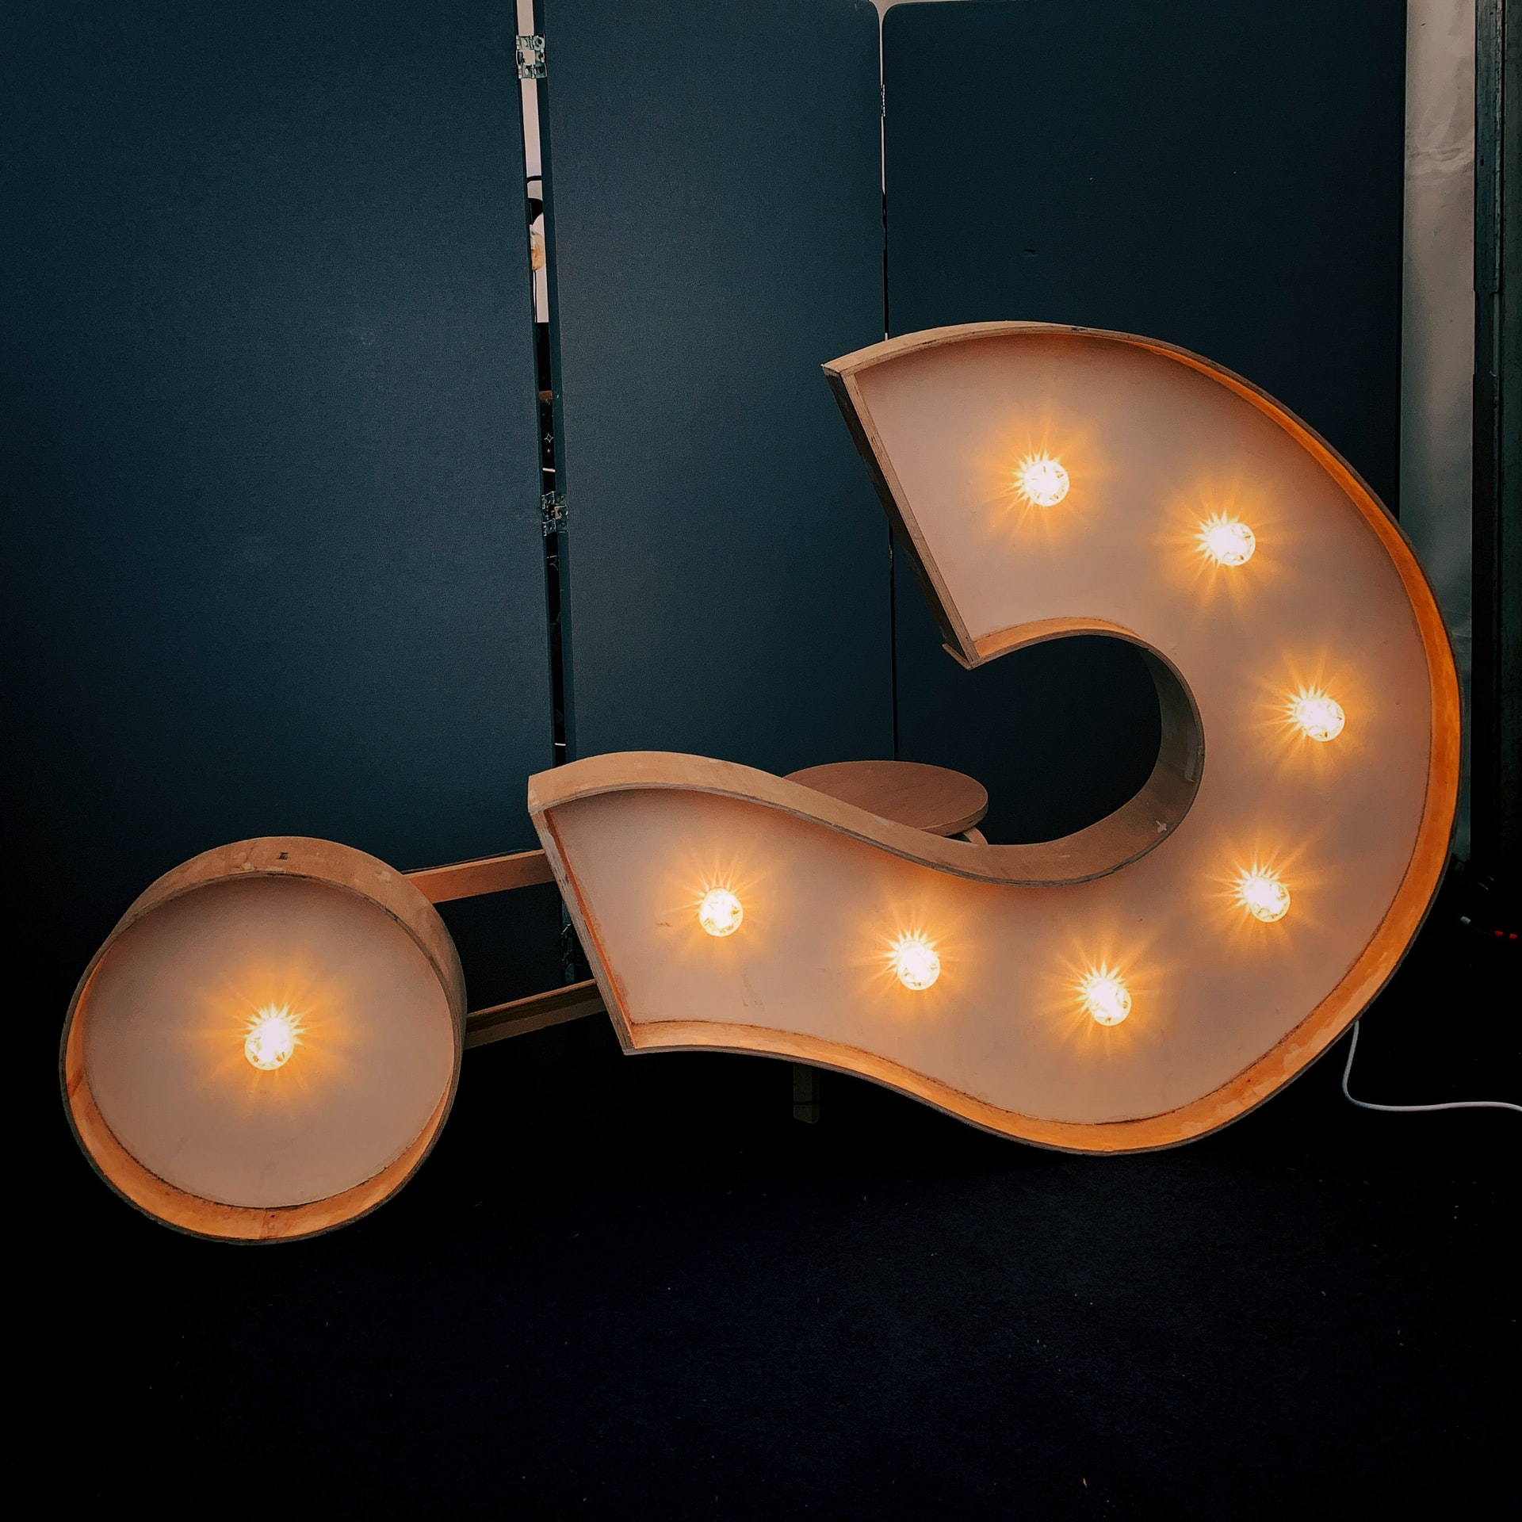
Q&A Time to ask your questions!

Slide 17
Teşekkür ederim!
Thank you!

Slide 18
Contact:
Office Address
Turkey in Horizon 2020 Project
And Sokak 8/12 Akasya Apt. 06680 Çankaya/Ankara
06520 Çankaya/Ankara,Turkey
Tel: +90 312 467 61 40
http://www.turkeyinh2020.eu/
info@TurkeyinH2020.eu

