Slide 1
Horizon Europe & EIC Accelerator
Project Writing Camp for SMEs (PWC6)
Adamantios Koumpis
Ankara, 16 September 2021
Photo by Christian Lue on Unsplash

Slide 2
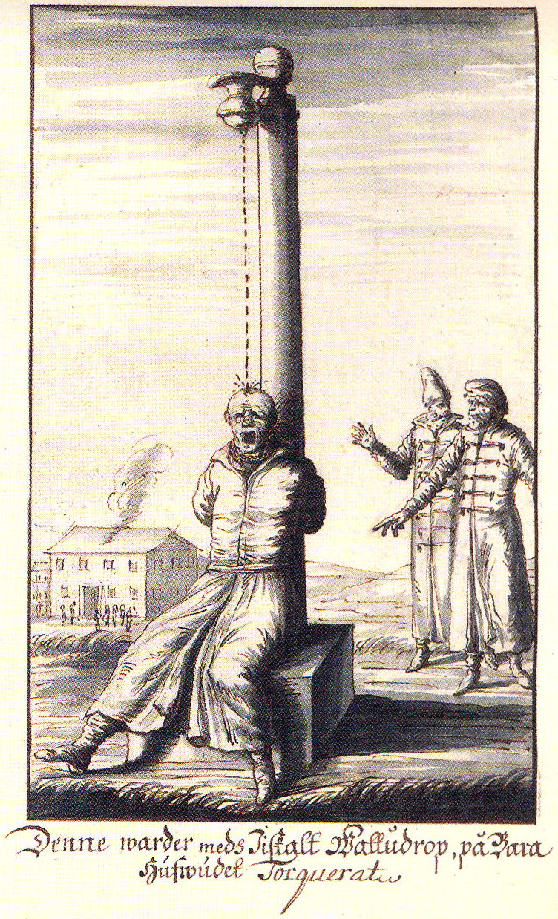
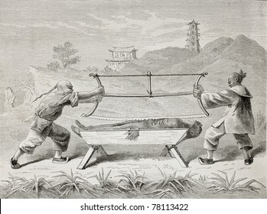
Topics to cover:
EIC Accelerator First Stage
EIC Accelerator Second Stage

Slide 3
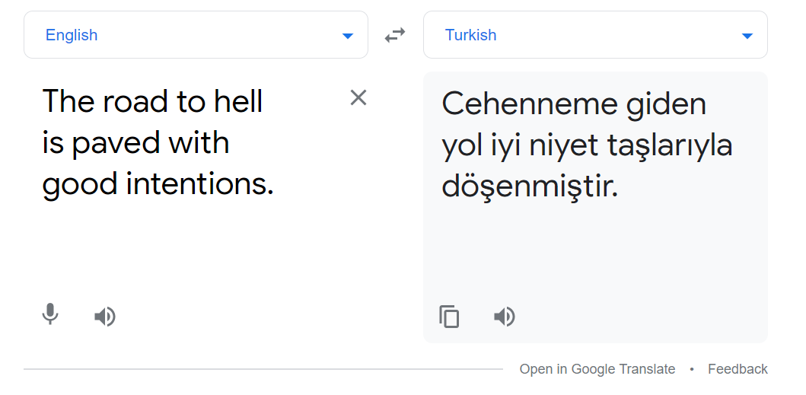
All in all…
The road to hell is paved with good intentions…

Slide 4
What we aim to do today…
It is a proposal writing camp – not some ‘Info Day’
We have to not stay in PowerPoint presentations but take a hands-on approach
Share experiences amongst us and learn from each other
We all (both the panel and the participants) have accumulated experiences and stories to share – let’s do it!
Learning by doing (‘hands-on’) vs learning from being taught

Slide 5
Who did it…

Slide 6
Lets collect some statistics…
Who has no experience?
Who has experience with H2020 SME Phase 1 and Phase 2?
Who has already some EIC Accelerator experience?
OK, then:
With First Stage?
With Second Stage?
Who heads for submission by October 6th?

Slide 7
For follow-up questions contact me at:
adamantios.koumpis@gmail.com

Slide 8
Q&A Time to ask your questions!

Slide 9
Teşekkür ederim!
Thank you!

Slide 10
Contact:
Office Address
Turkey in Horizon 2020 Project
And Sokak 8/12 Akasya Apt. 06680 Çankaya/Ankara
06520 Çankaya/Ankara,Turkey
Tel: +90 312 467 61 40
http://www.turkeyinh2020.eu/
info@TurkeyinH2020.eu

