Slide 1






EIC Accelerator Overview & Turkey in H2020/HE Project
PWC-7
Odysseas Spyroglou, KE2
Photo by Christian Lue on Unsplash

Slide 2
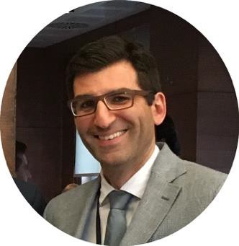

Meet the instructor
Odysseas Spyroglou
Team Leader / Key Expert 2. Legal, Financial & IPR
Innovation consultant with engineering, ICT and financial
background.
Over 20 years of working experience in EU funded projects: preparing proposals, building consortia and managing projects under FP7, CIP, COSME, INTERREG, MED, H2020 and more.
Specialise in Project Management & Quality, Intellectual Property and reengineering business processes.
Designed and delivered more than 300 training sessions on Innovation Management, IPR, Entrepreneurship, Proposal Writing, Project Management, financial administration.
20+
Years
60+
Projects
90m+
Funds
linkedin.com/in/ospyroglou

Slide 3
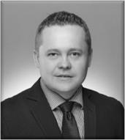
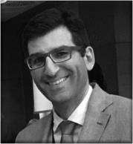
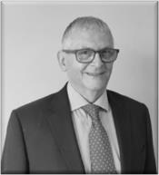

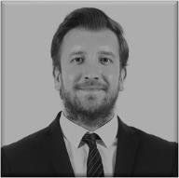







Our International Team of Experts
KONRAD NIERUBIEC
PROJECT DIRECTOR
k.nierubiec@idi.ie
ODYSSEAS SPYROGLOU
LEGAL & FINANCIAL EXPERT (TEAM
LEADER)
o.spyroglou@idi.ie
PHILIP SOWDEN
SME EXPERT
p.sowden@idi.i e
ADAMANTIOS KOUMPIS
TRAINING COORDINATOR
a.koumpis@idi.ie
ONUR KEMAL GÜNGÖR
NETWORKING EXPERT
k.gungor@idi.ie
NURKIZ YAPICI
PROJECT COORDINATOR
n.yapici@idi.ie
ŞELALE DAĞALP, ^{PMP®}
COMMUNICATION AND VISIBILITY MANAGER
s.dagalp@idi.ie
BAŞAK BOZKURT
PROJECT OFFICER
b.bozkurt@idi.ie
TUĞÇE ERYILMAZ
PROJECT OFFICER
t.eryilmaz@idi.ie
SELİN DOĞRUSÖZ
PROJECT AND EVENT ASSISTANT
s.dogrusoz@idi.ie
UYGAR BALTACI
PROJECT ADMINISTRATOR
u.baltaci@idi.ie
ELİF BENGİ ÖZDEMİR
COMMUNICATION EXPERT
b.ozdemir@idi.ie

Slide 4
Horizon Europe and Accelerator
Our approach to helping SMEs ahead of each cut-off date
Webinar
  General Advice on HE EIC Accelerator
Project Writing Training Event
  Accelerator Short Application
Project Writing Training Event
  Accelerator Full Application
Project Writing Camp
  Dealing with final Q&As on proposals ahead of submission

Slide 5





































Project activities …
Training Events SME Support
Introductory
Focus Groups
IPR
Access to Risk Finance
Webinars
Lobbying
Project Writing Camps
1-to-1 Support
Project Writing Training
Pitching Workshop
Feasibility Reports
Investment Readiness
Networking
Tools
Brokerage Events
International Study
Visits
Award Ceremonies
Conferences
Info Days
Website
Helpdesk
Training Guides

Slide 6
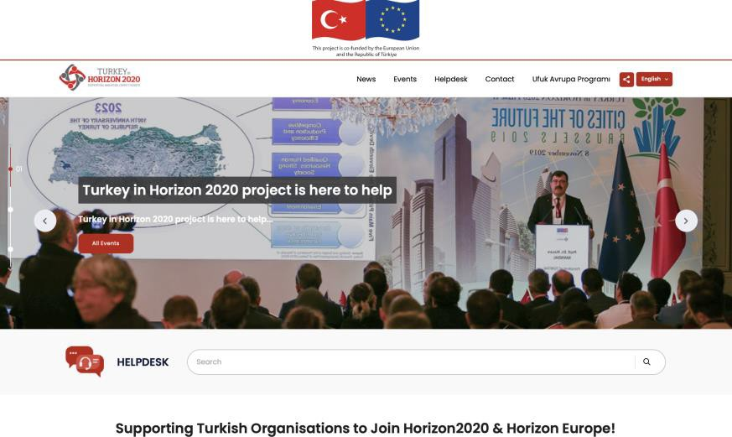
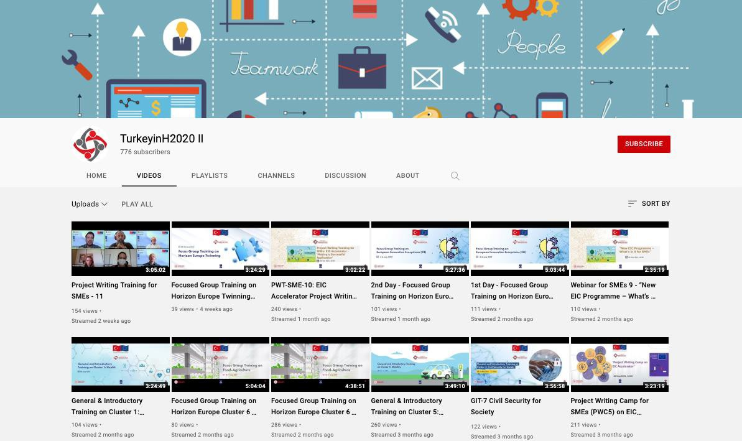
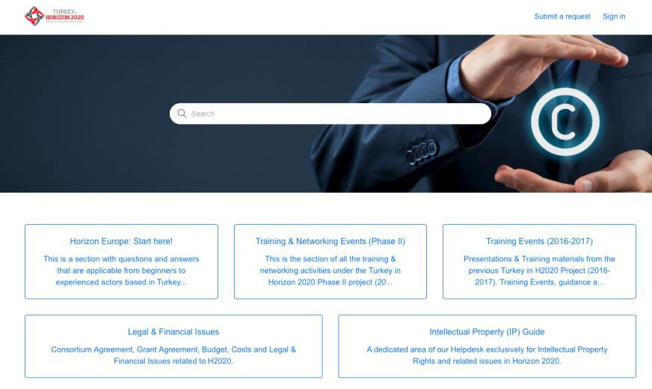
Our Online Presence
https://ufukavrupa.org.tr/en/th2020II
Http://helpdesk.turkeyinh2020.eu
https://www.youtube.com/c/TurkeyinH2020II/

Slide 7

What we will cover
EIC Accelerator
EIC Accelerator Challenges
Technologies for Open Strategic
Autonomy
Technologies for ‘Fit for 55’
Next Cut-off: 23 March, 15 June and 5 October
Identified areas of strategic relevance
  An overview of EIC Accelerator & Horizon Europe Policies
  EIC Work Plan for 2022
  Changes from previous year
  Opportunities & implications for Turkish SMEs

Slide 8
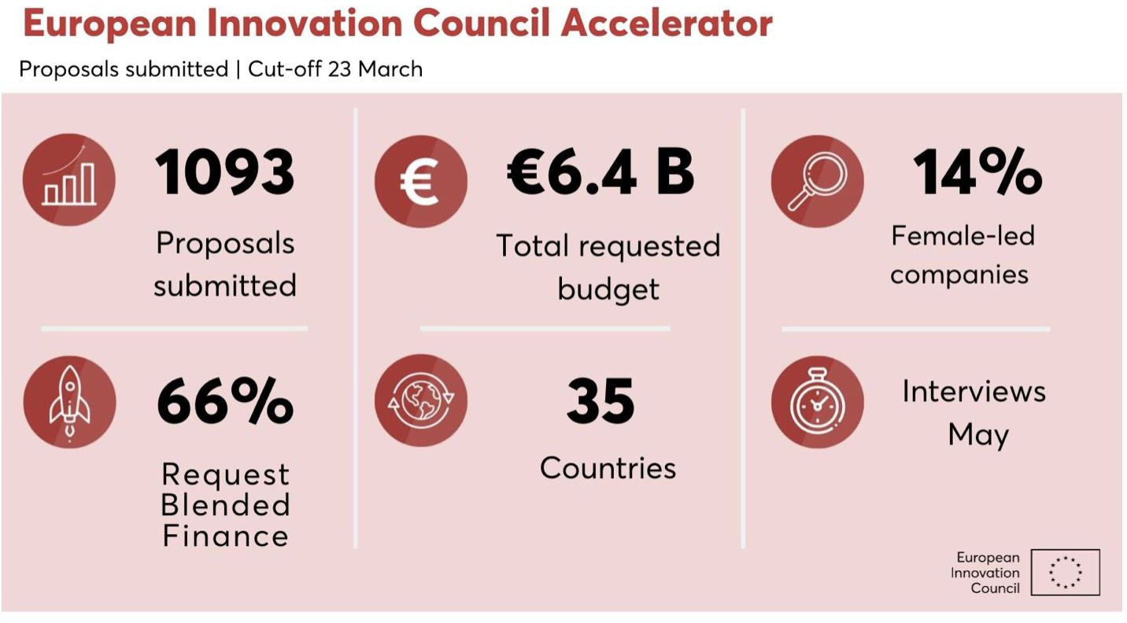
Some numbers
Last cut off

Slide 9


Vision of Europe
A sustainable, fair and prosperous future for people and planet based on European values.
Tackling climate change
(35 % budgetary target)
Helping to achieve Sustainable Development Goals
Boosting the Union's competitiveness and growth

Slide 10

Commission Priorities
Where EC is going to focus the next 4 years.
European
Green Deal
Stronger Europe
in the World
First Climate-neutral continent, resource efficient economy
Champion multilateralism and rules-based order
Promoting
European way of Life
Europe fit for
Digital
Age
Protection of rule of law, justice, core values
Empower people with new generation of
Technology
New push for
European Democracy
Bigger say to European citizens, protect democracy
Economy
that works for People
Attractive investment environment, quality jobs
Recovery Plan for Europe: Next Gen EU

Slide 11
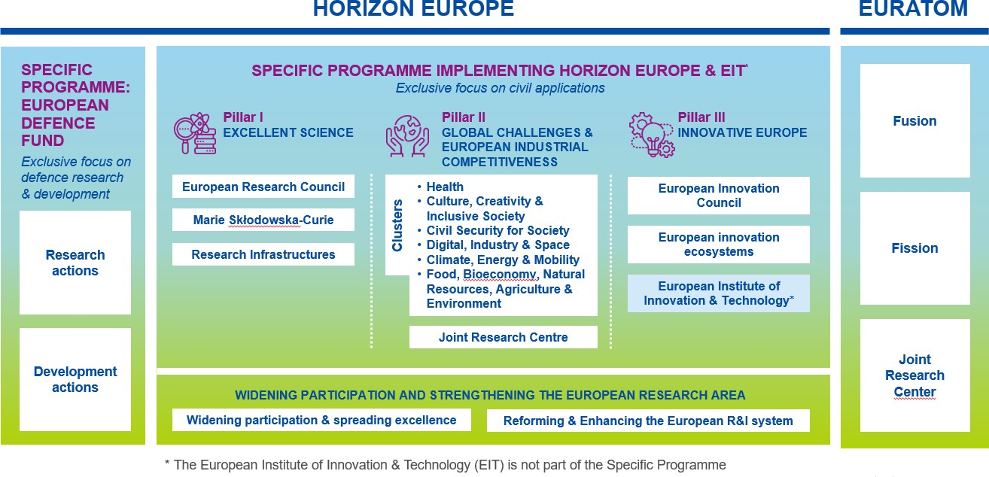
Structure of Horizon Europe
How Horizon Europe is organised

Slide 12
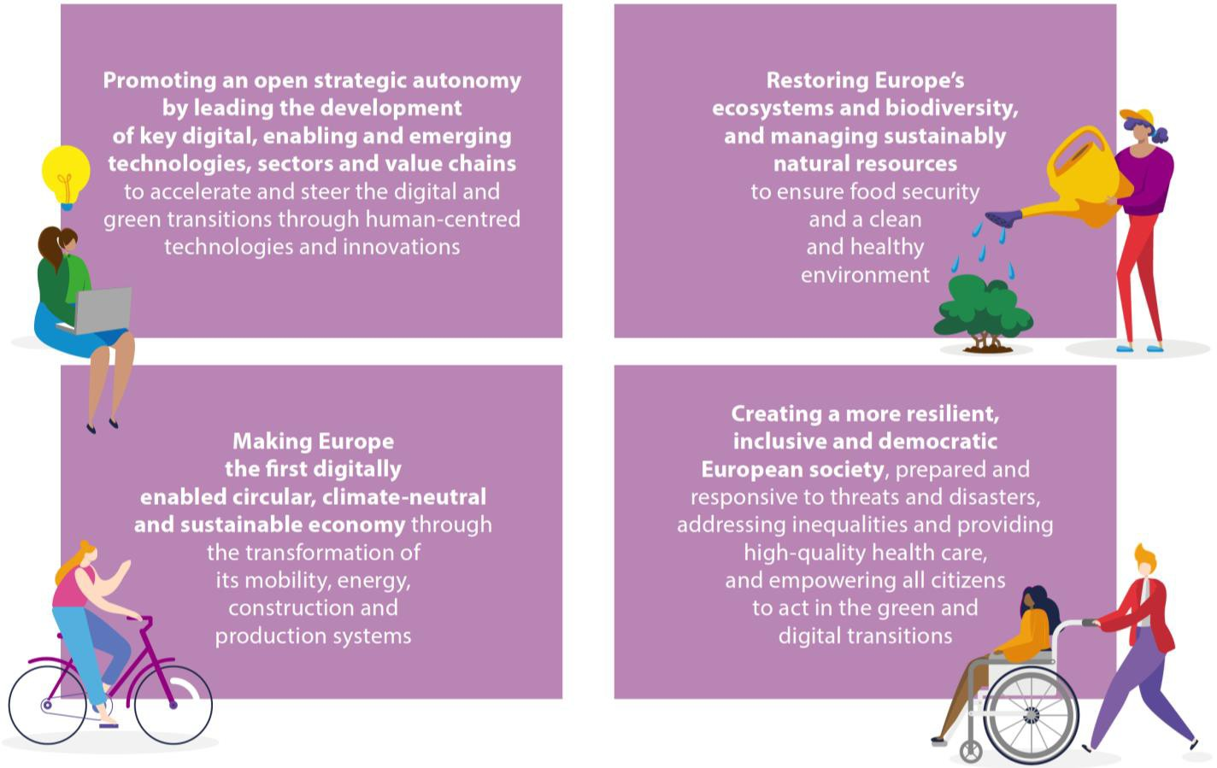
HE Key Strategic Orientations
Mirroring political priorities of the EU
A // Digital Transformation
B // Environmental
Protection
C // Sustainable
Development
D // Resilience &
Inclusivness
Titles outside the boxes are arbitrary, perception of the speaker.

Slide 13
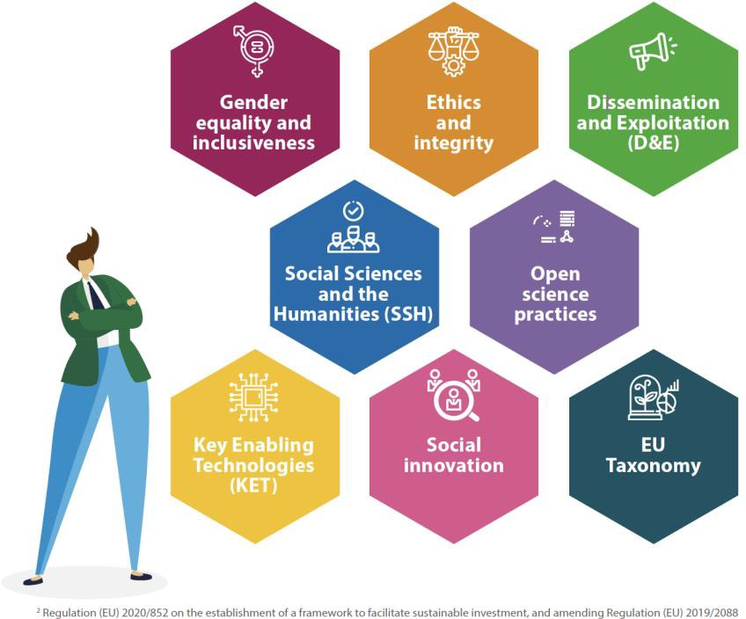
8 Horizontal Topics
EU Funding Management Modes
Relevant to all
programme components
Identified in Strategic Plan
Should be addressed appropriately

Slide 14


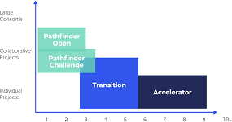
EIC Main Components
EIC PATHFINDER
multi-disciplinary research teams, undertake visionary research with the potential to lead to technology breakthroughs. [350 million €]
EIC TRANSITION
funding to turn research results into innovation opportunities, worth
€131 million. [131 million €]
EIC ACCELERATOR
start-ups and SMEs to develop and scale up high impact innovations with the potential to create new markets or disrupt existing ones. [1.61 billion €]

Slide 15
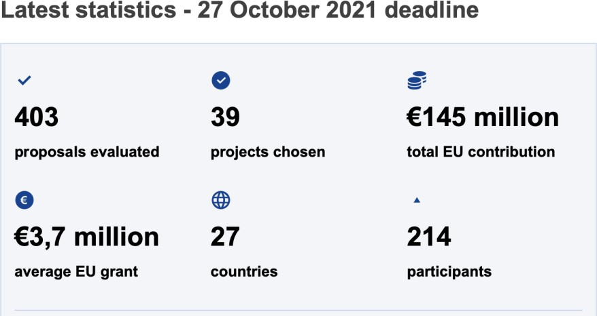
EIC Pathfinder Challenges
Carbon dioxide and nitrogen management and valorisation
Mid to long term and systems
integrated energy storage
Cardiogenomics
Towards the Healthcare Continuum: technologies to support a radical shift from episodic to continuous healthcare
DNA-based digital data storage
Alternative approaches to Quantum Information Processing, Communication, and Sensing

Slide 16

EIC Transition Challenges
Green digital devices for the future
Process and system integration of clean energy technologies
RNA-based therapies and diagnostics for complex or rare genetic diseases

Slide 17
EIC Accelerator Challenges
Technologies for Open Strategic Autonomy
  Components, technologies and systems for the pharmaceutical industry;
  Strategic healthcare technologies (cell and gene therapies, (RNA) based therapies)
  Sustainable and innovative approaches, critical raw materials (CRM)
  New applications of quantum technologies
  Edge computing applications
  Innovative applications making use of data and signals from EU space infrastructures
  Development of space technologies
  Critical security technologies for secure communication, data security and protection of borders
  Technologies for innovative financial and payment infrastructures and services
Technologies for ‘Fit for 55’
  Higher clean energy conversion and use
  Decarbonisation of hard-to-abate industries
  Energy efficiency and safety in the built environment
  Zero emission mobility solutions
  Climate neutrality in the land use
  Water, gas and indoor air management/monitoring systems
  Green digital technologies

Slide 18
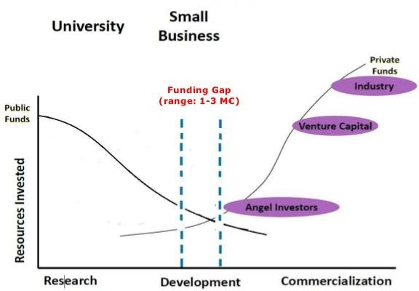
The funding gap EIC addresses

Slide 19


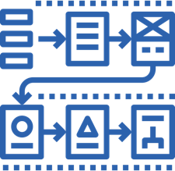
Get ready for EIC Accelerator
How to prepare for HE
Study the Documents
EIC Work Programme
2022
EIC Accelerator Guide
for Applicants
Learn the tools
Start building
Lean Methodology
Business Modeling
Tech Adoption Cycles
Business Plan
Data management
Financial Plan
Study the new Proposal Template
Ideation
Development
Go2Market
Prepare your concept
Submit the proposal

Slide 20
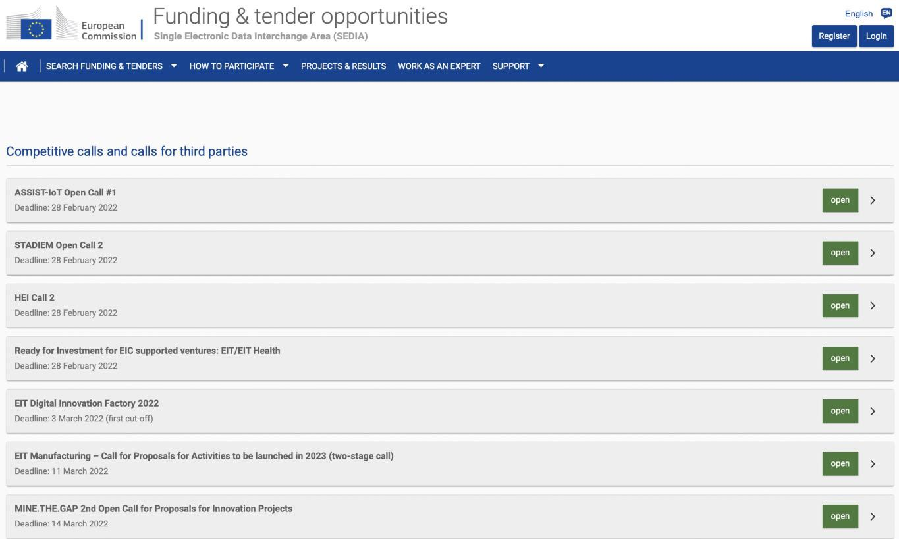
Opportunities for SMEs
Competitive calls and calls for third parties
https://ec.europa.eu/info/funding- tenders/opportunities/portal/scree n/opportunities/competitive-calls

Slide 21

Q&A
Time to ask your questions!

Slide 22

Contact:
Office Address
Turkey in Horizon 2020 Project
And Sokak 8/12 Akasya Apt. 06680 Çankaya/Ankara 06520 Çankaya/Ankara,Turkey
Tel: +90 312 467 61 40
http://www.turkeyinh2020.eu/
info@TurkeyinH2020.eu

